Slide 1
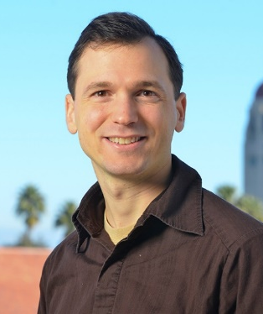
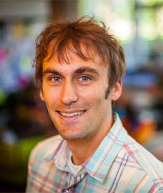
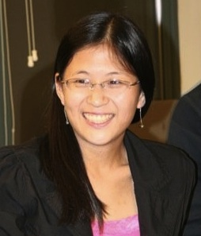
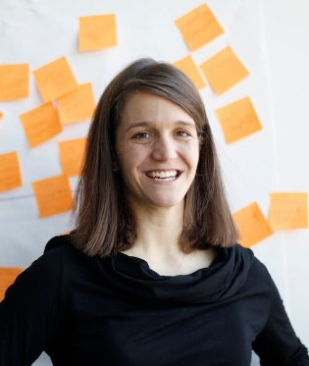
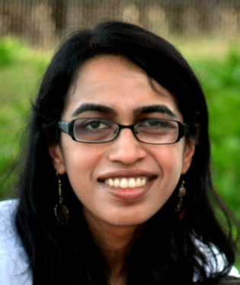
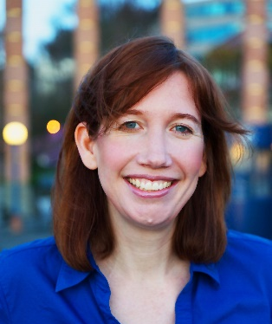
CHI 2016 workshop on Microproductivity
Michael Bernstein Stanford | Jeff Bigham CMU | Carrie Cai MIT | Liz Gerber Northwestern | Shamsi Iqbal MSR | Jaime Teevan MSR

Slide 2
#microCHI16
@msbernst | @jeffbigham | @carryveggies | @elizgerber | @iqbal_st | @jteevan

Slide 3
mi·cro·pro·duc·tiv·i·ty /ˈmīkrō prōˌdəkˈtivətē/ noun
The transformation of large productivity tasks into a set of smaller microtasks that can be completed individually in short bursts of time with limited context.
Notes:
Microsoft can enable this by supporting a shift in the nature of work towards microproductivity, with large productivity tasks being transformed into a set of smaller microtasks that can be completed individually in short bursts of time with limited context.
Many observed benefits to microproductivity
Flexibility, quality, specialization, learning
Bring this into our every day information work in a way that helps existing information workers be more productive and creates a nice hole to slot in collaborators, crowd workers, and automation
Research: Break a task down into small component pieces → easier to do, more resilient to interruptions, higher quality work

Slide 4
Aspects of Microproductivity
task de·com·po·si·tion /task dēˌkämpəˈziSH(ə)n/ noun
The process of breaking large tasks down into microtasks such that each microtask contributes towards the overall goal.
task com·ple·tion /task kəmˈplēSH(ə)n/ noun
The completion and aggregation of microtasks. Involves motivating people to complete microtasks, designing where and when to embed microtasks, and managing attention.
task sourc·ing /task sôrs-sing/ noun
The sourcing of tasks and microtasks to an actor to complete. A microtask can be completed by the task owner, peers, the crowd, or automation.

Slide 5
Task Decomposition
What are the best ways to create workflows of microtasks from a larger task goal?
What factors should be considered when deciding how to decompose a task?
How can the context necessary for the large task be encapsulated into each individual microtask?
What aspects of a task cannot be decomposed?

Slide 6
Task Completion
How to motivate people to perform microtasks?
How can microtasks be designed so as to be resilient to interruptions?
How can microproductivity be encouraged without being disruptive to a user’s existing activities?
When and where should microtasks be embedded?
Can microtasks be used to build knowledge?
How can we measure outcomes and contribution towards a large task?

Slide 7
Task Sourcing
Who should perform a microtask?
What is the impact of the actor on the task structure?
How can context be provided to actors at different levels of familiarity with the task?
What are the tradeoffs between performing tasks individually versus distributing microtasks across multiple performers and later aggregating the results?

Slide 8
Microproductivity Schedule – Morning
Time | Description
8:45 – 9:00 | Workshop Welcome
9:00 – 9:15 | Introduction to Capture Tool
9:15 – 10:00 | Group Introductions
10:00 – 10:30 | Microproductivity Mindmap
10:30 – 11:00 | Break
11:00 – 12:00 | Research Overviews
11:00 | - Task decomposition (HumorTools: Decomposing creativity), Lydia Chilton
11:20 | - Task completion (WearWrite: Crowd-assisted writing from a watch), Michael Nebeling
11:40 | - Task sourcing (Working for the machine), Michael Bernstein
Break for Lunch

Slide 9
Microproductivity Schedule – Afternoon
Break for Lunch
Time | Description
13:00 – 13:30 | Breakout Group Formation
13:30 – 16:30 | Group Work
15:00 – 16:00 | Break as desired
16:30 – 17:00 | Group Reports
17:00 – 17:30 | Workshop Wrap-Up

