Slide 1
Slow Search
With People
Jaime Teevan, Microsoft Research, @jteevan
In collaboration with Michael S. Bernstein, Kevyn Collins-Thompson, Susan T. Dumais, Shamsi T. Iqbal, Ece Kamar, Yubin Kim, Walter S. Lasecki, Daniel J. Liebling, Merrie Ringel Morris, Katrina Panovich, Ryen W. White, et al.
Notes:
Talk: Slow Search
You may think: Oh good! I just took two minutes to search from my mobile device and it was ANNOYING. Are you going to help me fix that?
Bad news: I’m not trying to get rid of slow search. Rather, I’m here to advocate for it!
(Collaborators listed are those who appear in 2 or more papers cited in this talk.)
Slow Search
Teevan, Collins-Thompson, White, Dumais. Viewpoint: Slow search. CACM 2014.
Teevan, Collins-Thompson, White, Dumais, Kim. Slow search: Information retrieval without time constraints. HCIR 2013.
Crowdsourcing
Bernstein, Teevan, Dumais, Libeling, Horvitz. Direct answers for search queries in the long tail. CHI 2012.
Jeong, Morris, Teevan, Liebling. A crowd-powered socially embedded search engine. ICWSM 2013.
Kim, Collins-Thompson, Teevan. Using the crowd to improve search result ranking and the search experience. TIST (under review).
Lasecki, Teevan, Kamar. Information extraction and manipulation threats in crowd-powered systems. CSCW 2014.
Organisciak, Teevan, Dumais, Miller, Kalai. A crowd of your own: Crowdsourcing for on-demand personalization. HCOMP 2014.
Salehi, Teevan, Iqbal, Kamar. Talking to the crowd: Communicating context in crowd work. CHI 2016 (under review).
Friendsourcing
Morris, Teevan, Panovich. A comparison of information seeking using search engines and social networks. ICWSM 2010.
Morris, Teevan, Panovich. What do people ask their social networks, and why? A survey study of status message Q&A behavior. CHI 2010.
Teevan, Morris, Panovich. Factors affecting response quantity, quality and speed in questions asked via online social networks. ICWSM 2011.
Seflsourcing
André, Teevan, Dumais. From x-rays to silly putty via Uranus: Serendipity and its role in web search. CHI 2009.
Cheng, Teevan, Iqbal, Bernstein. Break it down: A comparison of macro- and microtasks. CHI 2015.
Eickhoff, Teevan, White, Dumais. Lessons from the journey: A query log analysis of within-session learning. WSDM 2014.
Lee, Teevan, de la Chica. Characterizing multi-click behavior and the risks and opportunities of changing results during use. SIGIR 2014.
Teevan. How People Recall, recognize and reuse search results. TOIS 2008.
Teevan, Adar, Jones, Potts. Information re-retrieval: Repeat queries in Yahoo's logs. SIGIR 2007.
Teevan, Liebling, Lasecki. Selfsourcing personal tasks. CHI 2014.

Slide 2
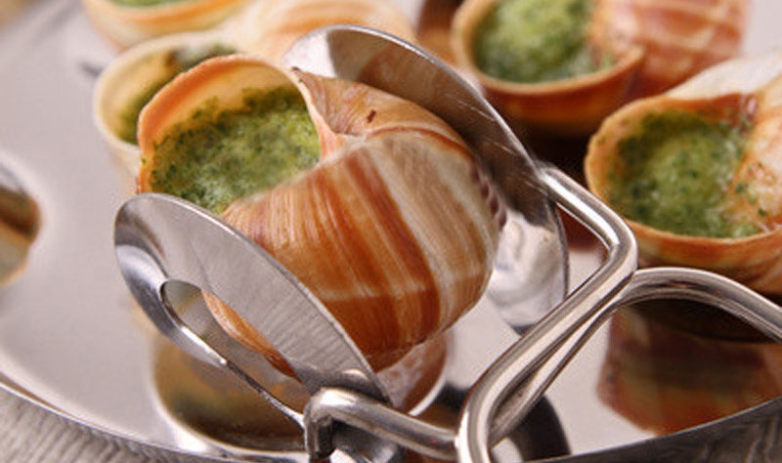
Slow Movements
Notes:
Current world fast
Slow movements a reaction
Slow search
Slow the user experience
Slow processing by search algorithms
--
Slow movements trying to slow things down in exchange for quality
Slow food, slow parenting, slow science, etc.
We’re applying these notions to search.
Many ways time can be incorporated into search
Ways to help the user act slower, learn, reflect
Ways to make use of extra time (focus of this talk)
Teevan, Collins-Thompson, White, Dumais. Viewpoint: Slow search. CACM 2014.
Dörk., Bennett, Davies. Taking our sweet time to search. CHI 2013, Workshop on Changing Perspectives of Time in HCI.

Slide 3

Speed Focus in Search Reasonable
Notes:
Focus on search speed has good motivation
Increased time has negative impact
Even positive changes negative
Search engines make lots of compromises to speed things up
--
Historically there has been a focus on speed in search
And this is for good reason
Slow search results impact the user experience
Bing and Google have run experiments introducing server side delays
On the order of 100 or 200 milliseconds
People with delays think results are worse, issue fewer queries, engage less with the search engine
And impact persists after search
We have looked at natural variation in response time
Within a single query, sometimes results are returned fast, sometimes slow
See increased abandonment, time to click
Even changes that appear good aren’t if they negatively impact the experience
For example: Showing 30 results instead of 10 = bad experience because it slows the page load time
Search engines make a number of compromises for speed
Example: Independence assumptions for words in documents
Example: New Google logo loads faster
Example: Bing gives only 8 search results
Teevan, Collins-Thompson, White, Dumais, Kim. Slow search: Information retrieval without time constraints. HCIR 2013.
Linden. Marissa Mayer at Web 2.0. November 9, 2006. http://bit.ly/2J2amv
Shurman, Brutlag. Performance related changes and their searcher impact. Velocity 2009. http://oreil.ly/fTmYwz

Slide 4


Not All Searches Need to Be Fast
Long-term tasks
  Long search sessions
  Multi-session searches
Social search
  Question asking
Technologically limited
  Mobile devices
  Limited connectivity
  Search from space
Notes:
Irony: Milliseconds matter when we spend so much longer searching
We can predict when people will search fairly accurately
Example of how time not always the most important things is question asking
Technological limitations also reduce impact of milliseconds
--
Over half of the time that people spend using a search engine they are engaged in multi-query search sessions that take minutes or hours.
And many of these tasks extend over multiple sessions.
A few hundred milliseconds shouldn’t really matter in these cases.
We have seen different impact of time by query type, with informational queries being less impacted by delay.
Users could tell us when they engage in a long session.
But it is also possible to predict when a session will take a long time.
Slow search could be useful in these cases to proactively identify relevant information to a search task a user has started.
Another example of where people already wait for information
Is in online social network question asking
Will talk more about this later.
People also already experience “slow search” with search engines – we just call it “mobile search”.
When it takes seconds to download information, a few hundred milliseconds doesn’t matter.
Search from Mars is an extreme example of this – light takes 25 minutes to make the round trip.
Dumais. Task-based search: A search engine perspective. Talk at NSF Task-Based Information Search Systems Workshop, March 14-15, 2013. http://bit.ly/15rK5tD
Kotov, Bennett, White, Dumais, Teevan. Modeling and analysis of cross-session search tasks. SIGIR 2011.
Morris, Teevan, Panovich. What do people ask their social networks, and why? A survey study of status message Q&A behavior. CHI 2010.
Morris, Teevan, Panovich. A comparison of information seeking using search engines and social networks. ICWSM 2010.
Chen, Subramanian, Li. RuralCafe: Web search in the rural developing world. WWW 2009, 411-420.

Slide 5
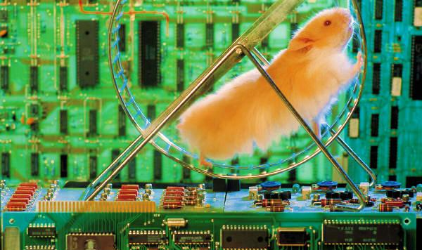
Making Use of Additional Time
Notes:
Relax constraints to take more time
Use slow resources (like people)
Tackle things in completely new ways
--
If we build slow search experiences, search engines can make use of additional time to relax existing constraints
Of course, we have been focused on speed for so long, we barely know what to do with extra time!
Imagine if I told you you had an extra five minutes to respond to each request in whatever you are trying to support with your research?
What would you do with the time?
We can play with things that we couldn’t before
Relax independence assumptions
Use more complex algorithms
We can load balance
We can use slow resources
Visit a webpage on demand to ensure the latest content
Involve other people in the search processes (focus of this talk)
Allows us to start to tackle search in a completely new way
Make big changes to the user experience rather than small ones

Slide 6
Crowdsourcing
Using human computation to improve search
Notes:
This talk looks at incorporating people into the search process
Many different types of people: Crowd, Friends, Self
Begin by looking at paid crowd workers
Using the crowd is good place to start because:
We can think about what we might be able to do algorithmically in the future (maybe even fast), like a giant Wizard-of-Oz experiment.
We don’t need to worry about issues of motivation – the incentive is financial. Will touch on the use of friends as a slow resource later in the talk.
A lot of research in IR involves crowdsourcing
But in an offline manner, used, for example, to train a ranker
What if we incorporated people into the online experience?

Slide 7

Replace Components with People
Search process
  Understand query
  Retrieve
  Understand results
Machines are good at operating at scale
People are good at understanding
with Kim, Collins-Thompson
Notes:
Goal: Use crowd workers to try out things that are currently hard to do algorithmically.
Take the pieces of the search process that aren’t succeeding and have people do them.
Generic search process:
Understand the query (example: query expansion)
Match the query against a large corpus of documents
Process the results (example: filtering, re-ranking)
Machines do some of this really well – like large-scale matching
People don’t operate well at scale
But people are good at understanding
Machines currently don’t do that well
Build a hybrid
Kim, Collins-Thompson, Teevan. Crowdsourcing for robustness in web search. TREC 2013.
Kim, Collins-Thompson, Teevan. Using the crowd to improve search result ranking and the search experience. TIST (under review).

Slide 8
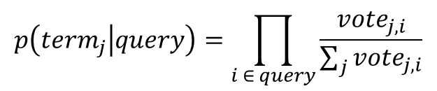
Understand Query: Query Expansion
Original query: hubble telescope achievements
Automatically identify expansion terms:
  space, star, astronomy, galaxy, solar, astro, earth, astronomer
  Best expansion terms cover multiple aspects of the query
Ask crowd to relate expansion terms to a query term
Identify best expansion terms:
  astronomer, astronomy, star
 | space | star | astronomy | galaxy | solar | astro | earth | astronomer
hubble | 1 | 1 | 2 | 1 | 0 | 0 | 0 | 1
telescope | 1 | 2 | 2 | 0 | 0 | 0 | 0 | 1
achievements | 0 | 0 | 0 | 0 | 0 | 0 | 0 | 1
$$p\left({term}_{j} | query\right)=\prod_{i ∈ query}{\frac{{vote}_{j,i}}{\sum_{j}{{vote}_{j,i}}}}$$
Notes:
Example: Query expansion
Query expansion looks for terms that are related to a query
As a way to help solve the vocabulary mismatch problem
But it often makes mistakes and includes terms that are not that useful
Maybe people can help us choose the best ones
Example task: Which of the following words are related to “telescope” in the query “hubble telescope achievements”?

Slide 9






Understand Results: Filtering
Remove irrelevant results from list
Ask crowd workers to vote on relevance
Example:
  hubble telescope achievements
Notes:
Example: Result filtering
Go through the top results retrieved, and remove the irrelevant results

Slide 10
People Are Not Good Components
Test corpora
  Difficult Web queries
  TREC Web Track queries
Query expansion generally ineffective
Query filtering
  Improves quality slightly
  Improves robustness
Not worth the time and cost
Need to use people in new ways
Notes:
Benefit: Robustness
People don’t often really screw things up
May be useful for cases where mistakes are very costly

Slide 11
Understand Query: Identify Entities
Search engines do poorly with long, complex queries
Query: Italian restaurant in Squirrel Hill or Greenfield with a gluten-free menu and a fairly sophisticated atmosphere
Crowd workers identify important attributes
  Given list of potential attributes
  Option add new attributes
  Example: cuisine, location, special diet, atmosphere
Crowd workers match attributes to query
Attributes used to issue a structured search
with Kim, Collins-Thompson
Notes:
Kim, Collins-Thompson, Teevan. Using the crowd to improve search result ranking and the search experience. TIST (under review).

Slide 12
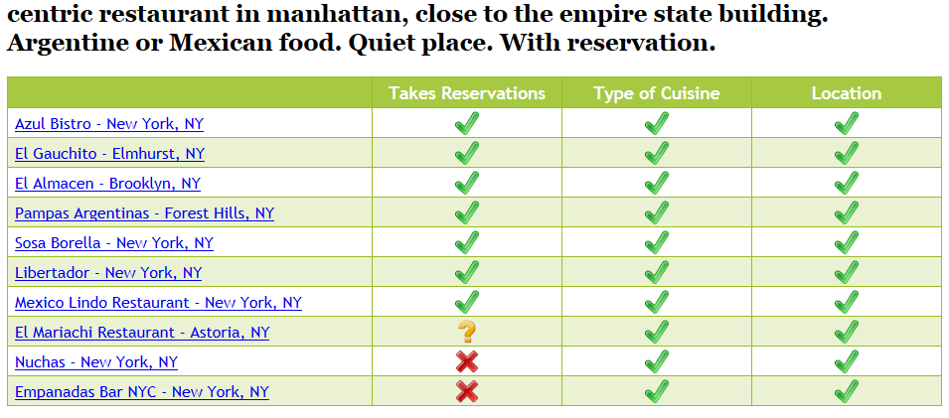
Understand Results: Tabulate
Crowd workers used to tabulate search results
  Given a query, result, attribute and value
  Does the result meet the attribute?

Slide 13
People Can Provide Rich Input
Test corpus: Complex restaurant queries to Yelp
Query understanding improves results
  Particularly for ambiguous or unconventional attributes
Strong preference for the tabulated results
  People asked for additional columns (e.g., star rating)
  Those who liked the traditional results valued familiarity

Slide 14
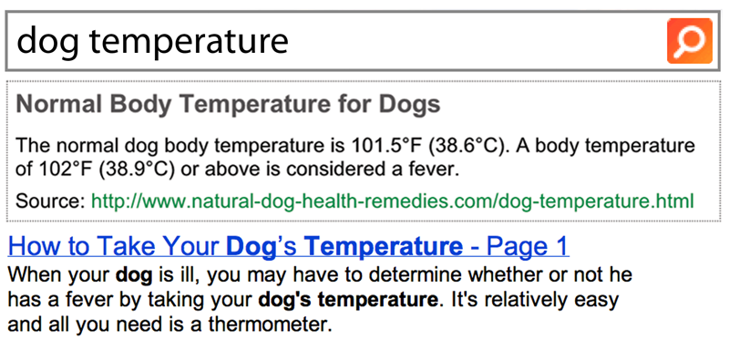
Create Answers from Search Results
Understand query
  Use log analysis to expand query to related queries
  Ask crowd if the query has an answer
Retrieve: Identify a page with the answer via log analysis
Understand results: Extract, format, and edit an answer
with Bernstein, Dumais, Liebling, Horvitz
Notes:
Bernstein, Teevan, Dumais, Libeling, Horvitz. Direct answers for search queries in the long tail. CHI 2012.

Slide 15
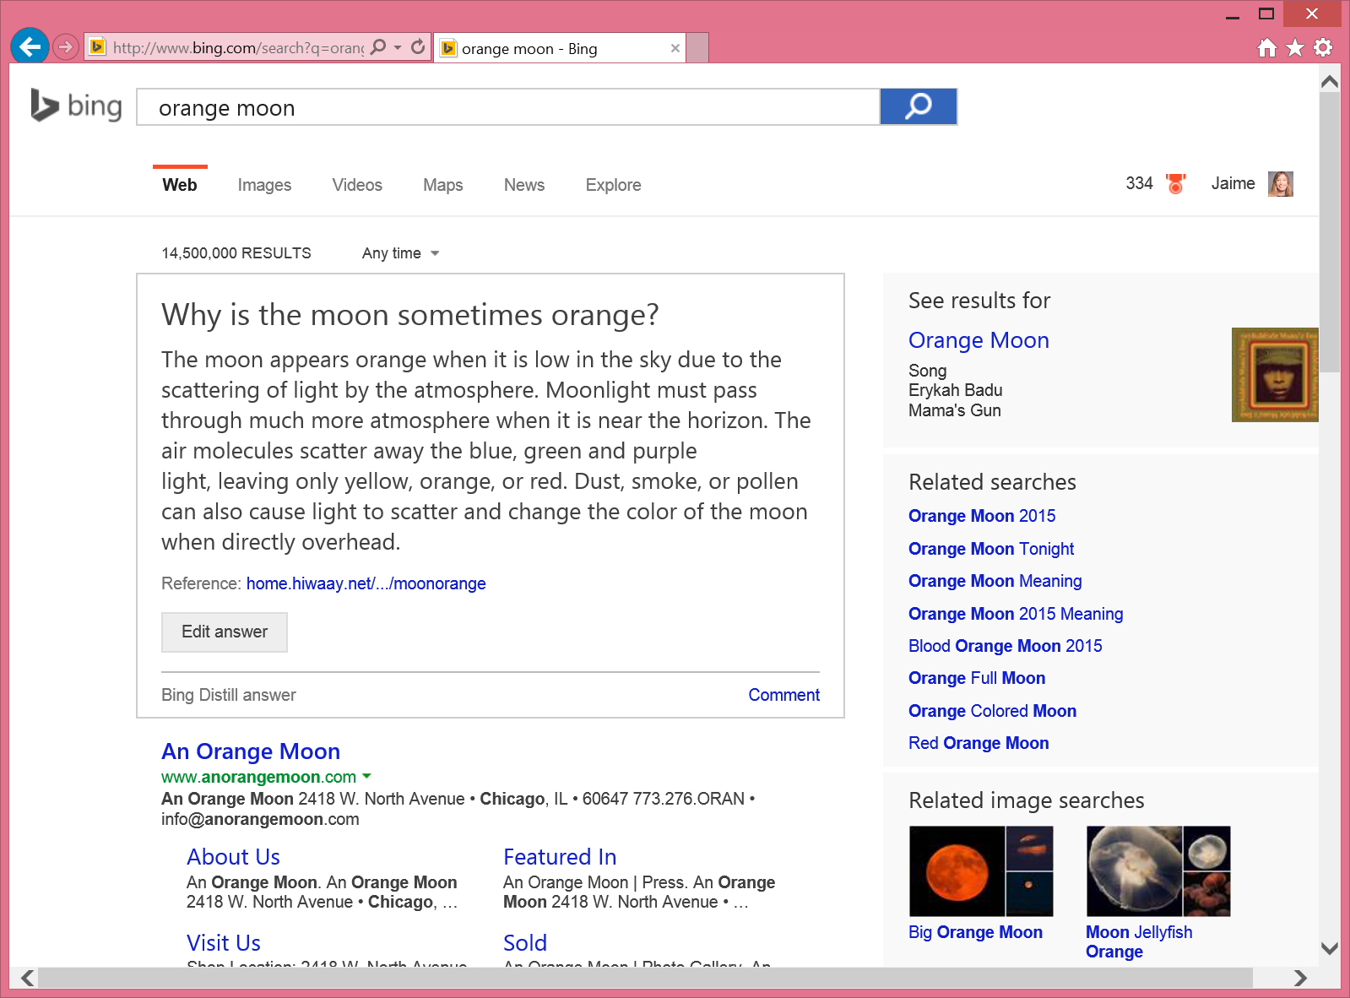
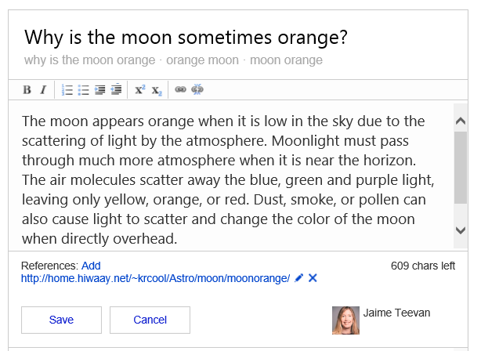
Community Answers with Bing Distill
Notes:
http://www.bing.com/distill

Slide 16
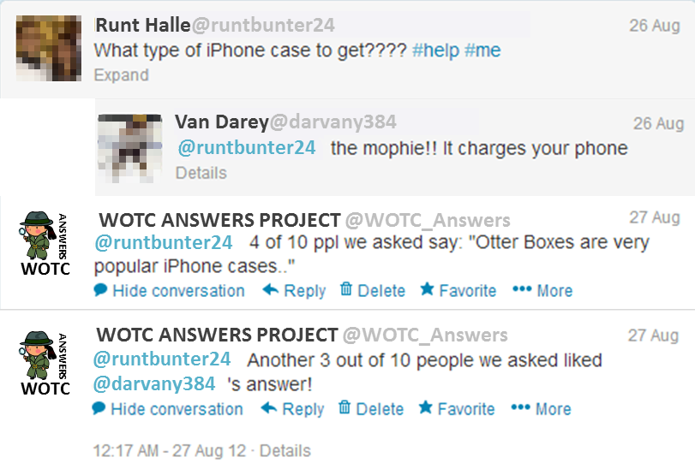
Create Answers to Social Queries
Understand query: Use crowd to identify questions
Retrieve: Crowd generates a response
Understand results: Vote on answers from crowd, friends
with Jeong, Morris, Liebling
Notes:
Jeong, Morris, Teevan, Liebling. A crowd-powered socially embedded search engine. ICWSM 2013.

Slide 17
Working with an
Unknown Crowd
Addressing the challenges of crowdsourcing search
Notes:
Crowds are great.
We’ve shown we can do really complex things that require deep understanding.
We can explore things we can’t yet do algorithmically.
However, there are costs to using the crowd.
Slow – address through user interface issues (e.g., social network question asking, different experiences), and real-time crowdsourcing
Expensive – Defray to user or advertiser, altruism (friends), self interest (self)
Some of the biggest costs come from the fact that crowd workers are unknown.
They don’t know what we are looking for, our interests.
And they might even not act in our best interest. After all, they have their own interests.
Let’s start by thinking a little about how we can tell the crowds more about our interests.
And then dive into what happens when our interests and the crowds diverge.

Slide 18
Communicating with the Crowd
How to tell the crowd what you are looking for?
Trade off:
  Minimize the cost of giving information for the searcher
  Maximize the value of the information for the crowd
with Salehi, Iqbal, Kamar
Notes:
Salehi, Teevan, Iqbal, Kamar. Talking to the crowd: Communicating context in crowd work. CHI 2016 (under review).

Slide 19
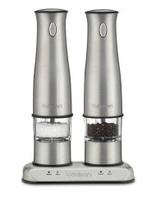
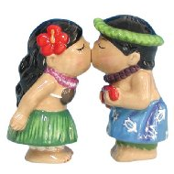
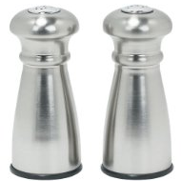
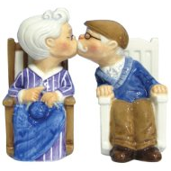
Guessing from Examples or Rating
?
with Organisciak, Kalai, Dumais, Miller
Notes:
One way in particular that we’ve explored to communicate with the crowd:
Show crowd workers the kind of things the searcher is interested in and ask them to guess what the searcher would like on other items.
Easy for the searcher to rate a set of example items and then use that as training for the crowd
Set up is familiar – this is the same data we collect to do collaborative filtering and use for training algorithms
Problem is: We don’t have the training data needed to extrapolate for many datasets (private, small, new)
Can use the crowd for on-demand collaborative filtering
Data can be collected on new content, re-used
But you need a lot of workers to find a good match
Organisciak, Teevan, Dumais, Miller, Kalai. A crowd of your own: Crowdsourcing for on-demand personalization. HCOMP 2014.

Slide 20
Asking the Crowd to Guess v. Rate
Guessing
  Requires fewer workers
  Fun for workers
  Hard to capture complex preferences
Rating
  Requires many workers to find a good match
  Easy for workers
  Data reusable
 | Rand. | Guess | Rate
Salt shakers | 1.64 | 1.07 | 1.43
Food (Boston) | 1.51 | 1.38 | 1.19
Food (Seattle) | 1.68 | 1.28 | 1.26
(RMSE for 5 workers)
Notes:
Both: Target tail areas, personal data, areas where we don’t have a lot of collaborative data
Results shown for 5 workers
10 workers did much better for taste-matching.
Didn’t make as much of a difference for guessing.

Slide 21
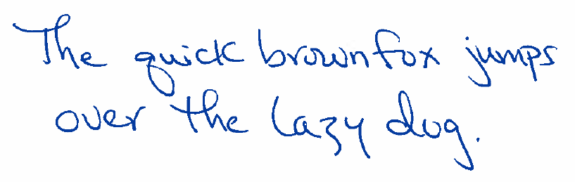





Handwriting Imitation via “Rating”
Task: Write Wizard’s Hex.
Notes:
Cool thing is this approach can be applied to tasks beyond what we currently handle algorithmically.
For example: Handwriting Imitation
Figure shows requester’s text: The quick brown fox jumps over the lazy dog
And a variety of people writing: Wizard’s Hex
Includes an example by the requester, some random examples, and ones that attempt to imitate the requester
Collaborative filtering approach: Takes a lot of people to do reasonably!
There are some people out there who have handwriting that is similar to yours, but not that many.
Having a random person write the term is pretty bad – only mistaken for the requester 17% of the time
The requester’s not that great, either – discovered as the requester 83%
13 people to find someone who will be mistaken for the requester 50% of the time

Slide 22






Handwriting Imitation via “Guessing”
Task: Write Wizard’s Hex by imitating above text.
Notes:
Grokking: Pretty good approximation (over 50%) with just 5 people.
This picture shows 5 grokked versions of the text, and 1 that is actually the requester.
Can you guess which is the true version?

Slide 23
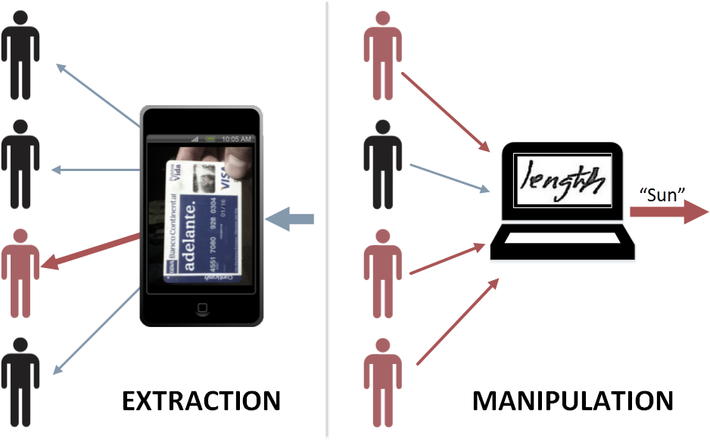
Extraction and Manipulation Threats
with Lasecki, Kamar
Notes:
Describe extraction and manipulation risks
Risk to search of extraction:
Search data is very personal.
Would you be willing to share your queries with someone else?
People will share their emails before their queries.
AOL example:
In 2006 AOL released anonymized logs with user data – for the SIGIR community to use for research purposes.
In less than a week, NYT front page de-anonymized Thelma Arnold (User 4417749), 2 AOL employees fired, CTO resigned, class action lawsuit
User 927: “how to kill your wife”
User 711391: “i love alaska”
We want to learn:
What is the risk of a crowd worker using your personal data inappropriately given a financial incentive?
Risk to search of manipulation:
SEO business is HUGE ($30 billion in US alone)
Some people really want you to see what they want you to see, not what you are looking for
If there were a way to control the crowd, you could control what search engines see
We want to learn:
What is the risk of the crowd being used in a coordinated manner to force a system to come up with the wrong outcome?
Lasecki, Teevan, Kamar. Information extraction and manipulation threats in crowd-powered systems. CSCW 2014.

Slide 24
Information Extraction
Target task: Text recognition
Attack task
  Complete target task
  Return answer from target:
1234 5678 9123 4567
62.1%
32.8%
1234 5678 9123 4567
Notes:
How willing would you be to return the generic credit card number to the attack task?
What about if it were somebody’s real credit card?
Only half as many people completed the attack task in this case.
Clearly not everyone is willing to do something questionable.

Slide 25
Task Manipulation
Target task: Text recognition
Attack task
  Enter “sun” as the answer for the attack task
gun (36%), fun (26%), sun (12%)
sun (75%)
sun (28%)
Notes:
What do you think this says?
Crowd workers asked to do the target task say:
Gun: 36%
Fun: 26% (actually is fun)
Sun: 12%
When the attack task asks workers to input “sun” we get many more instances of “sun”
The workers don’t feel like what they are doing is particularly bad, so we are able to influence behavior
However, when they are shown the word “length” instead, they are much less likely to enter “sun”
Seems there is a base rate of roughly 1 in 3 crowd workers appear willing to do questionable things regardless.
Be it extraction or manipulation
And about a third can be manipulated by making the attack task seem less questionable (e.g., plausible input, fake credit card v. real one)

Slide 26
Payment for Extraction Task
Notes:
Interestingly, this middle third can also be manipulated by paying them more
Paying $.50 instead of $.05 doubles the number of attackers
That third that won’t enter the realistic looking credit card number?
They’ll do it for an extra 45 cents.
Target tasks can fight back by paying more or asking people not to attack them.
Pay more to do the target task ($.25): The base 32% will still attack, but the conditional attackers won’t.
Bad news: Some people willing to take advantage of the information they see during crowd work for financial gain
Good news: Some people pass on additional money to do “the right thing”
There may be ways to use the “good” workers to identify “bad” workers
Currently thinking about approaches that use an “ethical gold” to identify good workers and help them police negative behavior.

Slide 27
Friendsourcing
Using friends as a resource during the search process
Notes:
Up until now we have been looking at paid crowd workers
Another kind of person to include in the search process are our friends
Friends aren’t going to steal our information or maliciously manipulate outcomes
Friends do provide personalized replies
And friends don’t cost money (although they do cost social capital)
We have explored how our friends currently help us find information
And, just like we did with the crowd workers, how we might be able to manipulate them to help us search as best as possible
Provides great insight into an existing slow search experience
Morris, Teevan, Panovich. What do people ask their social networks, and why? A survey study of status message Q&A behavior. CHI 2010.

Slide 28

Searching versus Asking
Notes:
Want to compare asking versus searching
Highlights the potential value of our friends when searching
And paints a picture of slow searching
Asked people to race their friends
Example: Any tips for tiling a kitchen backsplash?
Wrote a question and posted it to Facebook
Then went to their favorite search engine and searched to learn about it.
Questions long, provide context, took time to write
Queries were faster to enter (none mattered individually), but searching took longer
Morris, Teevan, Panovich. A comparison of information seeking using search engines and social networks. ICWSM 2010.

Slide 29

Searching versus Asking
Friends respond quickly
  58% of questions answered by the end of search
  Almost all answered by the end of the day
Some answers confirmed search findings
But many provided new information
  Information not available online
  Information not actively sought
  Social content
with Morris, Panovich
Notes:
Over half of the participants got an answer by the time they were done searching (almost all within a day)
Sometimes the answer confirmed what they found
More often, however, the answer provided new information
Not available online
For example, [couch to stay in on New Zealand].
As another example, this person who asked for a vegetarian recipe had a friend type up his grandmother’s handwritten recipe – the recipe didn’t even exist in digital form prior to the question being asked.
As much information as there is out there, there isn’t an answer in existence already to every possible question.
Not something the asker thought to search for
Example: start your own business
What is interesting about these cases is that friends were providing serendipitous connections. We sometimes worry about search personalization narrowing the information we encounter, but here we see our friends, who arguably are providing the most personalized content a person could get, and they are creating serendipity, not detracting from it.
Sometimes the question provided social benefits
Conclusion: Seems searching and asking complementary, useful at different points in the search

Slide 30
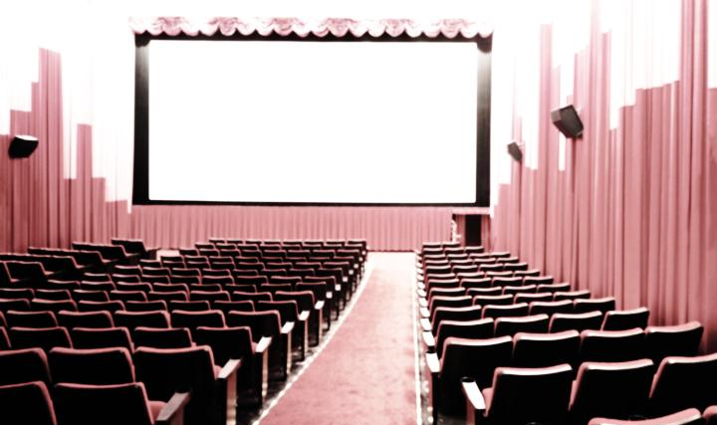

Shaping the Replies from Friends
Should I watch E.T.?
Notes:
Earlier we saw that there were ways to get the crowd to give us the best possible answers
Goal: How to ask questions of our friends as effectively as possible?
Ran a controlled study where hundreds of people asked, “Should I watch ET?” on Facebook
Varied time of day, gender, network makeup
Varied phrasing
Short (75 characters, half a Tweet)
Sometimes a statement
Often scoped
“Do my parent friends know how to soothe a screaming toddler?”
“Does anyone know …” (1 in 5)
For ET: “movie buff”, “anyone”
Asked hundreds of people to post variants
Collected and analyzed the replies
Learned a lot about ET
Drew Barrymore is the little sister
Guns replaced with walkie-talkies in 20th anniversary edition
Based on an imaginary friend Spielberg created when his parents divorced

Slide 31
Shaping the Replies from Friends
Larger networks provide better replies
Faster replies in the morning, more in the evening
Question phrasing important
  Include question mark
  Target the question at a group (even at anyone)
  Be brief (although context changes nature of replies)
Early replies shape future replies
Opportunity for friends and algorithms to collaborate to find the best content
with Morris, Panovich
Notes:
Attribute take-aways:
Larger social networks provide better responses
Questions in the morning get faster replies, but in the evening get more/better replies
Phrasing take-aways:
Question
Scope
Length (fewer requests for clarification, more suggestions of alternatives)
Question asked shape the replies people give
Early replies can also shape the other replies
An answer means less likely to get an answer later on
Language mimicked
Type of answer influences later answer types (links lead to more links)
Teevan, Morris, Panovich. Factors affecting response quantity, quality and speed in questions asked via online social networks. ICWSM 2011.

Slide 32
Selfsourcing
Supporting the information seeker as they search
Notes:
We have looked at what it involves to have other people in the search process.
But the searcher is another source of human input in the search process.
Currently this happens without any real support from our search tools.
We issue queries, look at the results, and iterate.
Query suggestion helps us, but each query more or less stands on its own.
Now we are going to think about how we can support a searcher’s role in their own search process.

Slide 33

Jumping to the Conclusion
with Eickhoff, White, Dumais, André
Notes:
Because we can’t really just take someone to the end of the search experience.
There’s a huge cost to doing that.
People learn along the way
Change the way the problem is framed
Serendipitous encounters
We need to understand the endpoint as richer than just a piece of content that is found
Example: Looked at what people learn during a search session.
We see that as people search on a topic they
Develop a more sophisticated query vocabulary
Retrieve more diverse results
Are there better ways to capture these benefits?
Provide term definitions to help understand the final result.
Some results changed behavior, and we could predict them. Give people a series of results to read rather than a singe result.
Eickhoff, Teevan, White, Dumais. Lessons from the journey: A auery log analysis of within-session learning. WSDM 2014.
André, Teevan, Dumais. From x-rays to silly putty via Uranus: Serendipity and its role in web search. CHI 2009.

Slide 34

Supporting Search through Structure
Provide search recipes
  Understand query
  Retrieve
  Process results
For specific task types
For general search tasks
Structure enables people to
  Complete harder tasks
  Search for complex things
  from their mobile devices
  Delegate parts of the task
with Liebling, Lasecki
Notes:
The other thing we see is that people follow common patterns for search
And they may want to be involved in many of these steps
For specific tasks:
Example: Shopping
Faceted search a way to express shopping needs
Comparison interfaces way to understand results as you get down to just a few
Example: Learn about a medical issue
For general search tasks:
Mimic the crowd processes but use the self?
Example:
Which terms are related?
Which results are relevant?
In addition to enabling us to complete tasks that may be beyond our searching ability, this structure also helps us:
Search from mobile devices.
As of summer 2015, mobile search has overtaken desktop and laptop search – more common!
Right now we can only do simple tasks from our mobile (local search, fact check)
With structure, can do more complex searces
Delegate parts of the task to other people or slow algorithms, as we discussed earlier.
Teevan, Liebling, Lasecki. Selfsourcing personal tasks. CHI 2014.
Cheng, Teevan, Iqbal, Bernstein. Break it down: A comparison of macro- and microtasks. CHI 2015.

Slide 35
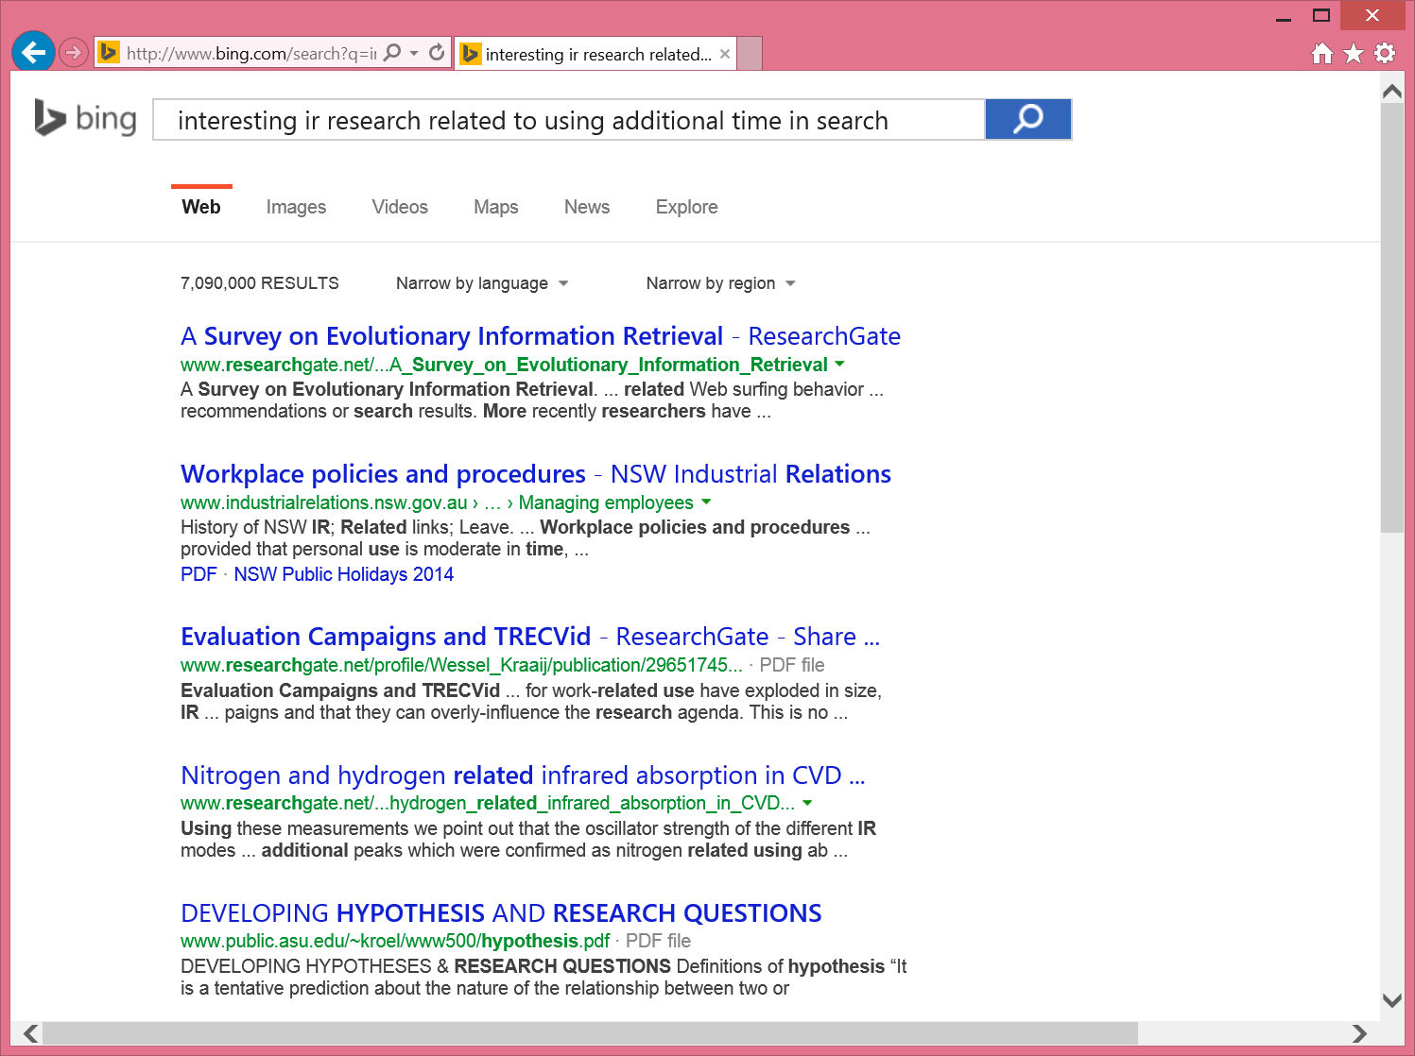
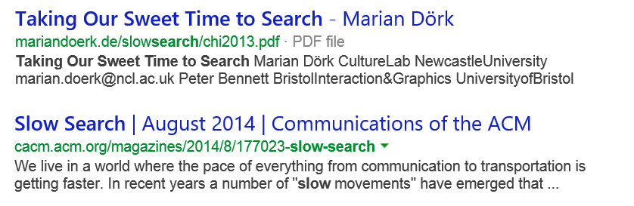
Algorithms + Experience
Notes:
Example: Run a long, complex search and get some not-so-good results right away.
I may click on the third result and go explore it a little to learn something about the space.
While the search engine in parallel tries to find better results.
When I return to the search result list the search engine can show me those new results
Either the search engine can call out that there is new content, but we tend to ignore this and find disruptive
Another option is to re-rank the result list dynamically with new content

Slide 36




Algorithms + Experience = Confusion
Notes:
But there’s a real challenge to doing this!
Algorithmic slow search plus an extended experience with search results can cause problems.
Because we develop knowledge, understanding, expectations as we interact with information.
And new algorithmically identified content can be disruptive.
The fact that change is disruptive is well known in the HCI community.
Dynamic menus example.
The question is: Do we face the same risk when we try to help people search better by providing slow content during a search?
Mitchell, Shneiderman. Dynamic versus static menus: An exploratory comparison. SIGCHI Bulletin, 1989.
Somberg. A comparison of rule-based and positionally constant arrangements of computer menu items. CHI 1986.

Slide 37
Change Interrupts Finding
When search result ordering changes people are
  Less likely to click on a repeat result
  Slower to click on a repeat result when they do
  More likely to abandon their search
with Lee, de la Chica, Adar, Jones, Potts
Notes:
The answer is: Yes!
Across sessions:
26% of time repeat searches at different rank.
94 seconds to re-click v. 192 seconds to re-click (over twice as long!)
Within a query:
Fewer repeat clicks within a session (53% v. 88%)
Slower time to click when returning to a search result list (26 seconds v. 6 seconds)
Happens within a query and across sessions
Even happens when the repeat result moves up
How can we reconcile the benefits of introducing change with the fact that it gets in the way of our expectations?
Seems like we need magic!
Fortunately, we can do magic.
Lee, Teevan, de la Chica. Characterizing multi-click search behavior and the risks and opportunities of changing results during use. SIGIR 2014.
Teevan, Adar, Jones, Potts. Information re-retrieval: Repeat queries in Yahoo's logs. SIGIR 2007.

Slide 38
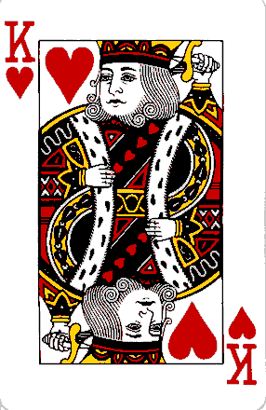
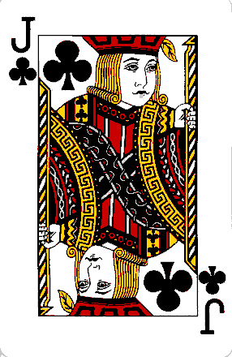
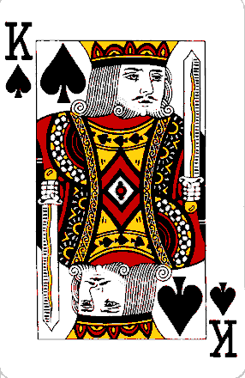
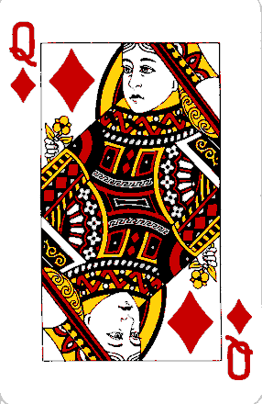
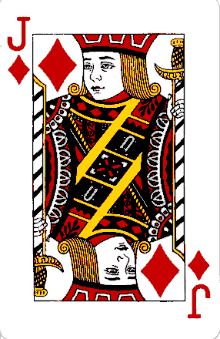
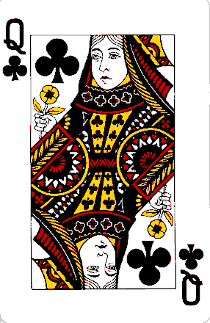
Use Magic to Minimize Interruption
Notes:
Pick a card, any card

Slide 39

Abracadabra

Slide 40
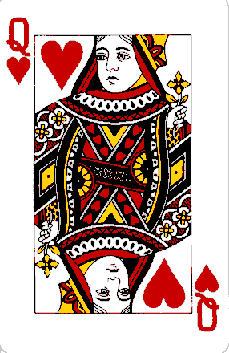
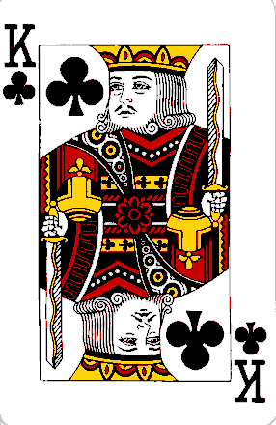
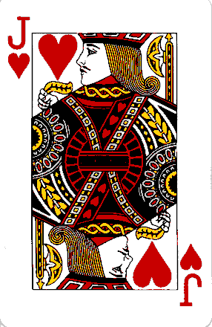
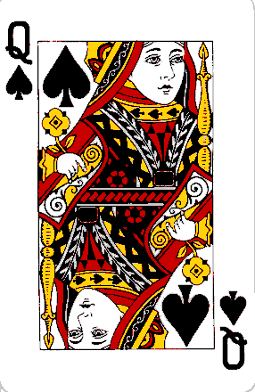
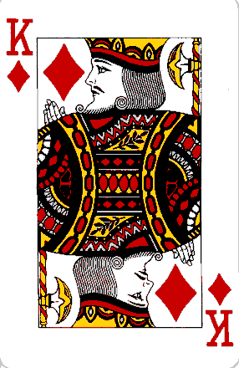
Your Card is Gone!

Slide 41
Consistency Only Matters Sometimes
Notes:
What’s going on here?
People forget a lot!
We can take advantage of the fact that people don’t attend to very much
To introduce changes right before their very eyes
Only need to keep the content that a person is focused on constant

Slide 42
Bias Presentation by Experience
Notes:
Naively we’d want to rank new content at the top of the list – they’re what I want most, so let’s put them first!
But I won’t see them there, and they will confuse me because studies show that I internalize the first few results I see.
A better place to put them so that I will encounter them and find them useful is immediately after the result I just clicked.
We have found that if you are thoughtful about how you add new content
You can create search results lists that appear the same and don’t disorient people
But contain new content that is useable!
Operates like a new search result list when finding new content, and like an previously viewed list when finding old content.
Kim, Cramer, Teevan, Lagun. Understanding how people interact with web search results that change in real-time using implicit feedback. CIKM 2013.
Teevan. How people recall, recognize and reuse search results. TOIS, 2008.
Teevan. The Re:Search Engine: Simultaneous support for finding and re-finding. UIST 2007.

Slide 43

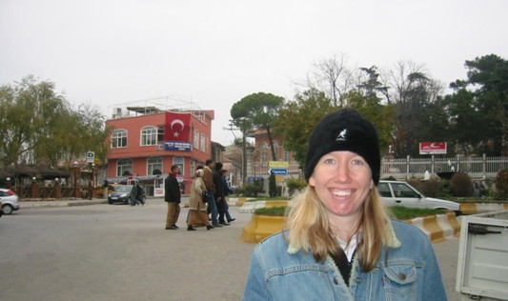
Make Slow Search Change Blind
Notes:
This is like playing with change blindness.
[Crosswalk appears and disappears.]

Slide 44
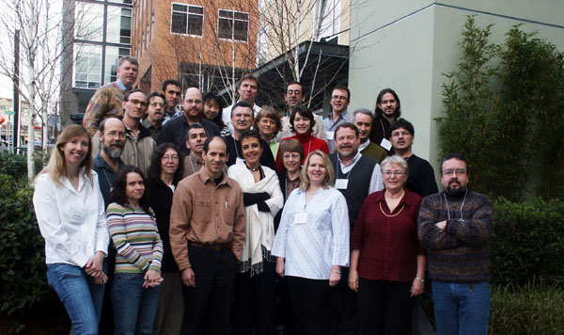
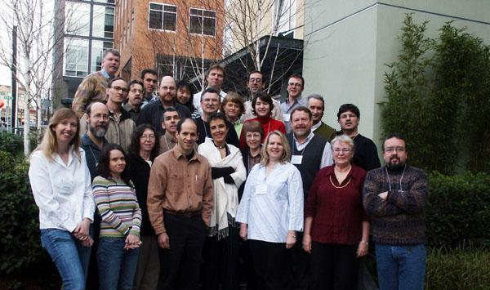
Make Slow Search Change Blind
Notes:
[Jim Gemmell appears and disappears.]

Slide 45

Summary
Notes:
Allowing more time in search creates interesting opportunities
Enables us to include people in the search process
Crowd:
Not useful as replacement components
Useful for creating new experiences
Looked at some of the risks and opportunities for using the crowd
Using friends mitigates some of the risks
And we saw that friends can be a source of valuable and complementary content
Additionally, we can provide more structured support for individuals engaged in slow search
To help them maintain context, learn, and grow as they search.
But we must remember that we build expectations as we interact with results and not cause disruptions.
Overall, we have seen that it is possible to support the ways ourselves, our friends and the crowd respond to information requests
In a way that creates the opportunity for interesting collaboration between algorithmic content and people
Excited for slow search to enable exploration of new search experiences

Slide 46
Further Reading in Slow Search
Slow Search
  Teevan, Collins-Thompson, White, Dumais. Viewpoint: Slow search. CACM 2014.
  Teevan, Collins-Thompson, White, Dumais, Kim. Slow search: Information retrieval without time constraints. HCIR 2013.
Crowdsourcing
  Bernstein, Teevan, Dumais, Libeling, Horvitz. Direct answers for search queries in the long tail. CHI 2012.
  Jeong, Morris, Teevan, Liebling. A crowd-powered socially embedded search engine. ICWSM 2013.
  Kim, Collins-Thompson, Teevan. Using the crowd to improve search result ranking and the search experience. TIST (under review).
  Lasecki, Teevan, Kamar. Information extraction and manipulation threats in crowd-powered systems. CSCW 2014.
  Organisciak, Teevan, Dumais, Miller, Kalai. A crowd of your own: Crowdsourcing for on-demand personalization. HCOMP 2014.
  Salehi, Teevan, Iqbal, Kamar. Talking to the crowd: Communicating context in crowd work. CHI 2016 (under review).
Friendsourcing
  Morris, Teevan, Panovich. A comparison of information seeking using search engines and social networks. ICWSM 2010.
  Morris, Teevan, Panovich. What do people ask their social networks, and why? A survey study of status message Q&A behavior. CHI 2010.
  Teevan, Morris, Panovich. Factors affecting response quantity, quality and speed in questions asked via online social networks. ICWSM 2011.
Seflsourcing
  André, Teevan, Dumais. From x-rays to silly putty via Uranus: Serendipity and its role in web search. CHI 2009.
  Cheng, Teevan, Iqbal, Bernstein. Break it down: A comparison of macro- and microtasks. CHI 2015.
  Eickhoff, Teevan, White, Dumais. Lessons from the journey: A query log analysis of within-session learning. WSDM 2014.
  Lee, Teevan, de la Chica. Characterizing multi-click behavior and the risks and opportunities of changing results during use. SIGIR 2014.
  Teevan. How People Recall, recognize and reuse search results. TOIS 2008.
  Teevan, Adar, Jones, Potts. Information re-retrieval: Repeat queries in Yahoo's logs. SIGIR 2007.
  Teevan, Liebling, Lasecki. Selfsourcing personal tasks. CHI 2014.

Slide 47
Questions?
Slow Search with People
Jaime Teevan, Microsoft Research, @jteevan

