Slide 1
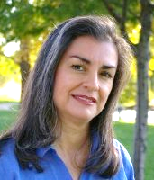
Building Your Professional Persona
Patty Lopez
Jaime Teevan
Notes:
Patty and Jaime
Both do brief introductions

Slide 2
CRA-W Programs inspire and increase the success of women & minorities in computing
600+ students & PhD researchers every year
from 250 U.S. institutions
Notes:
Patty:
To effect this change, CRA-Women organizes programmatic interventions.
Our current programs reach over 600 students a year across the United States.

Slide 3
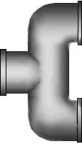
What does CRA-W do? Individual & Group Research Mentoring
Undergrads: Undergraduate Research Experiences
Undergrads: Distinguished lecture role models
Grad Cohort: group mentoring of graduate students
Grad Students: Discipline Specific Research workshops
PhD Researchers: group mentoring early & mid career @ CMW, CAPP, Grace Hopper & Tapia
Academic careers
Undergraduates
Graduate Students
Industry/government labs
600+ students & PhDs a year
Notes:
Patty:
CRA-W helps women succeed in research by providing them with research experiences with professors, role models, information about graduate school, information about computer research jobs, and help in their disciplines with group and individual mentoring in all stages of their research experience.

Slide 4
More info on programs at: table right outside and CRA-W Booth #540 in the exhibit hall
Notes:
Patty:
(working the booth)

Slide 5
Building Your Professional Persona
Notes:
Patty:
Intro to the topic

Slide 6
Agenda
What is your Professional Persona?
Representing yourself through
Your published research
Your online presence
Your professional conduct
Notes:
Patty:
Overview and exercise to help develop your professional persona.
Then we’ll look at how you can convey that persona
Through the research you publish
Through your online presence
And through your professional conduct

Slide 7
What is your Professional Persona?
Notes:
Patty:
Frame the topic

Slide 8
What Is a Professional Persona?
Your professional character and reputation
How you distinguish yourself from your peers
A narrative that describes your expertise and personal brand
Creates interest in your ideas and contributions
Enables you to seek greater opportunities
Notes:
Patty:
Introduce the topic.

Slide 9
Why Do You Need One?
Job opportunities
Invitations to present, publish, & participate
Award nominations
External evaluation
Media opportunities
Research visibility
Recruiting
Visibility within your institution
Notes:
Patty:
Job opportunities: for yourself and students
Invitations:
- speaking invitations, including keynote addresses
- possible collaborators, including grant opportunities
- professional service opportunities, including committees and reviewing
Award nominations:
- not so much that someone would choose to nominate you because they find you online but that someone who already decided to nominate you would have the information they needed.
External evaluation:
Once you've been nominated for an award, or submitted a proposal, or even submitted a paper, reviewers may well look for information about you online.

Slide 10
How To Develop One?
Develop your personal brand with five components:
Competencies: Your special skills fulfilling task requirements
Personality: Your behavior, communication skills, and attitudes
Differentiation: What separates you from others, leaves a lasting memory
Social Media Presence: How you present yourself online in various forums
Appearance: Your body language, clothing attire, and overall posture
Use your personal brand to differentiate yourself and make a positive impression
Notes:
Patty:
Talk in more detail about these five components

Slide 11
Activity: Develop Your Persona
Practice your elevator pitch
Share research you’re working on/most interested in
Online presence
What three adjectives would you like others to use to describe you?
What would you hate to hear said about yourself?
Poll: Who in the audience would like to share their exchanges? What was hard, and what was easy?
Notes:
Patty & Jaime: Pair up – take 3 min each, then reflect on last two questions. Total time: 10 min.

Slide 12
How To Develop It?
Offline:
Do good research! This is what counts the most.
Your workday life: colleagues, students, professors
Volunteer at your department, school, conferences, though research comes first
Online:
Your published body of research
Professional web site
Organization web site(s)
General ‘academic’ web sites
LinkedIn
Facebook, Twitter, Tumblr etc.
Notes:
Patty:
Research consistently shows that women are over-tapped to volunteer, especially early in their career (pre-tenure, for example). It is your research that will really speak for you most strongly.

Slide 13
First Impressions Matter
Make full use of it!
With a brief glance, people evaluate you
In person
Dress to your professional persona
Develop an elevator pitch for yourself
Film yourself: What does your body language say?
How do you stand, move, and gesture?
Where do you look? Do you make eye contact?
How do you speak?
How do you take and respond to questions?
Online
Create a professional webpage
Search for yourself: What do the search results say about you?
Notes:
Patty:
Discuss online first impressions – what does a search engine turn up for you? What would someone take away from your website? What URL would you give someone to learn more about you?
Reflect on what how others might view you through online videos and search results.

Slide 14
Representing Yourself Through Your Published Research
Notes:
Jaime:

Slide 15
Publishing Your Research
Benefits
Advance the state of the art
Public evidence of your abilities
Quality v. quantity
Quality! Quantity varies by area
Citations matter as career progresses
How to generate citations
High quality work
High visibility outlets
Strong online visibility
Notes:
Jaime:
In determining whether something is publishable, the audience that needs or wants the information is considered, not the authors need to publish. Quality is always the paramount concern, typical numbers of publications and numbers of authors/paper varies with sub-area.

Slide 16
Avenues for Publication
Primary outlets
Conference papers
Journal papers
Additional
Workshop Abstracts
Doctoral consortium Abstracts/Posters
Conference/Workshop Posters
Other outlets
Software, patents, books, data repositories
Social media: Blogs, Twitter, YouTube
Notes:
Jaime:
Conference status is different in CS
Primary outlet for CS (selective)
Place to meet for other disciplines (not selective)
Identifying top-tier conferences
Process
Acceptance rate/citations
Sponsoring organizations

Slide 17
Submission Process
Uniform submission date
May have separate abstract deadline
Program committee
May be hierarchical
May have non-committee reviewers
Decisions
May be two-pass
Details vary: Read the CFP carefully!!!
Notes:
Jaime:

Slide 18
Preparing Your Submission
Make the problem and its importance clear
Make your contributions clear
Provide visual illustrations when possible
Describe existing research and how it relates
Informed experts should be able to reproduce
Acknowledge limitations
Clearly explain your results, contributions
http://slowsearching.blogspot.com/search/label/Writing
Notes:
Jaime:
Introduction
Begins with a catchy description of the problem area
Avoid being too abstract, this is a good place to give the reader a concrete way to understand the problem area
Nice to introduce an example that will carry through the problem
Nice to have a picture, screenshot, diagram, or something visual to grab onto
Give the big picture
Typically ends with a paragraph describing the rest of the paper
Get the story right
Provide a picture at the right level
Don’t go to low: You know all of the details and are the expert in the topic area, make sure you give the big picture for people who aren’t as into the details as you are
Your thesis covers more, your whole thesis story isn’t always needed for framing
Don’t tell what you did, the order you figured things out isn’t necessarily the best way to communicate them
Just because something was a lot of work, that doesn’t mean it was the important contribution
Don’t feel the need to include everything, it’s better to get your main points across clearly
Create a “dead kittens” file for ideas that are so cute you don’t want to kill them, but that don’t really belong in the paper
You’re not trying to build to a surprise, don’t hold anything out early on – be clear in the abstract and intro what you’re going to say, say it in the body, and then tell them what you said at the end

Slide 19
Review Process
Understand reviewer roles
Reviewers are experts in the field
Must not have a conflict of interest
Single-blind, double-blind, etc.
Meta-review
Support reviewer selection
Reviewers drawn from:
Citations, lit search, contacts
Keywords or categories (beware of breadth)
Often accept based on title, abstract
Notes:
Jaime:
What reviewers look for:
Clear contribution
Solid evidence

Slide 20
Dealing with Reviews
Separate out the emotional response
Write a rebuttal or make edits later
Understand the reviews
Identify important issues
Get to the root cause of complaints
Issues you already address were unclear
Respond to the reviews
Reviewers will see the paper again
Notes:
Jaime:
You can have an emotional response even when a paper is accepted
Reviews may sting
Take reviews seriously but don’t read too much into reviews
Writing rebuttal – important, no additional experiments, be brief and to the point, don’t hide things
Understand reviews
Go through paper and tag issues with the comments, highlight reviews, …
Important issues tend to be:
- Raised by more than one reviewer
Raised by meta-reviewer
Get at the root cause of a complaint: Focus on a methodological issue may be that you weren’t clear about the focus, concern about the
How to handle reviews:
Papers don’t have to get in the first time you submit them
Built into the journal process, with conferences revise and re-submit expected
Take the time to respond to reviews positively, not just defensively (reviewers want to help you make the paper stronger)
Address reviewer comments, as reviewers are likely to see the paper again when you resubmit (or when it is published – at this point they can’t reject the paper again if you don’t address their suggestions, but they will know who you are and be annoyed)
Even when paper was accepted deal with responses
Long term game, long term management of reputation
You want to be know for doing good work and taking responses seriously

Slide 21
Dealing with Rejection
Great papers sometimes get rejected
There is variation and error in process
New or bridge topics particularly at risk
Keep trying
Good target: Three submissions
Consider a venue change
Match content to the best audience
ALWAYS address reviewer comments
Notes:
Jaime:
Give an example of paper that was rejected, revised, venue changed, now very well cited

Slide 22
Publication Process
Prepare the camera-ready version
Goal is strong paper, not just accepted paper
Address reviewer comments
Promote the research
Link to it from your webpage
Blog about it
Tweet about
Present the paper
Notes:
Jaime:
Include some times about how to present the work so it represents you well – presentation tips.
Link to it, blog about it, Tweet about it.

Slide 23
Presenting Your Research
Tailor your content to your audience
Fit your material into the available time
Outline what you plan to present
Ensure your material is engaging and segues smoothly
Check your verbal and body language
Avoid reading your slides, make eye contact
Summarize your key points at the end
Acknowledge your contributors
Notes:
Jaime:

Slide 24
Representing Yourself Through Your Online Presence
Notes:
Patty:

Slide 25
Creating an Online Presence
Create web content you can control
Support access to your publications
Manage what people find
Invite trusted friends to follow and share
Encourage comments, but moderate content
Post regularly to bring in fresh insights and perspectives
Notes:
Patty:

Slide 26
Poll: Content You Control
Raise your hand if you have:
Professional webpage
A university or work page
A Facebook account
A Linked-In account
Twitter, Tumblr, or social media account
A professional blog
Notes:
Patty:
People can’t control their academic Google Scholar page – that’s more of a “manage”
What link would you give a person to learn more about you?
Control that, have it include pointers to all of the content you would want a person to find.

Slide 27
Your Professional Website
What to list is your greatest locus of control:
Publications
Research interests
Media coverage
Photos
Teaching materials
Link to resume, CV, biography
Personal information – choose what you share
Notes:
Patty:
Your locus of greatest control
You may choose to limit what others can learn about you to avoid bias (e.g., marital status, family, sexual orientation, politics, etc.)

Slide 28
CV/Resume
You must have one!
It should be up-to-date - you can quickly update with new info within 2 hours
You may choose to link to it from the web
Ask a friend to review it
Notes:
Patty:

Slide 29
Internal Company Visibility
Companies may have “internal only” places to represent yourself:
Confidential project pages
Internal social networking and blogs
Mailing lists (scrutinize external addresses, distribution group lists & email distribution lists with many names)
Internal talks
….
Patty:
Notes:
Patty:

Slide 30
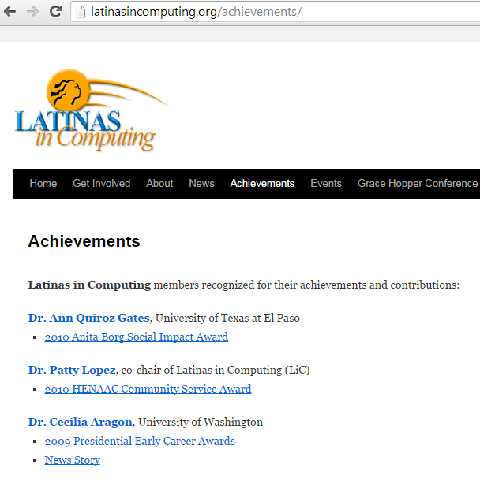
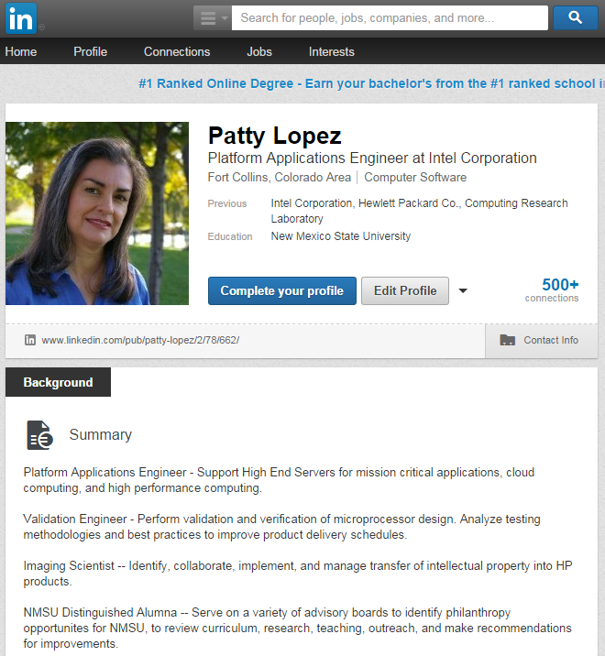
External Professional Visibility
Notes:
Patty:

Slide 31
Disseminating Technical Publications
Present in technical venues with proceedings
Connect with people in your research area at conferences, relate their work to yours
Ensure current info about you appears in scholarly digital libraries
You are the best ambassador for your own work
Find a way to highlight your expertise in a way that is authentic for you
University or department communications look for researchers to highlight and work to showcase
Use social media to link your articles
Notes:
Patty:

Slide 32
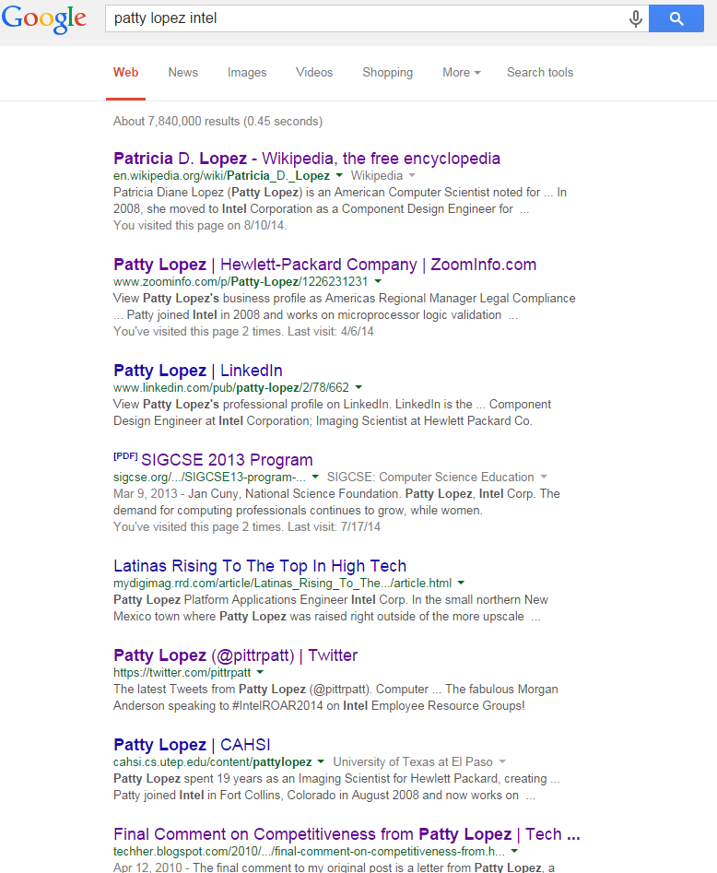
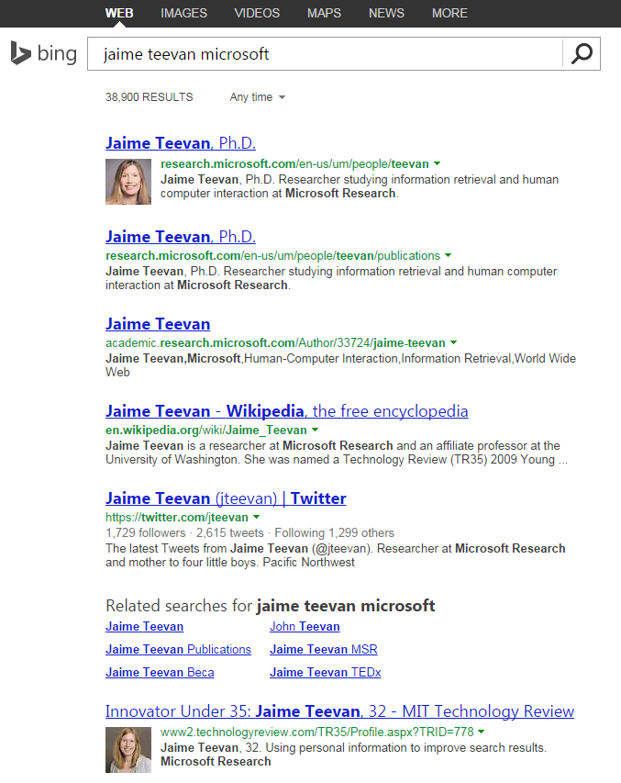
Managing What People Find
How do you show up in search engine results?
Notes:
Patty:

Slide 33
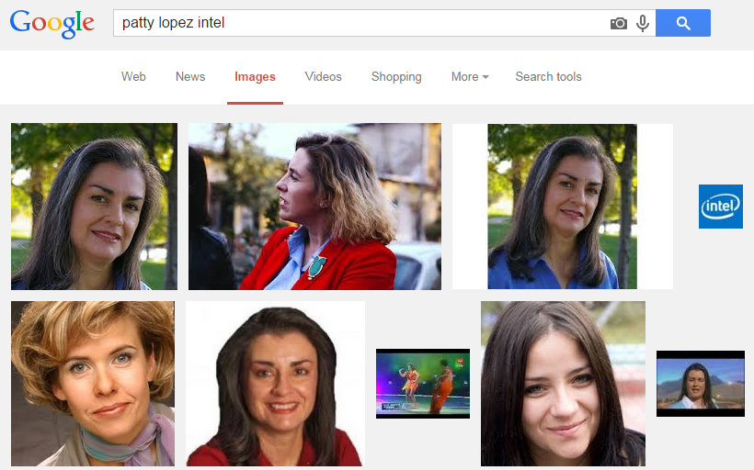
Managing Your Web Presence
Top 5-10 hits:
Does your professional website appear?
Does your LinkedIn profile appear?
Manage what you can control and try to remove or live with what you can’t (bad crops, people w/same name)
Check multiple search engines, and set up an alert
Notes:
Patty:
Perhaps include some SEO tips –
Your university site will be ranked higher because it is reputable.
Things that are linked to (especially from reputable sites) will be ranked higher, so create links
etc.
Also, think about how to manage your Scholar account, your ACM account, or other places for people to find your publications.

Slide 34
Optimizing Your Web Presence
Know what generates “hits”
How do you show up currently?
Blog/post articles relevant to your persona in the appropriate forums
Encourage others to link to your content
Include keywords that promote your persona
Keep your web content fresh
Reciprocate with like-minded others who promote you
Notes:
Patty:

Slide 35
Representing Yourself Through Your Professional Conduct
Notes:
Jaime:

Slide 36
Reflect Your Persona in Your Work Habits
Advocate for yourself and your ideas
Balance long- and short-term goals
Be open to opportunity
Strive to be authentic
Show up and persevere
Grow your skills, technical and soft
Respect others, be inclusive and available
Display and maintain a positive attitude
Show willingness and gratitude
Notes:
Jaime:

Slide 37
Author Responsibilities
Do NOT plagiarize
Obtain permission for use of material
Cite and acknowledge work
Be explicit about reuse of previous work
No dual submissions – if unsure, ASK!
Attend conference and present your work
Support the reviewing process
Submit work you are proud of
Respond to the reviews you receive
Provide thoughtful reviews
Notes:
Jaime:

Slide 38
Successful Co-Authorship
Collaborations fundamentally important!
Be explicit and generous with authorship
Authors: Contributed, verified, can present
Author ordering by contribution or convention
Acknowledge generously
Be a good collaborator
Externalize thinking, get ideas onto paper
Be respectful of time
Speak up
Notes:
Jaime:
Be explicit and generous about role
Author ordering
By contribution or convention
Importance of position
Author responsibilities
Contributed to the work
Verified the work
Willing and able to present
Externalize thinking
Get your ideas onto paper
Share outlines and drafts
Be respectful of time
Create a schedule
Share it
Keep to it
Speak up

Slide 39
Reviewer Responsibilities
Reasons, not binary a decision, matter
The clarity and validity of the reasons you give for accept or reject matter
You are making an impression
The person who assigned you the review will form an opinion of your ability and maturity from your review
Get credit for your work
if assigned as a sub-reviewer, ask that you be acknowledged by the event or journal
Notes:
Jaime:

Slide 40
Reviewer Responsibilities
Integrity, objectivity, accountability
Do NOT reject a paper because
You are writing a paper on the same subject
You do not like the author
Confidentiality
Single blind, double blind reviews
Paper is not publically available – do not use ideas from it
Conflicts of interest with people who
Work in the same place (never)
Was your advisor (never)
Have written papers together (recently)
Have a financial interest
Double blind a challenge – if unsure, ASK!
Notes:
Jaime:

Slide 41
Addressing Underrepresentation and/or Misconduct
Look for/ask about technical conferences with diverse keynotes and panels
Look beyond immediate circle of reviewers and encourage others to do the same
Report misconduct whenever possible
Ask conference organizers for a code of conduct policy if one does not exist:
http://adainitiative.org has resources & training available
Notes:
Jaime:

Slide 42
Summary
Discovered your Professional Persona
Discussed how to represent yourself through
Your published research
Your online presence
Your professional conduct
Notes:
Jaime:

Slide 43
Questions?
Notes:
Patty and Jaime

Slide 44
Acknowledgements
Thanks to material provided by:
Ayanna Howard, Georgia Tech
Amanda Stent, Yahoo Labs
Holly Rushmeier, Yale University
Mondira Pant, Intel Corporation
Ellen Spertus, Mills College
Dilma da Silva, Texas A & M University
Cecilia Aragon, University of Washington

Slide 45
Thank you to our sponsors
Private Foundation
Unversity Departments
www.cra-w.org

