Slide 1
This Talk Is Interactive!
Provide feedback:
http://aka.ms/msrdemo
Use a mobile Web browser
Optimized for smartphones
But any Internet-connected device works
Your feedback is mapped to a square
Can you find your square?
Join the interaction: http://aka.ms/msrdemo

Slide 2
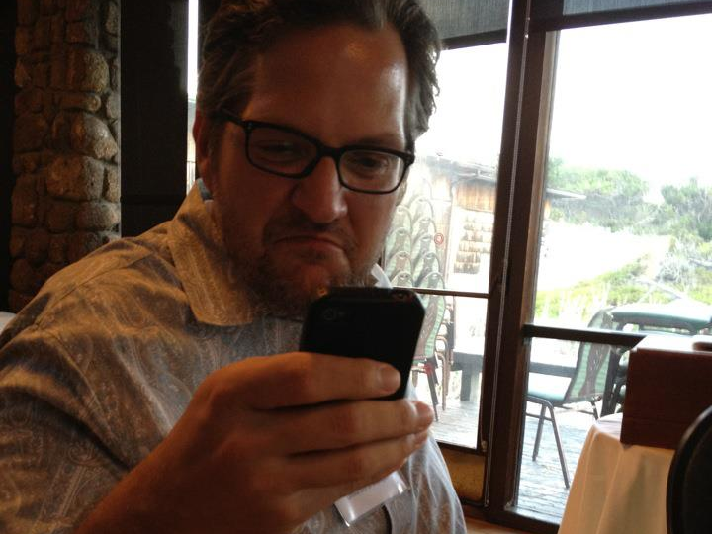
Why is Cliff so grumpy?
A: Can’t connect to Mitingo
B: Just lost at Angry Birds
C: Fogarty pulling a Gerhard Fischer
D: Unable to attend HCIC 2014
Join the interaction: http://aka.ms/msrdemo
Notes:
Try the system out.
If I say something you really like (e.g., HCIC rocks), you can hit the “Thumbs up”.
If I say something you really don’t like (e.g., HCI sucks), you can hit “Thumbs down”.
I can also use it to ask directed questions. For example: What is Cliff so grumpy about?

Slide 3
Face-to-Face Social Interaction
http://aka.ms/msrdemo
Jaime Teevan, Merrie Morris, Scott Saponas
Microsoft Research
Join the interaction: http://aka.ms/msrdemo

Slide 4
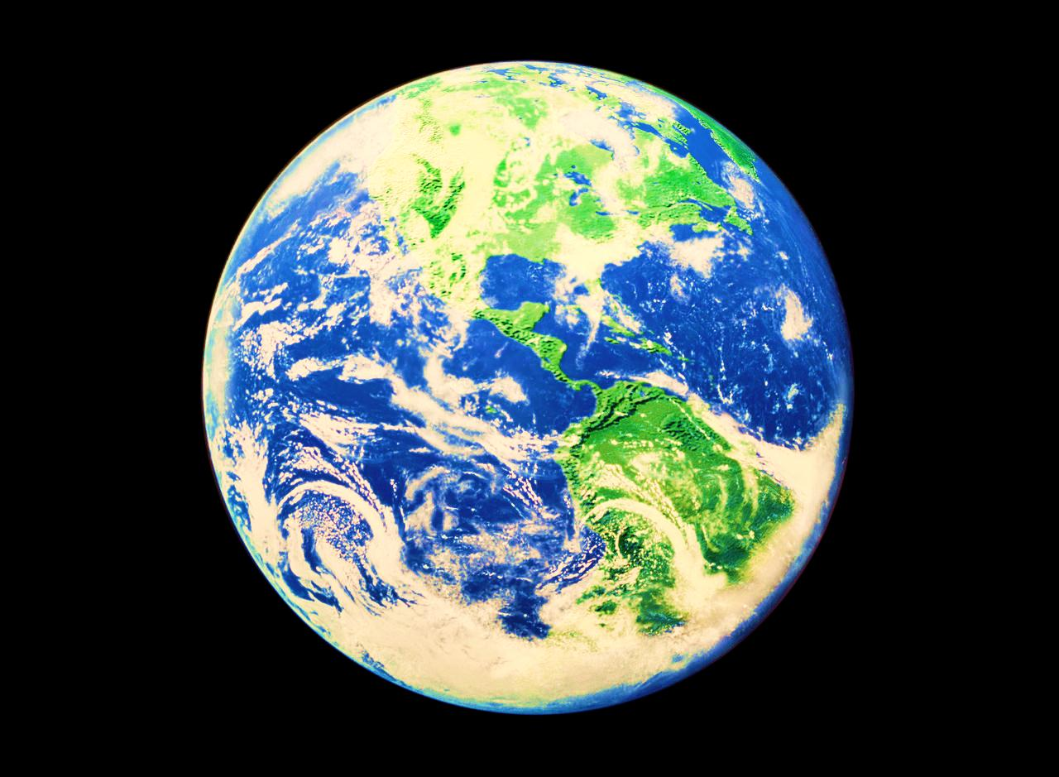
Join the interaction: http://aka.ms/msrdemo
Notes:
Mobile means location independent
People can reach us regardless of where we are
Example: If something went wrong at the kids’ school, they could call and tell me
I can reach information regardless of where I am
Example: I can look up the current election news from right here

Slide 5
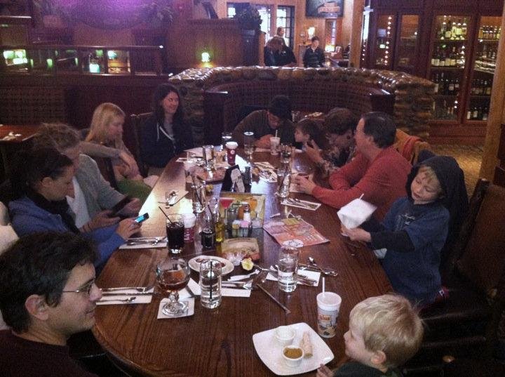
Join the interaction: http://aka.ms/msrdemo
Notes:
But while mobile devices connect us with the greater world
They are disengaging us with what is directly around us.
Do you like it when the person you’re eating with pulls out their phone?
We think of pictures like this as bad
Everyone is isolated by their device
Despite having a common conversations
But mobile devices should be designed to enhance face-to-face communication, not detract from it
People are with others when they use their mobile phones, they’re the computers we carry with us.
We try to fix it by stopping it (“No phones at the dinner table!”)

Slide 6
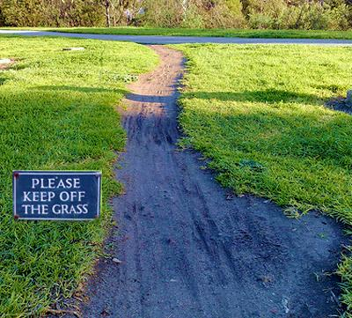
Join the interaction: http://aka.ms/msrdemo
Notes:
Parallel: Foot path in grass. Fence it off or pave it?
People are carving out their own paths with mobile devices
Listen to Bing voice search: People are talking in the background (“Let me do that, you’re driving!”)
We ran a study looking at people’s mobile search behavior, and found that 2 out of 3 searches from mobile phones are discussed with other people.
Currently no good technology-based support for co-located, synchronous communication (whiteboard? PowerPoint?)
We will build it with mobile phones

Slide 7
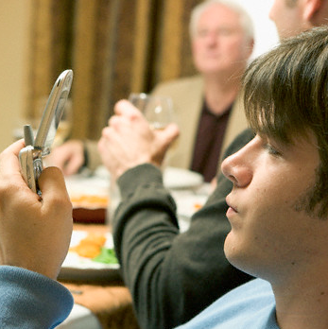
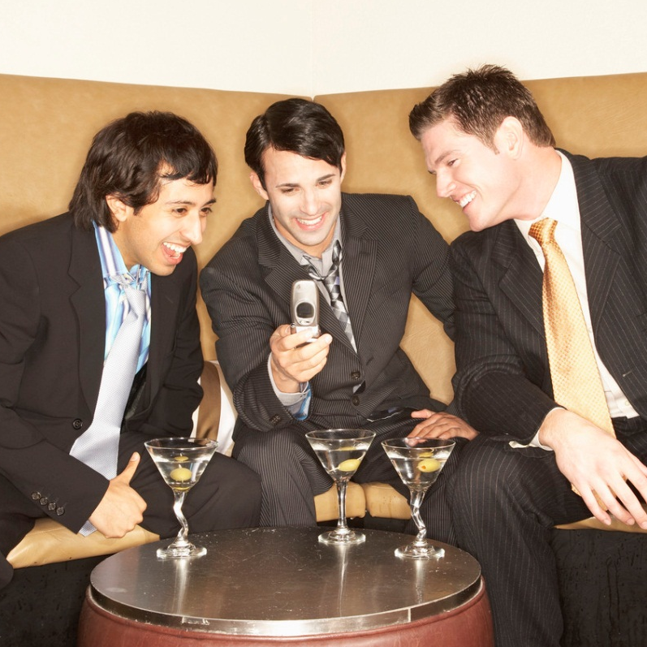
Personal Devices
Social Devices
Social Devices
Remove us from our social context
Isolate us from companions
Encourage rude, inattentive behavior
Distract attention
Promote apathetic, passive experiences
Foster culture of “absent presence”
Engage us with those around us
Connect us with our companions
Participate more fully in conversations
Focus attention
Promote dynamic, interactive experiences
Foster fully present collaborations
Join the interaction: http://aka.ms/msrdemo
Notes:
→ We think of mobile devices as personal, but they’re really with us in social settings.
Change in how phones are understood from personal → social devices
Popular social applications support interaction with others regardless of location.
Some recent applications support localized social content – but tend to be focused on weak ties.
How can we create location-based applications that support co-located interaction with strong ties?

Slide 8
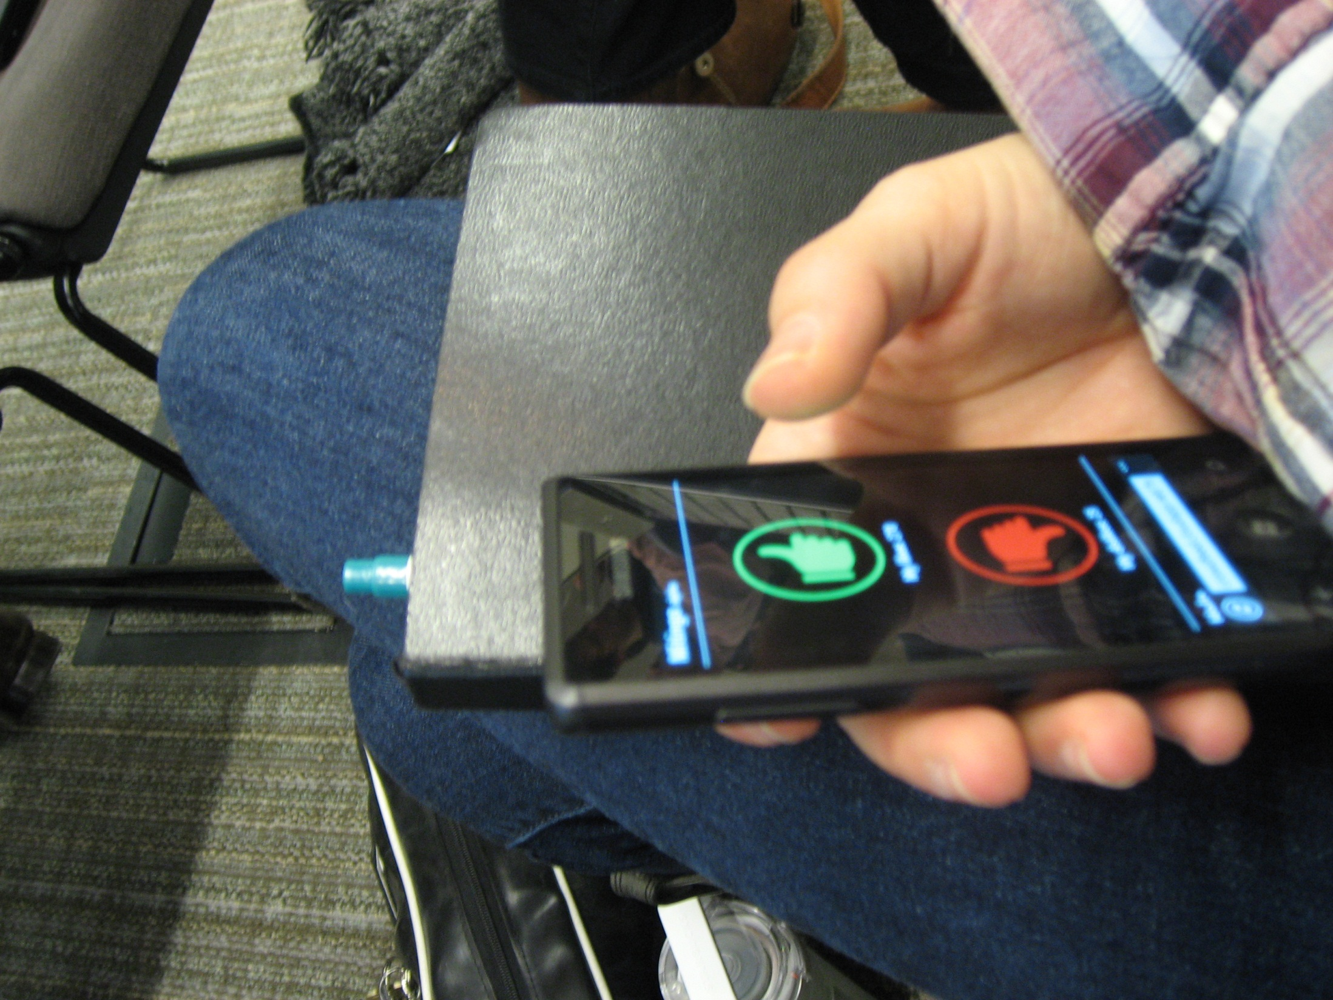
Unobtrusive
Join the interaction: http://aka.ms/msrdemo
Notes:
Devices are rude for co-located interaction because they take attention from the surroundings.
Solution: Unobtrusive I/O
Pocket Touch – input information by tapping pocket
Mitingo:
Flip phone to provide input
Presenter feedback

Slide 9
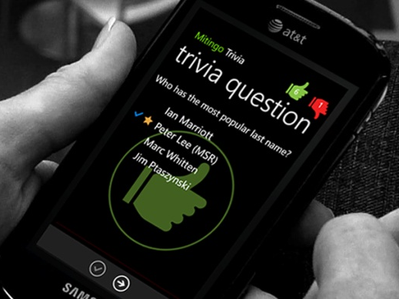
Conversation Starter
Join the interaction: http://aka.ms/msrdemo
Notes:
More than not getting in the way, they can also help encourage verbal communication.
We have a persistent connection, and the technology is just auxiliary.
Meetster: Trivia Game
Trivia questions in collaborative search
Also offload difficult communication, negative feedback.
Disliking something I say is easier for you with Mitingo.
Search application: I’m hungry, let’s decide!

Slide 10
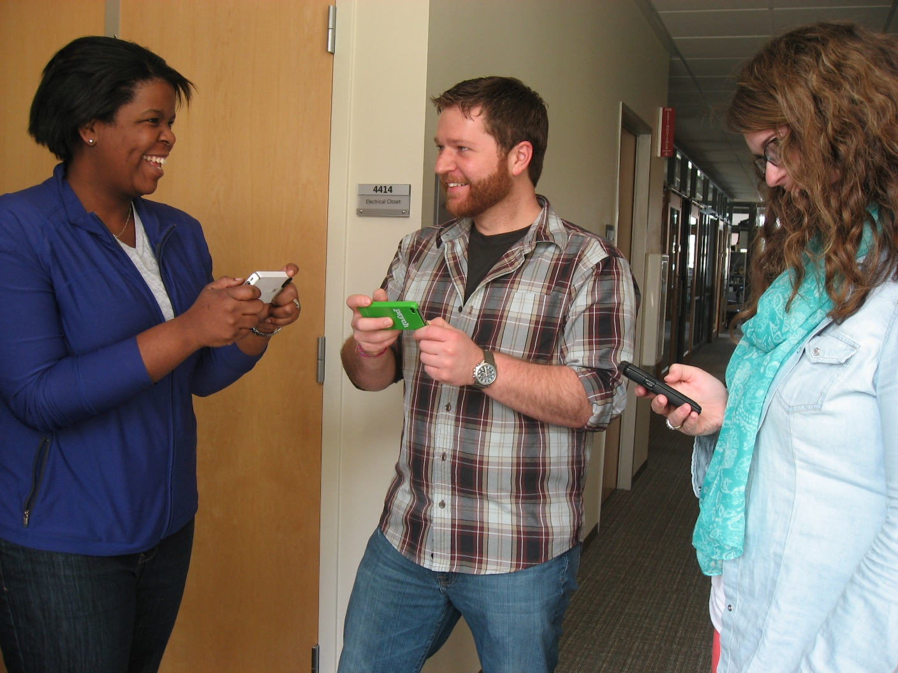
Physical Signaling
Join the interaction: http://aka.ms/msrdemo
Notes:
In addition to communicating verbally,
We also communicate a lot with our physical presence.
Describe O-SNAP’s use of phone orientation.

Slide 11
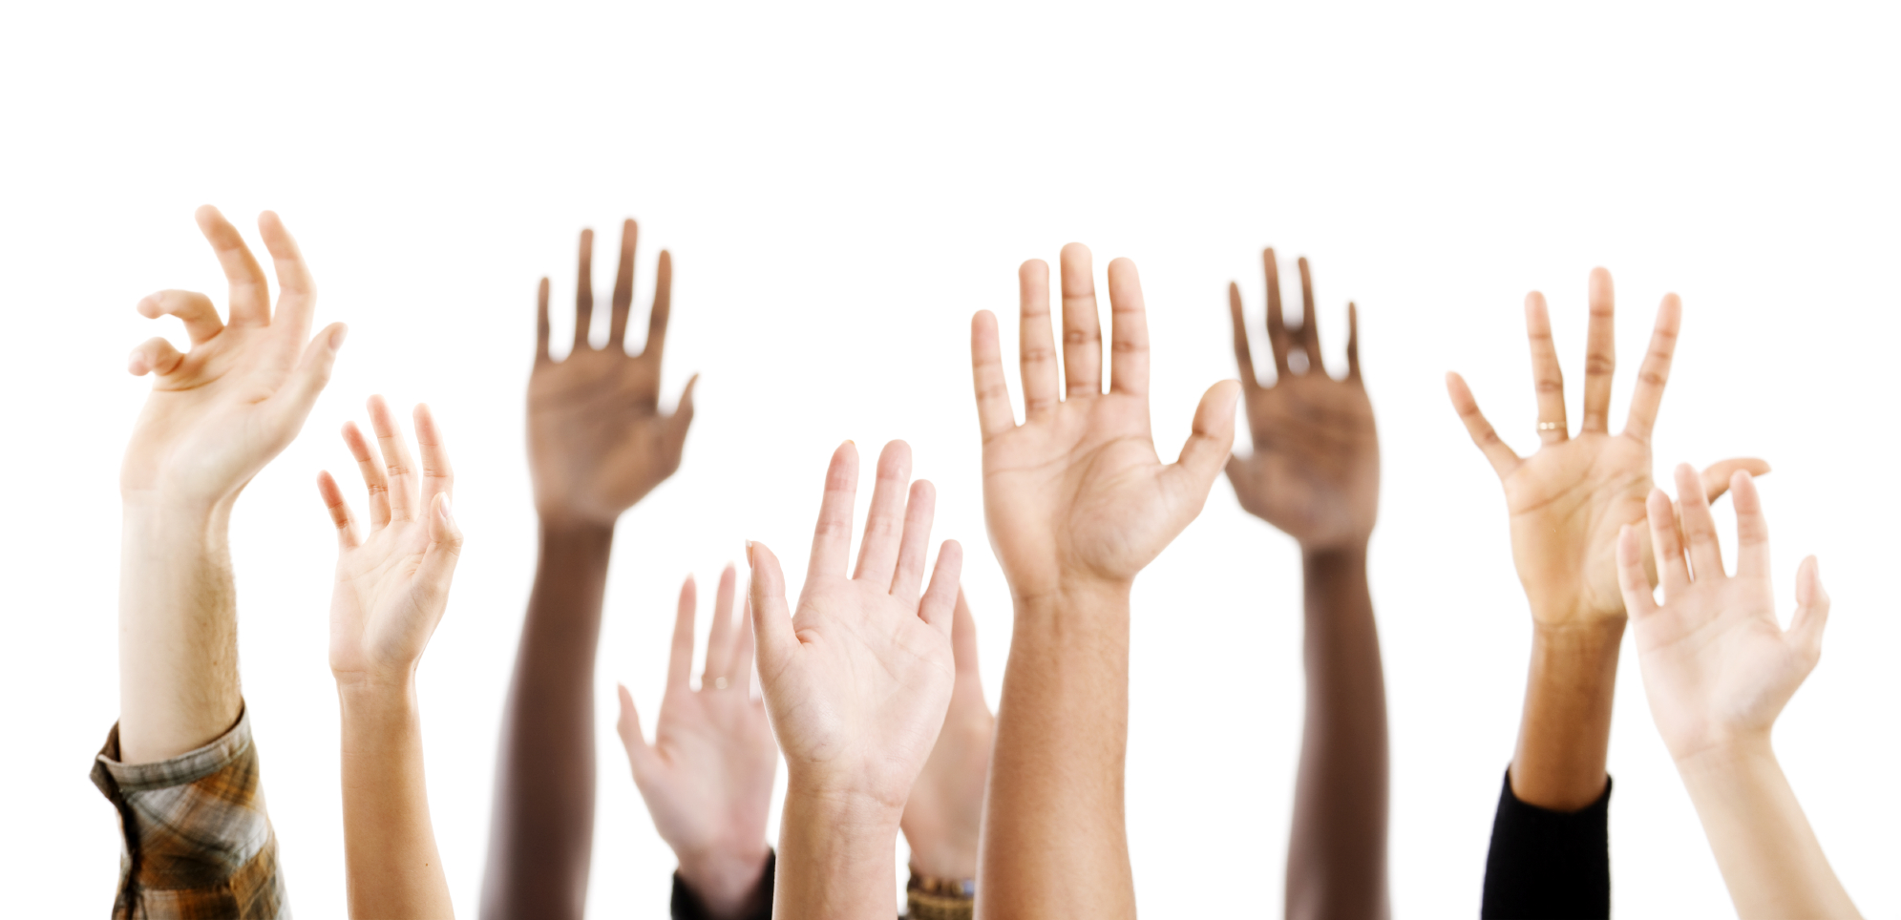
Motivation
Teevan, Karlson, Amini, Brush & Krumm. Understanding the importance of location, time, and people in mobile local search behavior. MobileHCI 2011.
Morris. Collaborative search revisited. CSCW 2013.
Unobtrusive
Saponas, Harrison & Benko. PocketTouch: Through-fabric capacitive touch input. UIST 2011.
Teevan, Liebling, Paradiso, Garcia, von Veh & Gehring. Displaying mobile feedback during a presentation. MobileHCI 2012.
Conversation Starter
Böhmer, Saponas & Teevan. Smartphone use does not have to be rude: Making phones a collaborative presence in meetings. MobileHCI 2013.
Teevan, Morris & Azenkot. Supporting interpersonal interaction during collaborative mobile search. IEEE Computing, 2014.
Physical Signaling
Teevan, Morris & Azenkot. Using physical signaling to support collaborative mobile search. CSCW 2014 Companion.
Join the interaction: http://aka.ms/msrdemo

Slide 12
Extra Slides

Slide 13
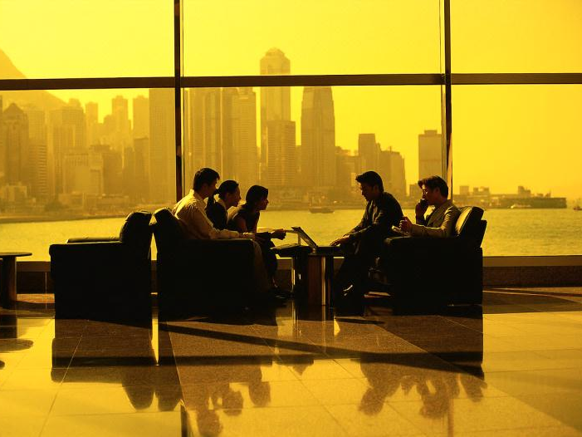
 |  | Me | Others
Working | Taking pictures | 32% | 22%
 | Viewing calendar | 70% | 62%
 | Taking notes | 18% | 17%
Playing | Playing games | 3% | 18%
 | Social networking | 9% | 37%
 | Browsing Web | 16% | 45%
Join the interaction: http://aka.ms/msrdemo
Notes:
Ran a survey to understand smartphone use in meetings
398 participants
Asked about their phone use in meetings, what they thought others did, and, to get a representative sample, their last meeting.
Distributed the time and day survey invitations were sent to avoid bias.
Most (72%) people reported bringing smartphones to meetings
And over half (60%) of those people used them during the meeting
Don’t hamper productivity. (only 20% agreed)
Do hamper the social relationships. (47% agreed)
Why? We think we’re being productive, but that others are rudely screwing around.

Slide 14
 |  | Agree | Disagree
Viewing Feedback | Was easy to see group feedback | 67% | 18%
 | Helped me know other’s reactions | 55% | 12%
 | I felt closer to the audience | 63% | 18%
 | Helped me pay closer attention | 18% | 59%
Giving | Engaged me with presentation | 60% | 16%
 | Engaged me with audience | 72% | 7%
Join the interaction: http://aka.ms/msrdemo
Notes:
Take-away: Provide feedback to get the most out of this presentation!
Other ways to study how we can influence each other.
Example: How does other people’s feedback influence your interpretation of the content?
Active/inactive; positive/negative
Can we artificially make events stand out?

Slide 15
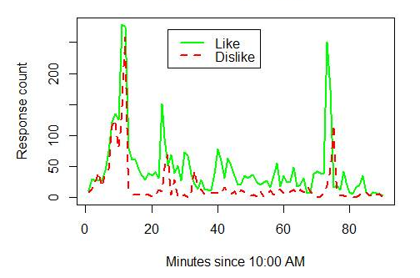
Join the interaction: http://aka.ms/msrdemo
Notes:
Observe:
More positive feedback than negative
Negative feedback often lags positive feedback
People do provide feedback throughout the meeting
Useful for presenter to reflect on presentation (“this slide was engaging”)
Useful for people who missed the meeting to catch up (creating summaries)
Challenges:
What does the feedback mean?
How to collect feedback that means what we want it to?
How to keep people providing feedback?

