Slide 1

The Web
Changes Everything
Jaime Teevan, Microsoft Research, @jteevan
Notes:
This talk: History of Web documents
Not referring to history as in the people and places
Which the University of Michigan played an important role in with the Merit Network
Talking about the history of documents that make up the web, what the web used to look like compared to what it looks like now.
The reason that this is interesting is that web content changes a lot.
We tend to think of the information we consume with as static – books, email
But much of the information we interact with changes,
And looking at how we interact with the web is a great way to think about this
Gives good insight into some interesting large-scale data challenges:
How content changes, what does it mean for content to change, how we can archive and study it.
How people interact with content as it changes, behavioral data, how do we understand the lens provided by people’s interactions.

Slide 2
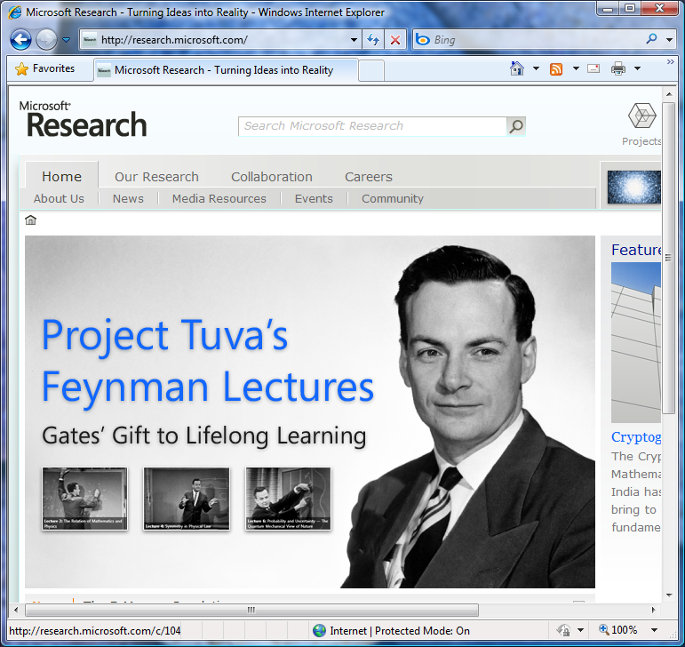
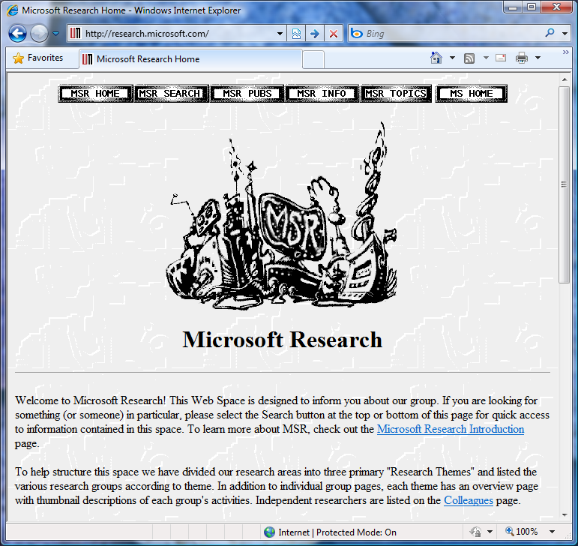
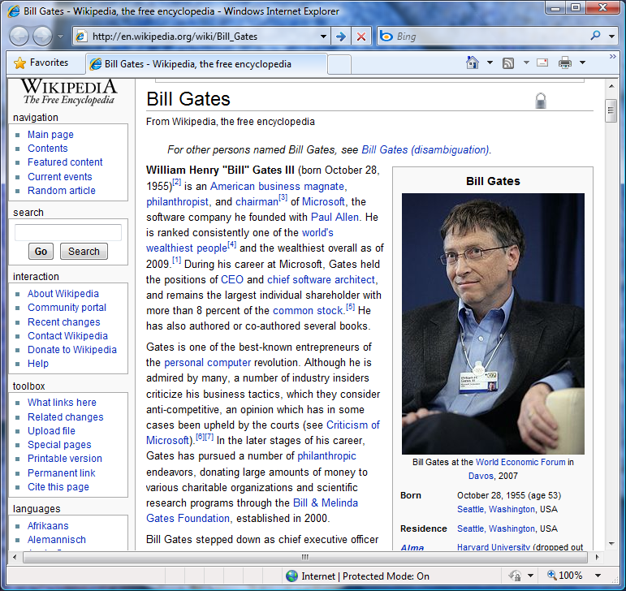
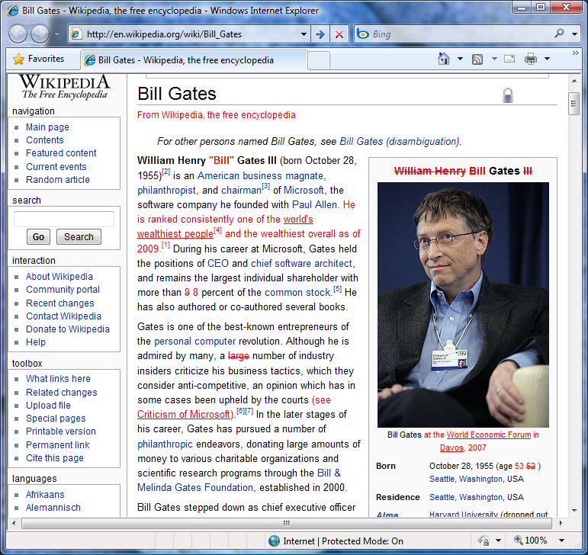
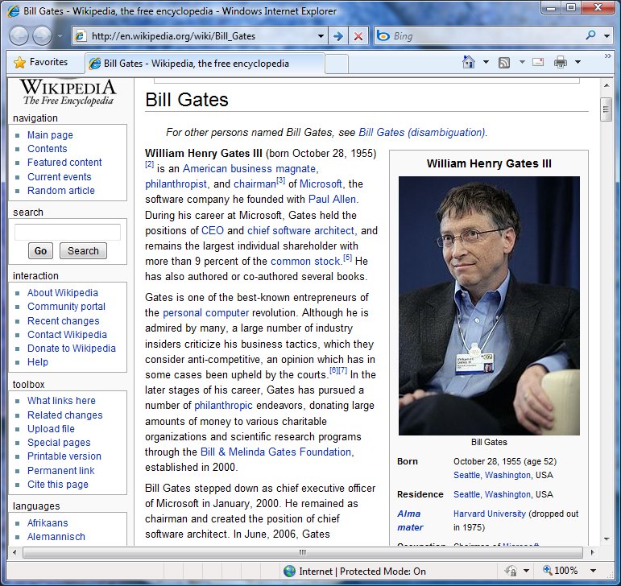
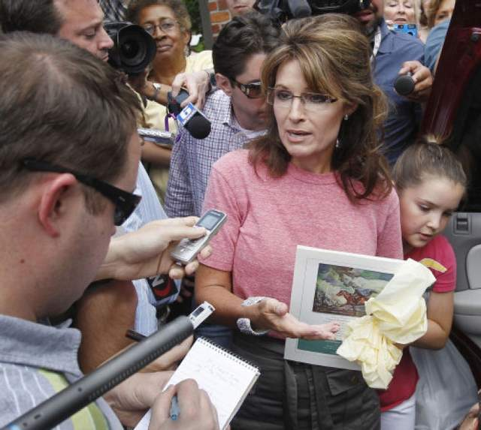
Notes:
Most of the time we interact with the web, we are interacting with it as it is right now.
So this is Microsoft Research’s homepage as it is right now (or, really, when I captured it for these slides).
But if you go back 10 years, this is what it looked like.
You can tell a lot about how an organization evolved by looking at how this changes.
Some changes are obvious.
Others more subtle.
Bill Gates page over the course of a week changes a lot, but not obvious.
Doesn’t look different, is different.
Another fun example: academic pages have text changes, but few formatting changes.
We tend not to be graphic designers, the general formatting stays the same, but we update the content
“Susan Dumais”: text retrieval to info retrieval, add machine learning, switch ordering
Sources for history: Web archive, Wikipedia change logs
Usually we ignore change.
Examples where it comes to the forefront:
Sara Palin and Paul Revere
“He who warned uh, the British that they weren’t gonna be takin’ away our arms, uh by ringing those bells, and um, makin’ sure as he’s riding his horse through town to send those warning shots and bells that we were going to be sure and we were going to be free, and we were going to be armed.” (Sarah Palin)
In her trip to Massachusetts last week, Palin flubbed the history of Revere’s ride, saying that he rode through Boston ringing bells to warn the British that the revolutionaries were armed and ready to fight. Revere actually rode quietly, to warn the revolutionaries that British troops were headed their way. … Palin fans have been attempting to add her version of the story to Revere’s Wikipedia page. (Washington Post)

Slide 3
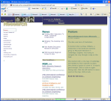

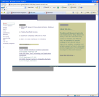
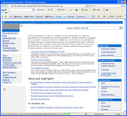
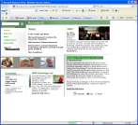
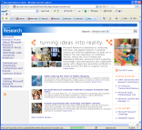
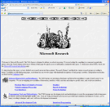
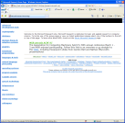
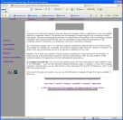
The Web Changes Everything
Content Changes
January February March April May June July August September

Slide 4
The Web Changes Everything
Content Changes
January February March April May June July August September
January February March April May June July August September
People Revisit
Today’s tools focus on the present
But there’s so much more information available!
Notes:
Focused on current version
But there is a rich history
Change: Web doubles in size and 50% changes every year.
Revisit: Over half of all visits are repeat.
Overview of talk:
Change
Revisits
Relationship
Example application or two for each

Slide 5
The Web Changes Everything
Content Changes
January February March April May June July August September
Large scale Web crawl over time
  Revisited pages
    55,000 pages crawled hourly for 18+ months
  Judged pages (relevance to a query)
    6 million pages crawled every two days for 6 months
Notes:
55k revisited pages chosen to span: unique users, visits/user, time between visits
What does it mean to do a crawl? We now get personalized content. How to capture services and experiences?

Slide 6
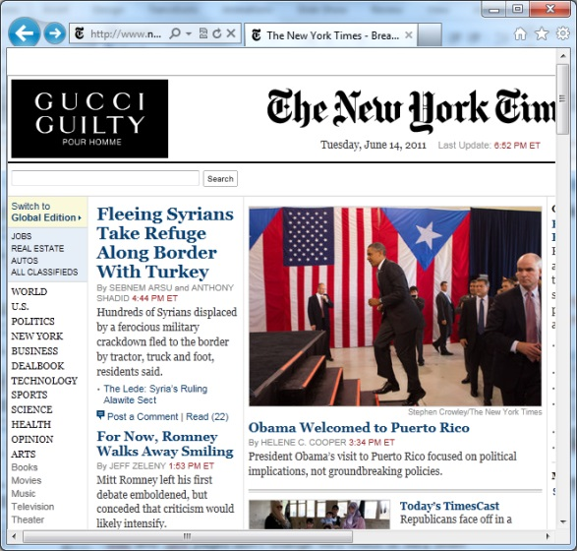
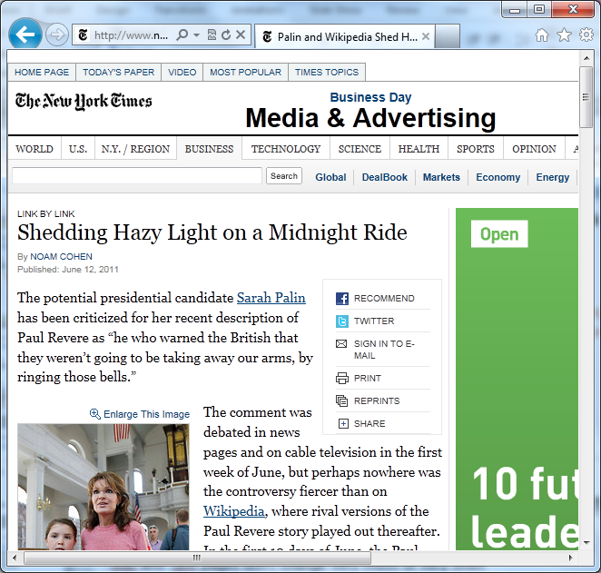
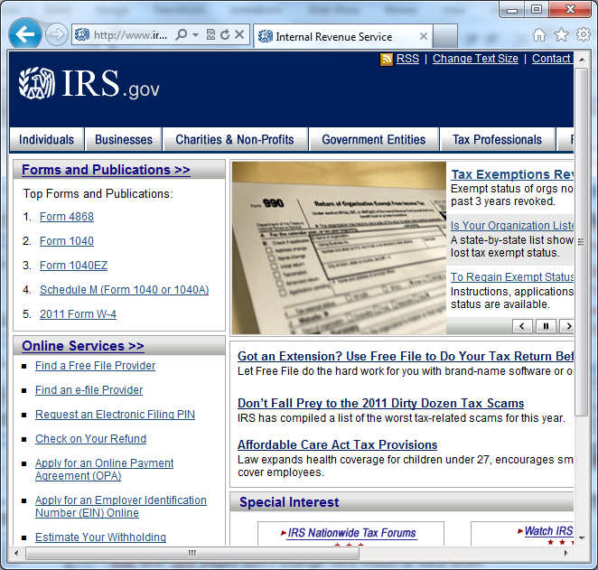
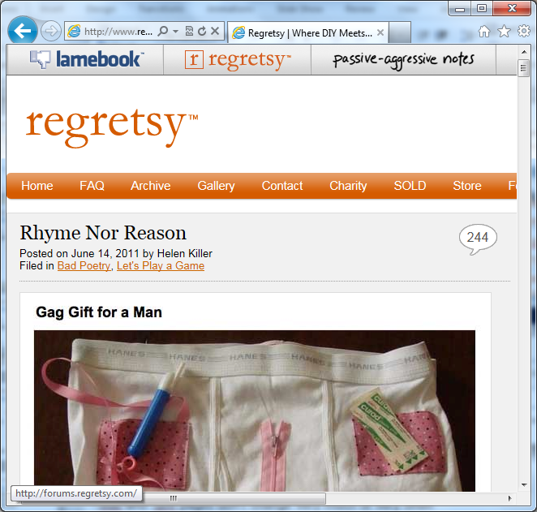
Measuring Web Page Change
Summary metrics
  Number of changes
  Time between changes
  Amount of change
Top level pages change by more and faster than pages with long URLS.
.edu and .gov pages do not change by very much or very often
News pages change quickly, but not as drastically as other types of pages

Slide 7

Measuring Web Page Change
Summary metrics
  Number of changes
  Time between changes
  Amount of change
Change curves
  Fixed starting point
  Measure similarity over different time intervals
Knot point
Notes:
Change curves designed to capture how a page changes over time
Example: NYTimes.com
Initially there’s a lot of change as articles change
But then there’s very little additional change, and what‘s left is:
Navigational infrastructure
Common words in article
Example: Celeb news blog, always talking about movies, actors, actresses, sometimes talking about Bieber, some news story
Characteristic hockey-stick shape representative of most (over 70%)
Knot point captures a page’s change pattern
Up high, doesn’t change very much (e.g., a departmental homepage)
To the right, changes slowly (e.g., an academic’s publication page)

Slide 8
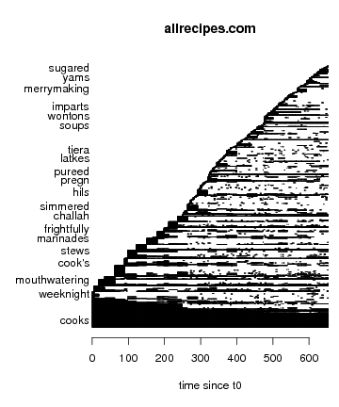
Measuring Within-Page Change
DOM structure changes
Term use changes
  Divergence from norm
    cookbooks
    frightfully
    merrymaking
    ingredient
    latkes
  Staying power in page
Sep. Oct. Nov. Dec.
Time
Notes:
Dive into micro-level changes, after macro-level discussion

Slide 9
Accounting for Web Dynamics
Avoid problems caused by change
  Caching, archiving, crawling
Use change to our advantage
  Ranking
    Match term’s staying power to query intent
  Snippet generation
Tom Bosley - Wikipedia, the free encyclopedia
Thomas Edward "Tom" Bosley (October 1, 1927 October 19, 2010) was an American actor, best known for portraying Howard Cunningham on the long-running ABC sitcom Happy Days. Bosley was born in Chicago, the son of Dora and Benjamin Bosley.
en.wikipedia.org/wiki/tom_bosley
Tom Bosley - Wikipedia, the free encyclopedia
Bosley died at 4:00 a.m. of heart failure on October 19, 2010, at a hospital near his home in Palm Springs, California. … His agent, Sheryl Abrams, said Bosley had been battling lung cancer.
en.wikipedia.org/wiki/tom_bosley
Notes:
Change not just a drawback, also a cool opportunity
Challenge: Think about how to do this
Match needs to content

Slide 10
Revisitation on the Web
Revisitation patterns
  Log analysis
    Browser logs for revisitation
    Query logs for re-finding
  User survey for intent
Content Changes
January February March April May June July August September
January February March April May June July August September
People Revisit
What’s the last Web page you visited?
Notes:
Think about the last page you visited – maybe up on your screen right now.
Raise your hand if you’ve been to it before?
80% of our visits are repeat
There’s a lot we can do to understand and use that, too.
Aggregate what people are doing, enable us to do new things that we couldn’t before
Highlight need to complement log data, not enough on its own

Slide 11
Measuring Revisitation
Summary metrics
  Unique visitors
  Visits/user
  Time between visits
Revisitation curves
  Revisit interval histogram
  Normalized
Time Interval

Slide 12
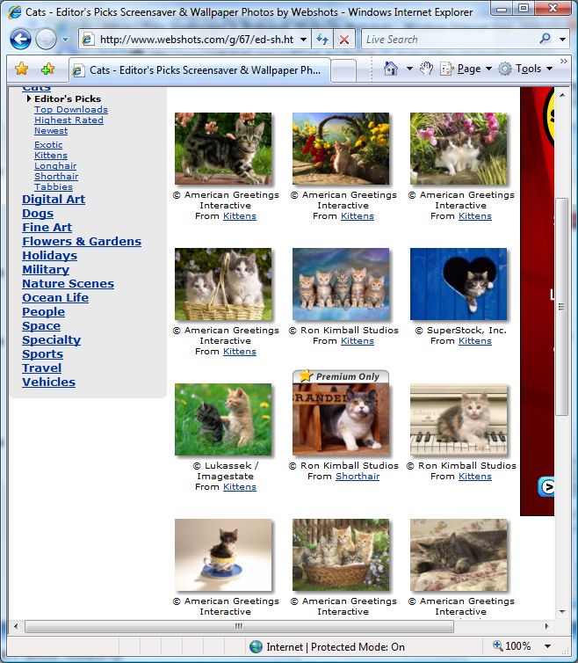
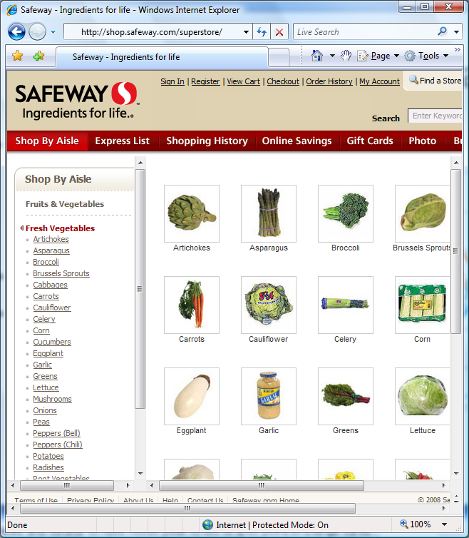
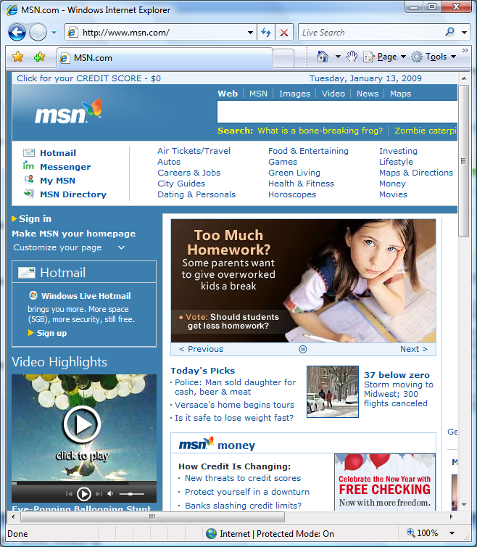
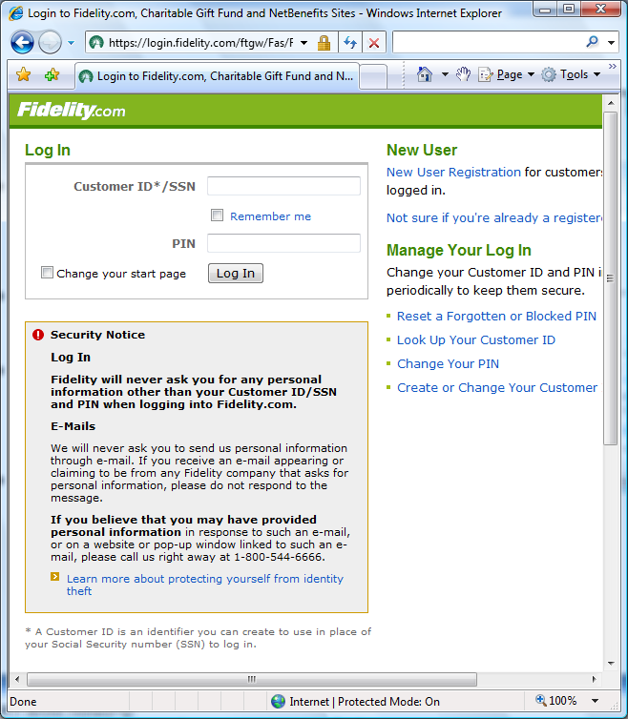
Four Revisitation Patterns
Fast
  Hub-and-spoke
  Navigation within site
Hybrid
  High quality fast pages
Medium
  Popular homepages
  Mail and Web applications
Slow
  Entry pages, bank pages
  Accessed via search engine
Notes:
Four primary pages that people visit:
Fast, hub and spoke. Maybe you want to get some kitten wallpaper. Porn in this category.
Hybrid, where you do this hub and spoke activity periodically (e.g., Gap)
Medium: Email, Facebook, things you visit all of the time
Slow: Only go every once in a while
Back buttons there from the get-go
Evolved the back button, become more sophisticated
Better ways of helping people return
I am particularly interested in how we use search engines to get back to things
Search is common for revisitation – ask how many people get to the symposium page by searching for it
We’re using SE to find things we already know about, not just things we’ve seen before

Slide 13
Search and Revisitation
Repeat query (33%)
  university of michigan
Repeat click (39%)
  http://umich.edu
  Query → um ann arbor
Lots of repeats (43%)
  Many navigational
 |  | Repeat Click | New Click
Repeat Query | 33% | 29% | 4%
New Query | 67% | 10% | 57%
 |  | 39% | 61%

Slide 14
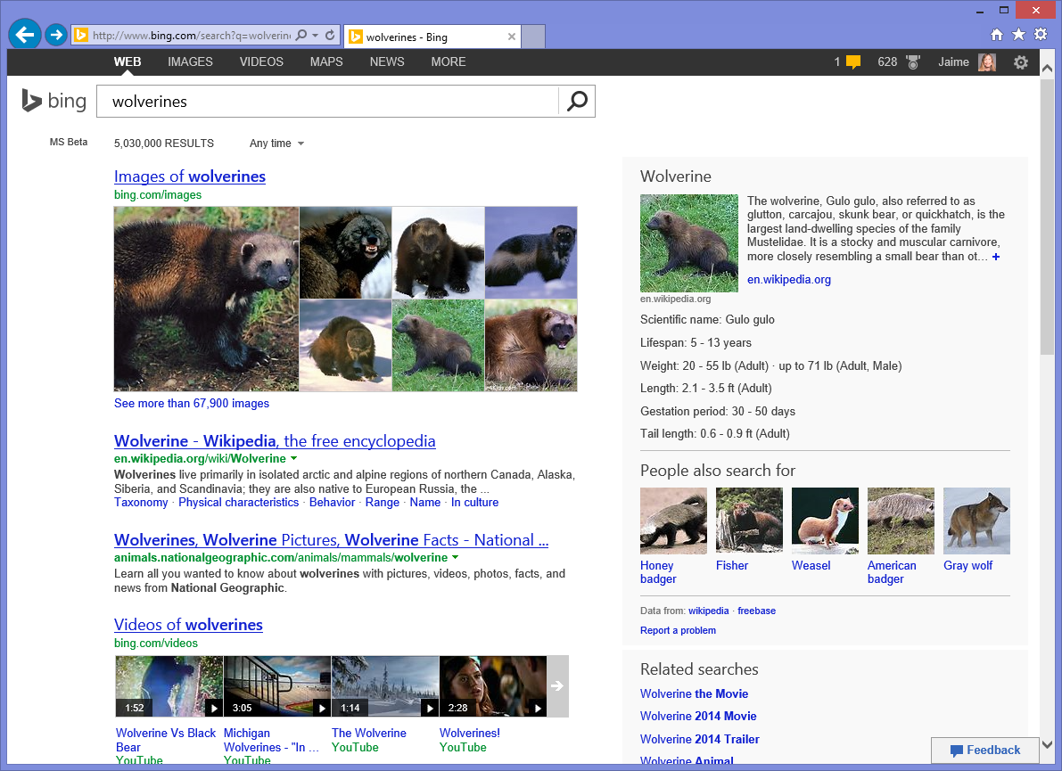

6th
Notes:
15% of all queries we have enough history to almost perfectly predict the click based on repeat behavior
(“almost perfectly” = 95% accuracy, or better than we can predict you’ll click on http://facebook.com if you search for “facebook.”)
Once I’ve done this once or twice, it becomes obvious what you want

Slide 15
How Revisitation and Change Relate
Content Changes
January February March April May June July August September
January February March April May June July August September
People Revisit
Why did you revisit the last Web page you did?
Notes:
So, most of us had revisited, do you remember why?
Going to see new content? Content seen before?
People have all sorts of reasons to go back to a page

Slide 16
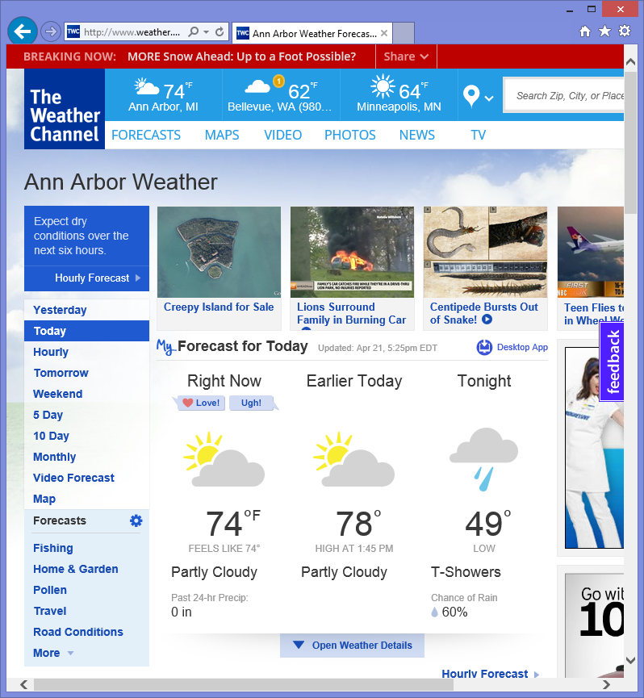
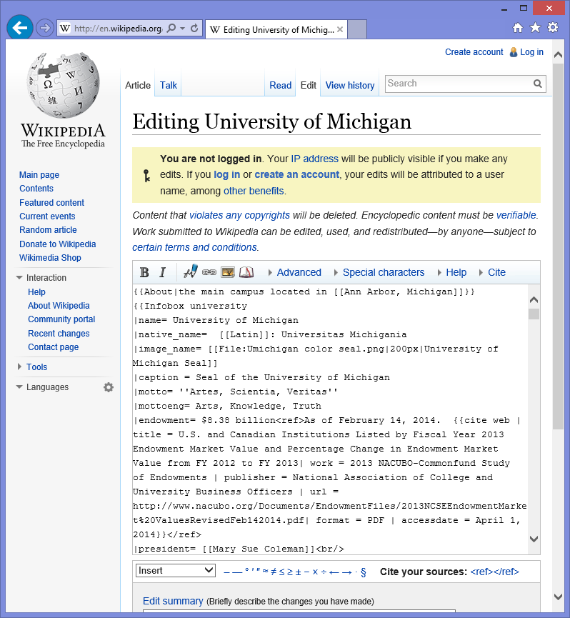
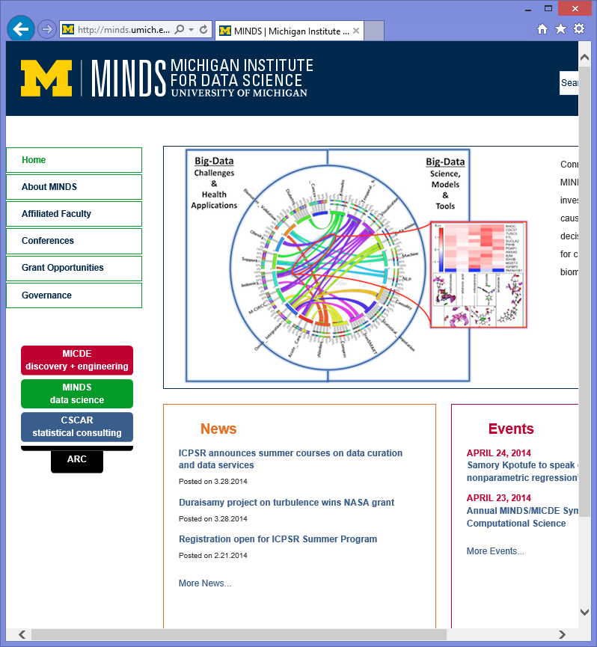
Possible Relationships
Interested in change
  Monitor
Effect change
  Transact
Change unimportant
  Find
Change can interfere
  Re-find

Slide 17
Understanding the Relationship
Compare summary metrics
Revisits: Unique visitors, visits/user, interval
Change: Number, interval, similarity
2 visits/user
3 visits/user
4 visits/user
5 or 6 visits/user
7+ visits/user
 | Number of changes | Time between changes | Similarity
2 visits/user | 172.91 | 133.26 | 0.82
3 visits/user | 200.51 | 119.24 | 0.82
4 visits/user | 234.32 | 109.59 | 0.81
5 or 6 visits/user | 269.63 | 94.54 | 0.82
7+ visits/user | 341.43 | 81.80 | 0.81
Notes:
Change goes up and time between changes go down as people visit more
Change sometimes drives visit
But similarity is pretty constant regardless

Slide 18
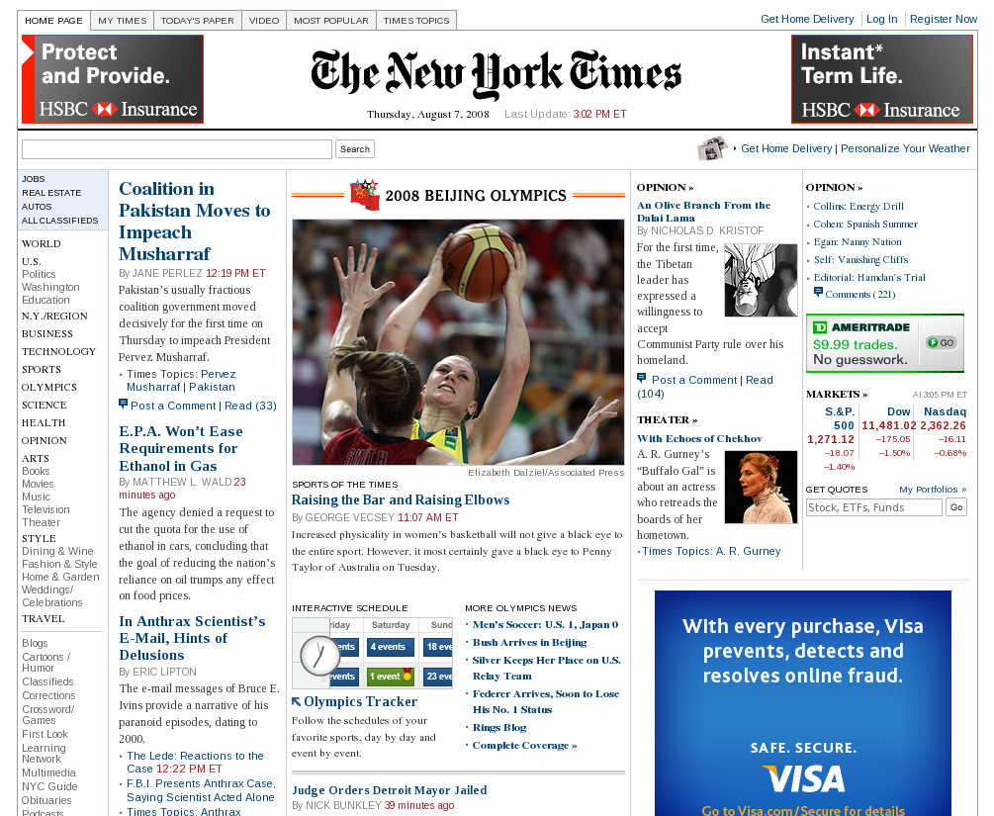


Comparing Change and Revisit Curves
Three pages
  New York Times
  Woot.com
  Costco
Similar change patterns
Different revisitation
  NYT: Fast (news, forums)
  Woot: Medium
  Costco: Slow (retail)

Slide 19
Comparing Change and Revisit Curves
Three pages
  New York Times
  Woot.com
  Costco
Similar change patterns
Different revisitation
  NYT: Fast (news, forums)
  Woot: Medium
  Costco: Slow (retail)
Time
Notes:
N.B.: Change curves don’t look like “hockey sticks” because time shown log-scale here to give a better picture of the “stick” part of the curve.
We can also compare our change curves with the revisitation curves
Describe Woot.com
Chose these three pages as examples because they have similar change curves
Show knot point
Reach steady state change at a day
Different revisitation patters because they are very different pages
News pages tend to have revisitation peak ahead of the knot point, driven by the change
Retail pages tend to have it afterwards, because change doesn’t matter

Slide 20
Within-Page Relationship
Page elements change at different rates
Pages revisited at different rates
Resonance can serve as a filter for interesting content
Notes:
We can also look within a page at change and revisitation.
There are revisitation patterns can serve as a filter.
Look at our three examples, see what changes at the rate that people revisit.

Slide 21
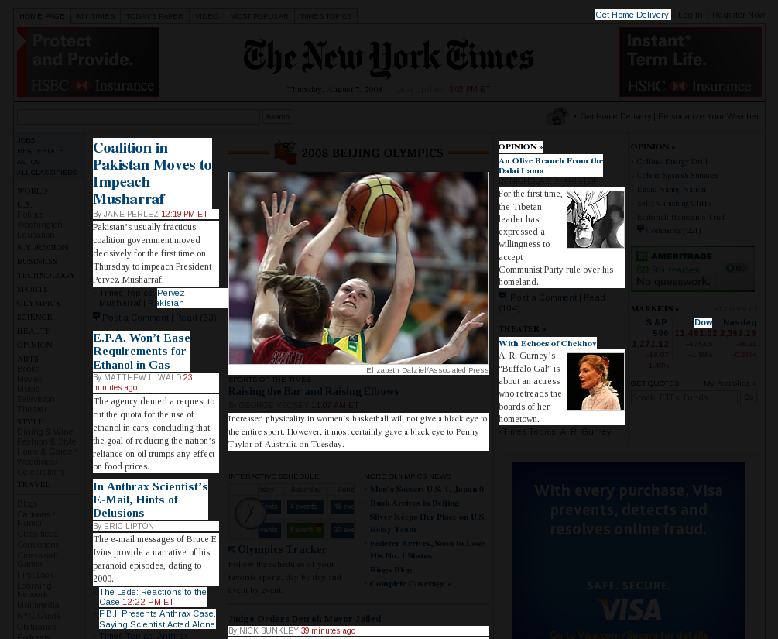

Slide 22


Slide 23
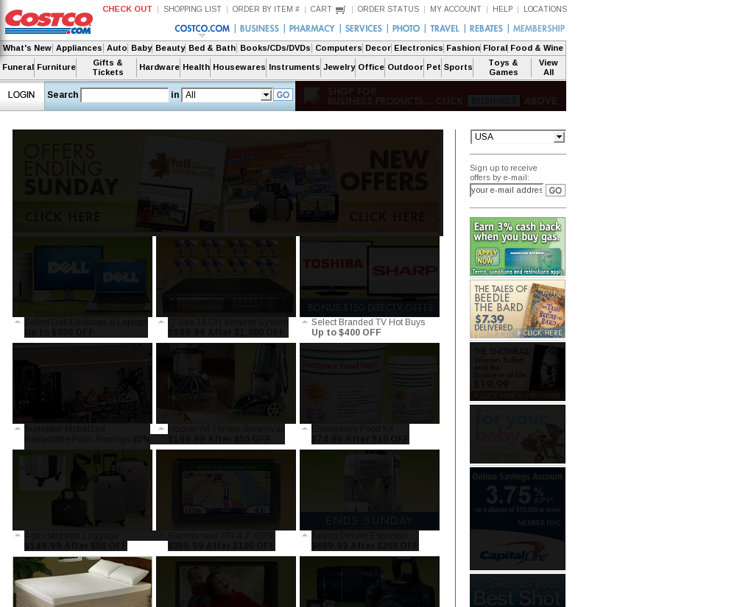
Notes:
Resonance enables us to filter for interest on the page
Can use in many ways, such as:
Creating mobile interfaces or smaller interfaces
Building better retrieval algorithms based on important content
Notifying people of changes to things they find interesting
(Funeral section jumps out)

Slide 24
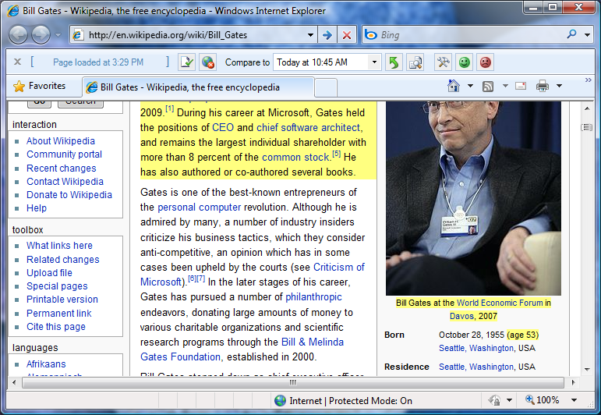
Exposing Change
Diff-IE toolbar
Changes to page since your last visit
Notes:
Expose important change to people

Slide 25
Interesting Features
New to you
Always on
Non-intrusive
In-situ
Notes:
You’re not always looking for change, important that it is always on.
Even when changes you’re not interested in happen
People use it to find expected change
First thing people do is go straight to their favorite news site, see that it changes
But we find tons of unexpected uses (e.g., show unexpected change, monitoring behavioral activity, how a page works)
Most useful where change not expected

Slide 26
Studying Diff-IE
Content Changes
January February March April May June July August September
SURVEY
How often do pages change?
o o o o o
How often do you revisit?
o o o o o
SURVEY
How often do pages change?
o o o o o
How often do you revisit?
o o o o o
Install
Diff-IE
January February March April May June July August September
People Revisit
Notes:
Install
Gave them a survey at the beginning, exact same one later
Also logged their behavior
Compare the first week with use after a month

Slide 27
Seeing Change Changes Web Use
Changes to perception
  Diff-IE users become more likely to notice change
  Provide better estimates of how often content changes
Changes to behavior
  Diff-IE users start to revisit more
  Revisited pages more likely to have changed
  Changes viewed are bigger changes
Content gains value when history is exposed
14%
51%
53%
Notes:
Better estimates of different categories of pages change – search engines v. reference webpages
Also saw changes to behavior

Slide 28
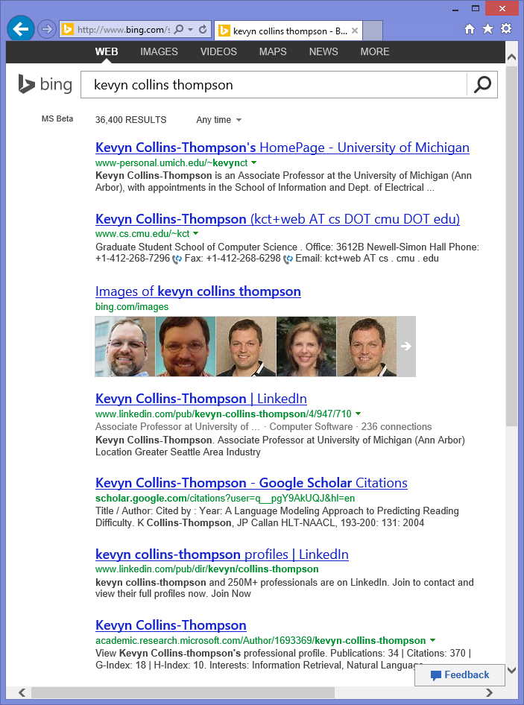
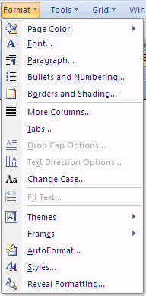
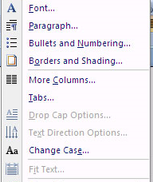
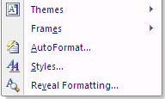
Change Can Cause Problems
Dynamic menus
  Put commonly used items at top
  Slows menu item access
Search result change
  Results change regularly
  Inhibits re-finding
    Fewer repeat clicks
    Slower time to click
Notes:
Fewer repeat clicks (53% v. 88%)
Slower time to click (26 seconds v. 6 seconds)

Slide 29
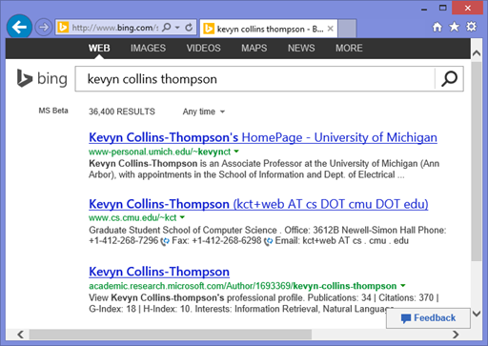


Change During a Single Query
Results even change as you interact with them
Notes:
Search result pages can often change, even while you are interacting with them
Click a result and come back
Reasons:
New, more relevant content
Intentional changes (e.g., 8 results to 10 results, removal of advertisement)
General instability
Interesting to study because it is happening as a user interacts with search results
Interesting challenge for doing this analysis: Want to not screw with the user experience (which we do chose to do sometimes)
We can also take advantage of mistakes – just need to be clear that the set of people being looked at are the same

Slide 30
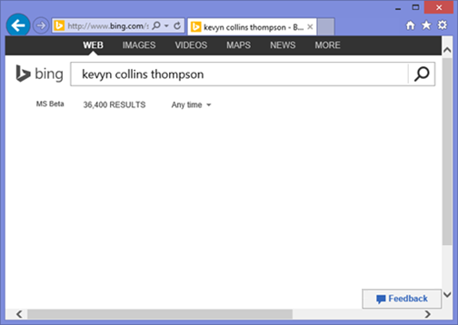
Change During a Single Query
Results even change as you interact with them
Many reasons for change
  Intentional to improve ranking
  General instability
Analyze behavior when people return after clicking

Slide 31
Understanding When Change Hurts
Metrics
  Abandonment
  Satisfaction
  Click position
  Time to click
Mixed impact
  Results change Above: 4.5% increase
  Results change Below: 1.9% decrease
Abandonment | Above | Below
Static | 36.6% | 43.1%
Change | 41.4% | 42.3%

Slide 32
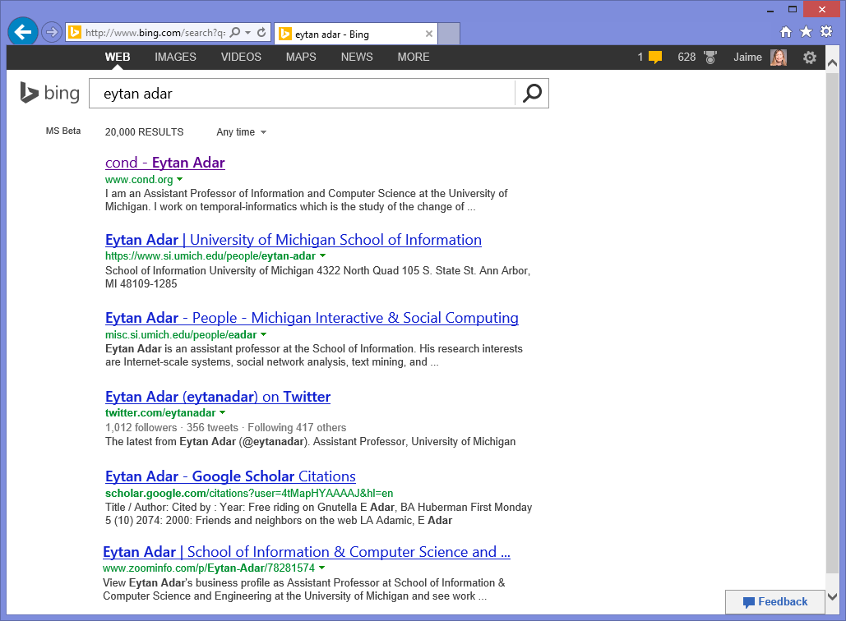
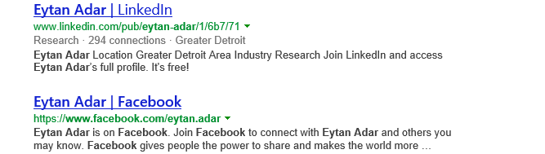
Use Experience to Bias Presentation

Slide 33
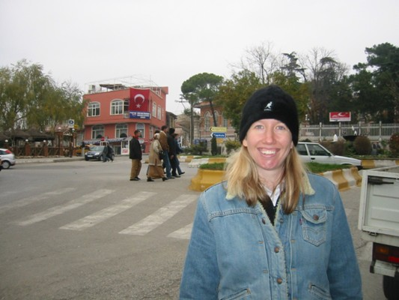
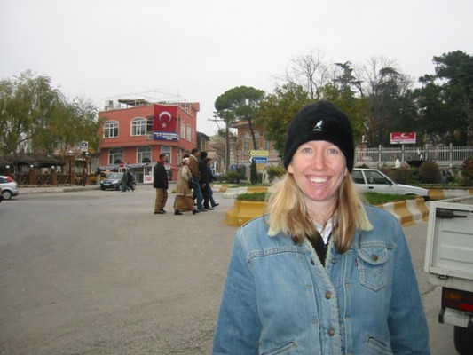
Change Blind Search Experience

Slide 34
The Web Changes Everything
Content Changes
Web content changes provide valuable insight
January February March April May June July August September
Relating revisitation and change enables us to
  Identify pages for which change is important
  Identify interesting components within a page
January February March April May June July August September
People revisit and re-find Web content
People Revisit
Explicit support for Web dynamics can impact how people use and understand the Web
Notes:
Goal: Convey the value of our being Web historians

Slide 35

Thank you.
Jaime Teevan @jteevan
Web Content Change
Adar, Teevan, Dumais & Elsas. The Web changes everything: Understanding the dynamics of Web content. WSDM 2009.
Kulkarni, Teevan, Svore & Dumais. Understanding temporal query dynamics. WSDM 2011.
Svore, Teevan, Dumais & Kulkarni. Creating temporally dynamic Web search snippets. SIGIR 2012.
Web Page Revisitation
Teevan, Adar, Jones & Potts. Information re-retrieval: Repeat queries in Yahoo’s logs. SIGIR 2007.
Adar, Teevan & Dumais. Large scale analysis of Web revisitation patterns. CHI 2008.
Tyler & Teevan. Large scale query log analysis of re-finding. WSDM 2010.
Teevan, Liebling & Ravichandran. Understanding and predicting personal navigation. WSDM 2011.
Relating Change and Revisitation
Adar, Teevan & Dumais. Resonance on the Web: Web dynamics and revisitation patterns. CHI 2009.
Teevan, Dumais, Liebling & Hughes. Changing how people view changes on the Web. UIST 2009.
Teevan, Dumais & Liebling. A longitudinal study of how highlighting Web content change affects people’s web interactions. CHI 2010.
Lee, Teevan & de la Chica. Characterizing multi-click behavior and the risks and opportunities of changing results during use. SIGIR 2014.

Slide 36
Extra Slides

Slide 37
Sources of Logs to Study Change
Temporal snapshots of content
  Picture of what web content looks like
  Billions of pages with billions of changes
  Difficult to capture personalization and interaction
Behavioral data
  Picture of how people interact with that content
  Need to relate behavior with actual content seen
  Issues with privacy and sharing
  Adversarial system use

Slide 38
Ways to Study Impact of Change
Experimental
  Intentionally introduce change
  May involve degrading experience
Naturalistic
  Look for natural change
  Source of change can also impact behavior
Logs only show actions
  The intention behind actions not captured
  Need to complement data collected

Slide 39
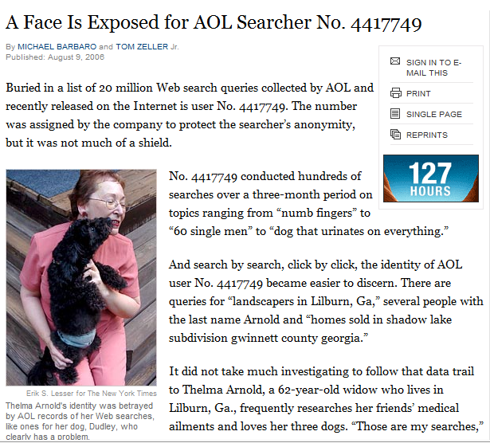
Example: AOL Search Dataset
August 4, 2006: Logs released to academic community
  3 months, 650 thousand users, 20 million queries
  Logs contain anonymized User IDs
August 7, 2006: AOL pulled the files, but already mirrored
August 9, 2006: New York Times identified Thelma Arnold
  “A Face Is Exposed for AOL Searcher No. 4417749”
  Queries for businesses, services in Lilburn, GA (pop. 11k)
  Queries for Jarrett Arnold (and others of the Arnold clan)
  NYT contacted all 14 people in Lilburn with Arnold surname
  When contacted, Thelma Arnold acknowledged her queries
August 21, 2006: 2 AOL employees fired, CTO resigned
September, 2006: Class action lawsuit filed against AOL
  AnonID Query QueryTime ItemRank ClickURL
  ---------- --------- --------------- ------------- ------------
  1234567 jitp 2006-04-04 18:18:18 1 http://www.jitp.net/
  1234567 jipt submission process 2006-04-04 18:18:18 3 http://www.jitp.net/m_mscript.php?p=2
  1234567 computational social scinece 2006-04-24 09:19:32
  1234567 computational social science 2006-04-24 09:20:04 2 http://socialcomplexity.gmu.edu/phd.php
  1234567 seattle restaurants 2006-04-24 09:25:50 2 http://seattletimes.nwsource.com/rests
  1234567 perlman montreal 2006-04-24 10:15:14 4 http://oldwww.acm.org/perlman/guide.html
  1234567 jitp 2006 notification 2006-05-20 13:13:13
  …
Notes:
Research community: How to share logs with research community?
Privacy a huge issue
AOL history:
Released at SIGIR, for the academic community’s use, great goal
There had been logs released before, but not with user ides
Three days later, AOL pulled the logs – although they had obviously made it out
Two days later, NYT identifies Thelma Arnold, an older woman in Georgia
Shortly after that, lots of fall out
Class action, $500k per user exposed

Slide 40
Example: AOL Search Dataset
Other well known AOL users
  User 927 how to kill your wife
  User 711391 i love alaska
    http://www.minimovies.org/documentaires/view/ilovealaska
Anonymous IDs do not make logs anonymous
  Contain directly identifiable information
    Names, phone numbers, credit cards, social security numbers
  Contain indirectly identifiable information
    Example: Thelma’s queries
    Birthdate, gender, zip code identifies 87% of Americans
Notes:
Thelma kind of benign, but others are less so
Play about User 927 – how to chop up a body and put it in a garbage bag, practicalities of killing your wife
Mini movie about a middle age woman over three months, mundane sexual queries lead to online affair, ends it, tries to patch up with her husband, how do I deal with my internet sex change addition, ends with queries about moving to Alaska
So much information available – how much you paid for your house, floor plans, etc.
However, we still want to share our logs!

Slide 41
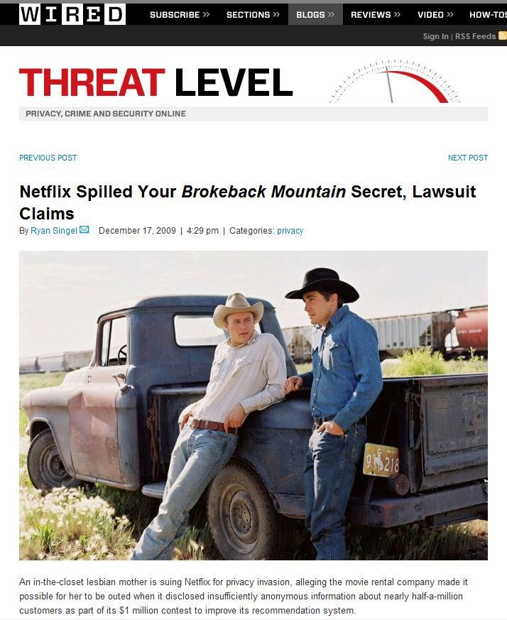
Example: Netflix Challenge
October 2, 2006: Netflix announces contest
  Predict people’s ratings for a $1 million dollar prize
  100 million ratings, 480k users, 17k movies
  Very careful with anonymity post-AOL
May 18, 2008: Data de-anonymized
  Paper published by Narayanan & Shmatikov
  Uses background knowledge from IMDB
  Robust to perturbations in data
December 17, 2009: Doe v. Netflix
March 12, 2010: Netflix cancels second competition
  Ratings
  1: [Movie 1 of 17770]
  12, 3, 2006-04-18 [CustomerID, Rating, Date]
  1234, 5 , 2003-07-08 [CustomerID, Rating, Date]
  2468, 1, 2005-11-12 [CustomerID, Rating, Date]
  …
  Movie Titles
  …
  10120, 1982, “Bladerunner”
  17690, 2007, “The Queen”
  …
    All customer identifying information has been removed; all that remains are ratings and dates. This follows our privacy policy. . . Even if, for example, you knew all your own ratings and their dates you probably couldn’t identify them reliably in the data because only a small sample was included (less than one tenth of our complete dataset) and that data was subject to perturbation.
Notes:
We still want to share our logs!
Even aware of this we keep trying.
Post-AOL people still trying to release logs
Netflix starts a contest.
Very, very careful – small sample, perturbed. Claim you wouldn’t be able to recognize your own data in the logs
Linking is the key.
Cancelled second contest, under a lawsuit.
Create logs for a common good.
Put out a search engine, ask everyone to use it
Done for six to nine months, maybe a year
Cancelled bc net result was five seconds of Google search traffic
Don’t get the data to see long tail, interesting stuff.
Challenge to the research community – how do we do it?

Slide 42
Examples of Diff-IE in Action

Slide 43
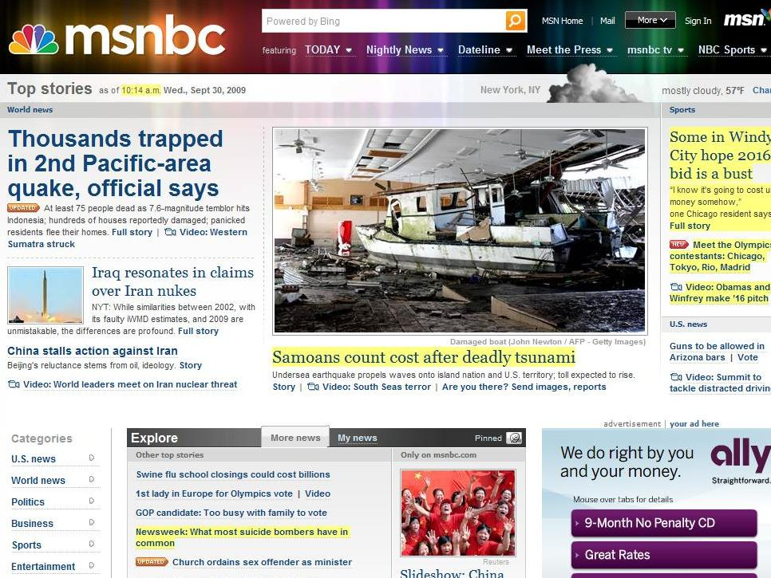
Expected New Content
Notes:
Old headline: Tsunami kills scores in Samoan islands – rest of article the same.

Slide 44
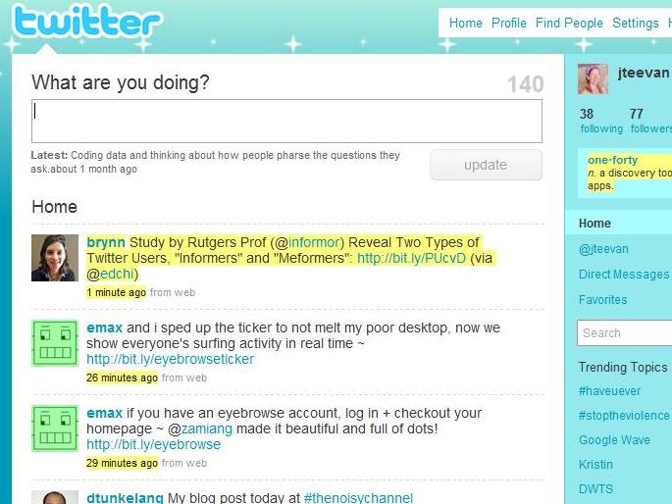
Monitor

Slide 45
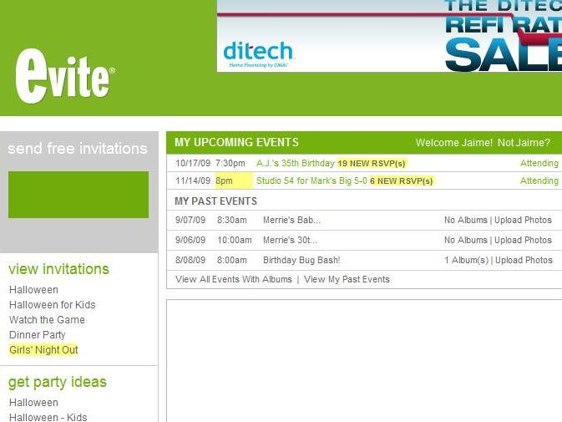
Unexpected Important Content

Slide 46
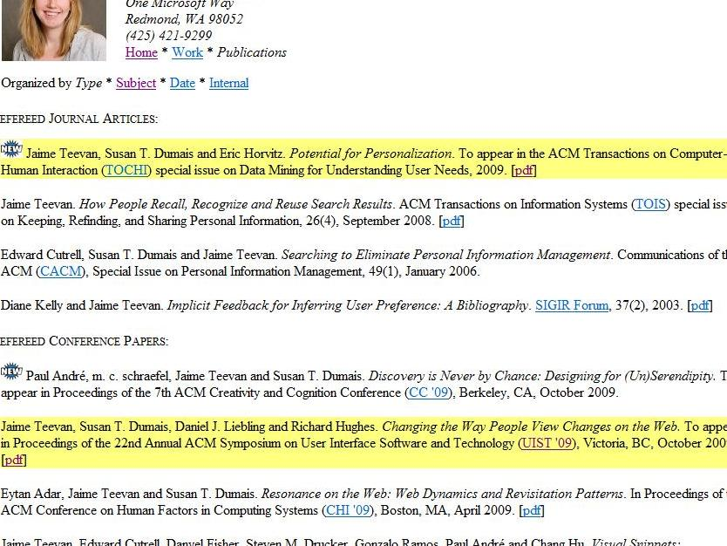
Serendipitous Encounters

Slide 47
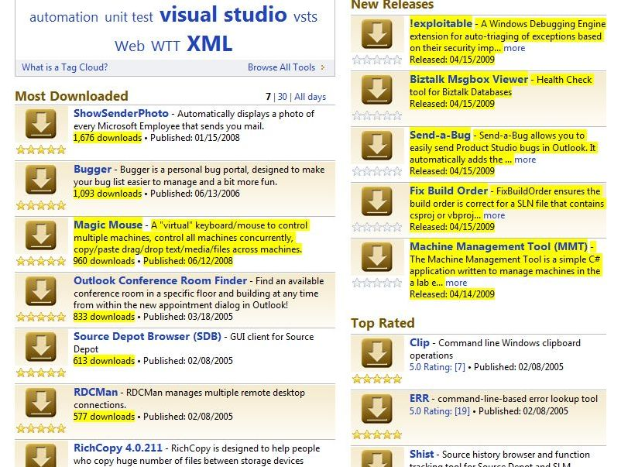
Unexpected Unimportant Content

Slide 48
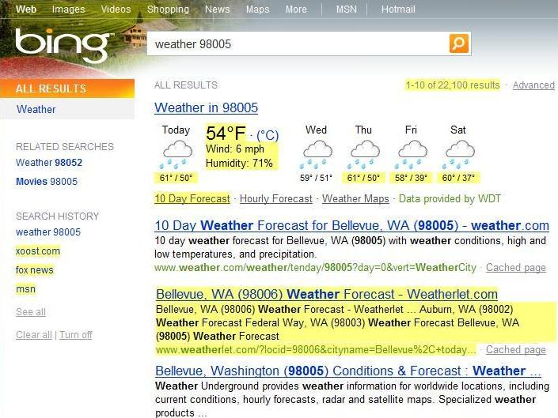
Understand Page Dynamics

Slide 49
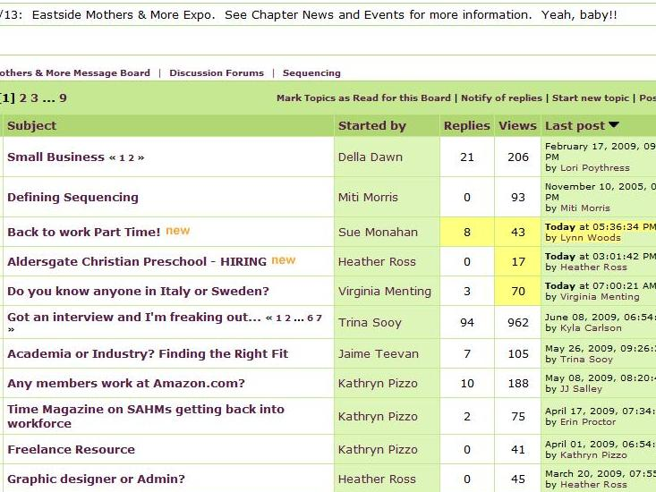
Attend to Activity

Slide 50

Edit

Slide 51

Expected
Unexpected
Unexpected Important Content
Expected New Content
Edit
Attend to Activity
Understand Page Dynamics
Monitor
Serendipitous Encounter
Unexpected Unimportant Content
Notes:
Observed examples of expected use
But also observed many unexpected examples
Unexpected examples often involve using Web content in new ways
Sometimes the expected scenarios aren’t the most useful because sites are already designed around supporting them.

Slide 52

Monitor
Notes:
Monitoring can be problematic on sites designed around monitoring, because the highlighting is distracting.

Slide 53

Find Expected New Content
Notes:
While Diff-IE helps find new content, if a page is too dynamic it can be overwhelming.
We deal with this by not highlighting instances where there’s been too much change, but there might be a better approach.

Slide 54


Example: Click Entropy
Question: How ambiguous is a query?
Approach: Look at variation in clicks
Click entropy
  Low if no variation
    human computer interaction
  High if lots of variation
    hci
Recruiting
Academic field
Government
contractor

Slide 55
Find the Lower Click Variation
www.usajobs.gov v. federal government jobs
find phone number v. msn live search
singapore pools v. singaporepools.com
Results change
Click entropy = 1.5
Click entropy = 2.0
Result entropy = 5.7
Result entropy = 10.7

Slide 56
Find the Lower Click Variation
www.usajobs.gov v. federal government jobs
find phone number v. msn live search
singapore pools v. singaporepools.com
tiffany v. tiffany’s
nytimes v. connecticut newspapers
Results change
Result quality varies
Click entropy = 2.5
Click entropy = 1.0
Click position = 2.6
Click position = 1.6

Slide 57
Find the Lower Click Variation
www.usajobs.gov v. federal government jobs
find phone number v. msn live search
singapore pools v. singaporepools.com
tiffany v. tiffany’s
nytimes v. connecticut newspapers
campbells soup recipes v. vegetable soup recipe
soccer rules v. hockey equipment
Results change
Result quality varies
Task affects # of clicks
Click entropy = 1.7
Click entropy = 2.2
Clicks/user = 1.1
Clicks/user = 2.1

