Slide 1
Information Re-Retrieval Repeat Queries in Yahoo’s Logs
Jaime Teevan (MSR), Eytan Adar (UW), Rosie Jones and Mike Potts (Yahoo)
Presented by Hugo Zaragoza

Slide 2
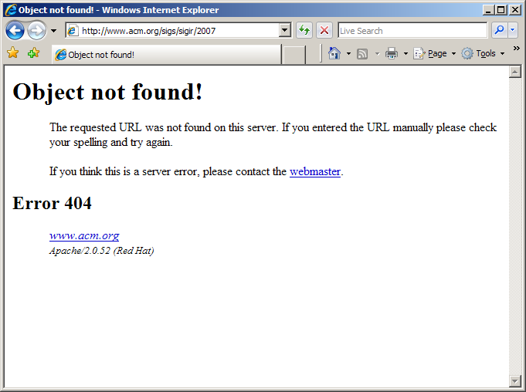
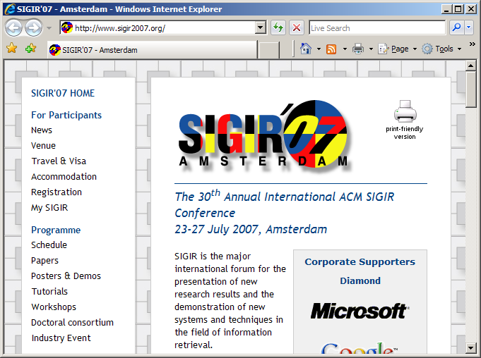
What’s the URL for this year’s SIGIR?
http://www.sigir07.org
http://www.sigir2007.com
http://www.acm.org/sigir/2007
http://2007.sigir.org
http://www.sigir2007.org
http://www.acm.com/sigir/07
http://sigir.acm.org/07
Notes:
Start the talk with a quick quiz: What’s the URL for this year’s SIGIR?
Here’s a list of good plausible candidates
For example, http://www.acm.org/sigir/2007 seems reasonable – but it leads to a 404
The correct answer is http://www.sigir2007.org

Slide 3
Doesn’t really matter…
Call for papers (Dec. ‘06)
Submission instructions (Jan ’07)
Response date? (Apr. ’07)
Formatting guidelines (May ’07)
Proceedings (Jun ’07)
Travel plans/registration (Jul ’07)
Notes:
For many of us, it doesn’t really matter what the URL is, because the way we get to it
Is to just go to our favorite search box and run a search.
(Perhaps poll: How many people here get to the SIGIR 2007 page via a query?)
It’s the way I get to it over and over again.
It’s how I found it back in December 2006 when I was looking for the CFP.
And in January when I needed submission instructions.
….
Up until just recently as I planned my travel to Amsterdam.
Whether or not we’ve done this specifically for the conference page, this kind of re-finding is something we’ve all done and that we know is very prevalent.

Slide 4
Overview
Log analysis to:
Quantify amount of re-finding behavior
Understand types of re-finding
Re-finding is very common
Stability of results affects re-finding
Possible to identify re-finding behavior
Notes:
We conducted a study to try to understand better how people use search engines to re-find.
Is it all just navigational behavior, or is the behavior richer?
Using log analysis we looked at
Quantifying the amount of re-finding behavior, and
Understanding the types of re-finding.
We found that however we define re-finding, it is very common.
The stability of results affects people’s ability to re-find.
We look at ways to identify re-finding behavior so we can provide the necessary stability.

Slide 5
What Is Known About Re-Finding
Re-finding recent topic of interest
Web re-visitation common [Tauscher & Greenberg]
People follow known paths for re-finding
Search engines likely to be used for re-finding
Query log analysis of re-finding
Query sessions [Jones & Fain]
Temporal aspects [Sanderson & Dumais]
Notes:
Re-finding is a recent topic of interest
This may be partly because Web re-visitation is very common
A number of Web site usage studies have found that up to 81% of all Web pages are re-visits.
Many of these re-visits happen immediately – e.g., with a back button
But there’s a heavy tail and many happen after long periods of time
One consistent finding that’s arisen from a number of laboratory and observational studies of re-finding is that people like to follow known paths to return to information.
This suggests search engines – which are commonly used to find information – are very likely to be used for re-finding.
For example, if you found the SIGIR Web page via a search for SIGIR 2007 before, you’re likely to do it again.
Given this, it is surprising that there hasn’t been more research in query log analysis of long term re-finding patterns in query logs.
There has been work looking at sessions – looking, for example, at how people modify their queries over time – but not at behavior by the same user over long periods of time
Mark Sanderson and Susan Dumais extended some of the work we’ve done exploring re-finding in a paper at ECIR, focusing on the temporal aspects of repeat searches, and we build on that work here to further characterize repeat searches over long periods of time.

Slide 6
Study Methodology
Looked for re-finding in Yahoo’s query logs
114 anonymous users
Tracked for a year (average activity: 97 days)
Users identified via cookie
13,060 queries and their clicks
Log studies rich but lack intention
Infer intention
Supplement with large user study (119 users)
Notes:
We looked at re-finding in Yahoo’s query logs
Go over details of study methodology
Perhaps throw in a sentence or two about how privacy preserving the research was
Users identified via a cookie
May think multiple people using the same computer are the same
May miss some of an individual’s behavior (other computers, also other SEs)
13060 queries collected in total – or about 150/person
Log studies are rich but lack intentionality. We know what people did but not why.
Must infer intention.
We also supplemented our log analysis with a relatively large scale (119 people) user study

Slide 7
Inferring Re-Finding Intent
Really hard problem
No one to ask: what were you doing?
But… we can make some inferences
Click on previously clicked results?
Click on different results?
Same query issued before?
Hypothesize
re-finding Intent
New query?
Notes:
Hard to infer intention
We have to approximate it based on behavior we observe in the logs.
We look at what people click on
And what queries they issue
And hypothesize re-finding intent for those queries where people click on the same results
(Perhaps give an example here.)

Slide 8
Click on previously clicked results?
Click on different results?
Same query issued before?
Click on previously clicked results?
Click on different results?
Same query issued before?
New query?
Hypothesize
re-finding Intent
New query?
Notes:
Diving into this table a little further.

Slide 9
Click on previously clicked results?
Click same and different?
Click on different results?
Same query issued before?
New query?
Notes:
We see there is actually also an area where people click on the same results and different results. Perhaps here they’re doing some re-finding and some new-finding.

Slide 10
Click on previously clicked results?
Click same and different?
Click on different results?
1 click > 1 click
Same query issued before?
New query?
Notes:
We can also further divide the instances where the same results are clicked to where only one result is clicked at all and where more than one result is clicked.

Slide 11
Click on previously clicked results?
39%
Click same and different?
Click on different results?
1 click > 1 click
3100 (24%) | 36 (<1%) | 635 (5%) | 485 (4%)
637 (5%) | 4 (<1%) | 660 (5%) | 7503 (57%)
Navigational
Same query issued before?
Re-finding with different query
New query?
Notes:
Filling the table out, these are the numbers we get.
Most queries are new queries with new results that are clicked.
However, it’s interesting to note that a lot – 39% -- of the queries have what could be re-finding behavior.
The queries in the upper left-hand corner are most likely navigational queries.
Similar to the SIGIR 2007 example in the beginning.
But there’s also a lot of additional rich re-finding behavior beyond merely navigational queries. About 2/3 navigational, the rest are not.
There are a number of queries where the query is not one that has been observed before, but repeat results are clicked.
Let’s look at that a little further.

Slide 12
How Queries Change
Many ways queries can change
Capitalization (“new york” and “New York”)
Word swap (“britney spears” and “spears britney”)
Word merge (“walmart” and “wal mart”)
Word removal (“orange county venues” and “orange county music venues”)
17 types of change identified
2049 combinations explored
Log data and supplemental study
Most normalizations require only one type of change
Notes:
There are many ways queries can change.
Give examples.
We identified 17 different ways queries can change,
And explored all 2049 combinations, both in the log data and in a supplemental study we ran to understand how queries change over time.
In this user study, we asked people to run a self-selected query, and then later asked them to recall that query. This gives us an idea of how queries change when we know they are intended to re-locate a piece of information.
Listed here are the most common ways we observed queries to change.
Most of the time queries only changed along one dimension, but there were also more complex changes.

Slide 13
Rank Change Reduces Re-Finding
Results change rank
Change reduces probability of repeat click
No rank change: 88% chance
Rank change: 53% chance
Why?
Gone?
Not seen?
New results are better?
Notes:
Like queries, result lists can change.
They may change because the query is different, but it’s also common for result lists to change over time – even when the query remains exactly the same.
In our data set, 26% of repeat searches, the clicked result occurred at a different rank.
We looked at duplicate queries where the result list changed
And compared the re-finding behavior for those queries with
duplicate queries where the result list did NOT change
Change reduces the prob. of a repeat click.
Number of reasons why this may be.

Slide 14
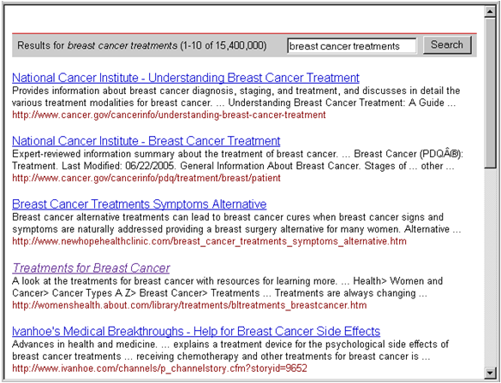
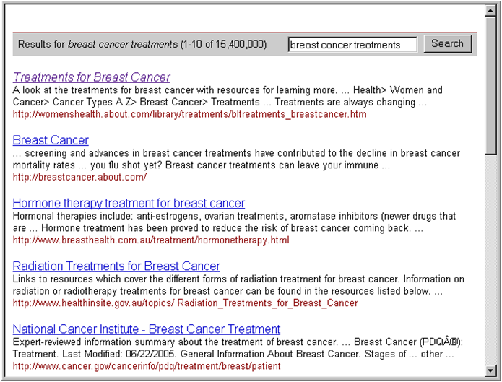
Gone? Not Seen? Better?
Notes:
Those reasons are shown here graphically.
To control for this variation, we looked only at results that were clicked both during the initial search and the following search – here we know the user was re-finding, and we want to know how easy it was to click on that result.

Slide 15
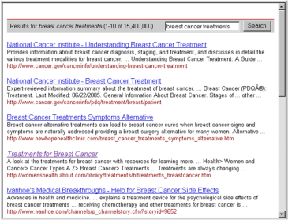
Change Slows Re-Finding
Look at time to click as proxy for Ease
Rank change → slower repeat click
Compared with initial search to click
No rank change: Re-click is faster
Rank change: Re-click is slower
Changes interferes and stability helps
→
?
Notes:
We found when rank changes, people are slower to click.
94 seconds to re-click v. 192 seconds to re-click
Change interferes with re-finding.
Conversely, stability helps support the re-finding of information.
This finding echoes results from HCI highlighting the importance of stability.
E.g., dynamic menus: Bubbling commonly used menu items to be listed at the top of a menu slows down menu item access – because people remember where it was in the list.

Slide 16
Helping People Re-Find
Potential way to take advantage of stability
Automatically determine if the task is re-finding
Keep results consistent with expectation
Simple form of personalization
Can we automatically predict if a query is intended for re-finding?
Notes:
We can take advantage of the value of stability for re-finding if we can automatically determine if a task is a re-finding task. (Search engines obviously don’t know what result will be clicked when a query is issued, and thus can’t classify queries the same way we do in our analysis.) In these cases, we can keep results consistent with expectation. Doing this is really a simple form of personalization.
Requires automatically predicting if a query is intended for re-finding.

Slide 17
Predicting the Query Target
For simple navigational queries, predict what URL will be clicked
For complex repeat queries, two binary classification tasks:
Will a new (never visited) result be clicked?
Will an old (previously visited) result be clicked?
Notes:
We looked at predicting the query target.
For navigational queries, we predicted what URL would be clicked.
For more complex repeat queries, we looked at two binary classification tasks:
Will a new (never visited) result be clicked?
Will an old (previously visited) result be clicked?

Slide 18
Predicting Navigational Queries
Predict navigational query clicks using
Query issued twice before
Queries with the same one result clicked
Very effective prediction
96% accuracy: Predict one of the results clicked
95% accuracy: Predict first result clicked
94% accuracy: Predict only result clicked

Slide 19
Predicting More Complex Queries
Trained an SVM to identify
If a new result will be clicked
If an old result will be clicked
Effective features:
Number of previous searches for the same thing
Whether any or the results were clicked >1 time
Number of clicks each time the query was issued
Accuracy around 80% for both prediction tasks
Notes:
Baseline: 61% not click on something new, 74% repeat click

Slide 20
Future Work
Experiment with different history mechanisms
Given knowledge about re-finding intent, how do we best modify result pages?
How to integrate new, better results?
Contextual re-finding
Re-finding varies by user
Re-finding varies by time of day
Notes:
Future work: How to use knowledge about re-finding intent to improve user search experience?
How to integrate new and possibly better results into a result list when stability is so important?
It also appears that there are a number of factors that affect re-finding. Can we take advantage of context?

Slide 21
Summary
Log analysis supplemented by a user study
Re-finding is very common
Navigational queries are particularly common
Categorized potential re-finding behavior
Explored ways query strings are modified
Stability of result rank impacts re-finding tasks
Provided a first step in the solution by automatically classifying repeat queries to identify re-finding

Slide 22
Thank you! Questions?
Jaime Teevan (MSR), Eytan Adar (UW), Rosie Jones and Mike Potts (Yahoo)
Presented by Hugo Zaragoza

