Slide 1
Understanding Query Ambiguity
Jaime Teevan, Susan Dumais, Dan Liebling
Microsoft Research

Slide 2
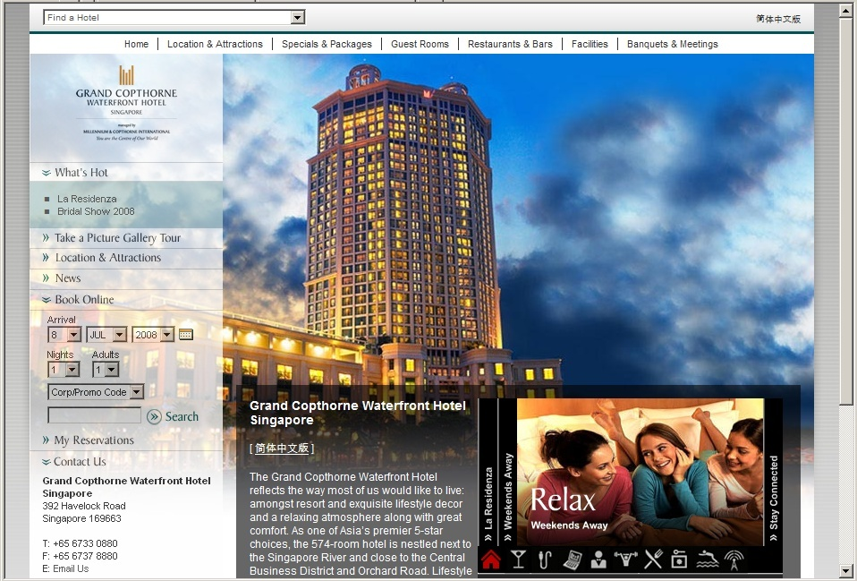
“grand copthorne waterfront”
Notes:
Probably everyone is thinking of the hotel’s web site when they issue this query.

Slide 3
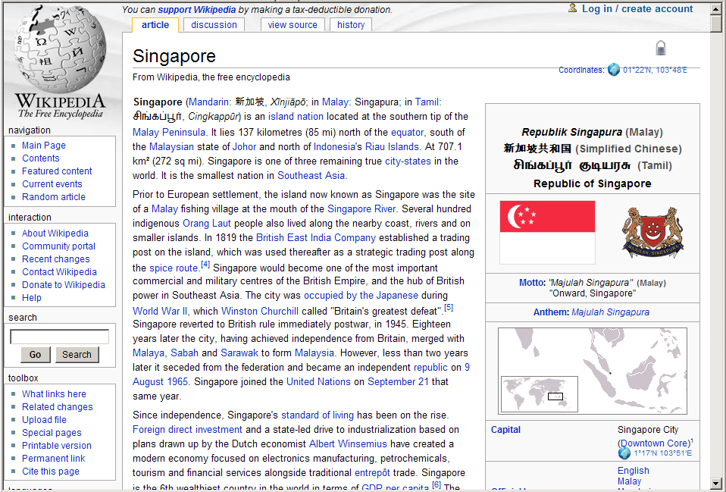

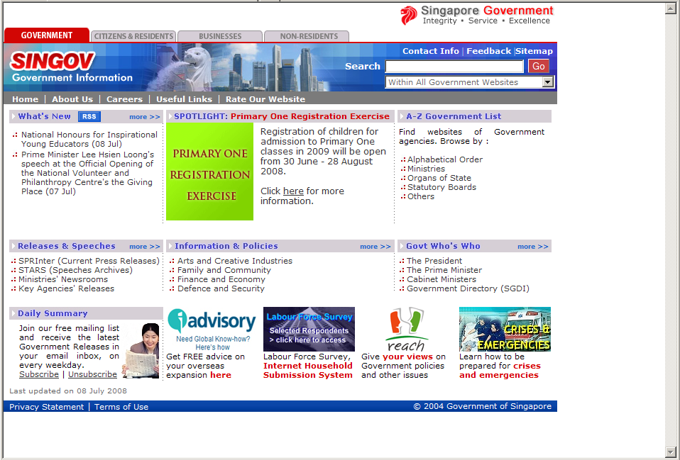
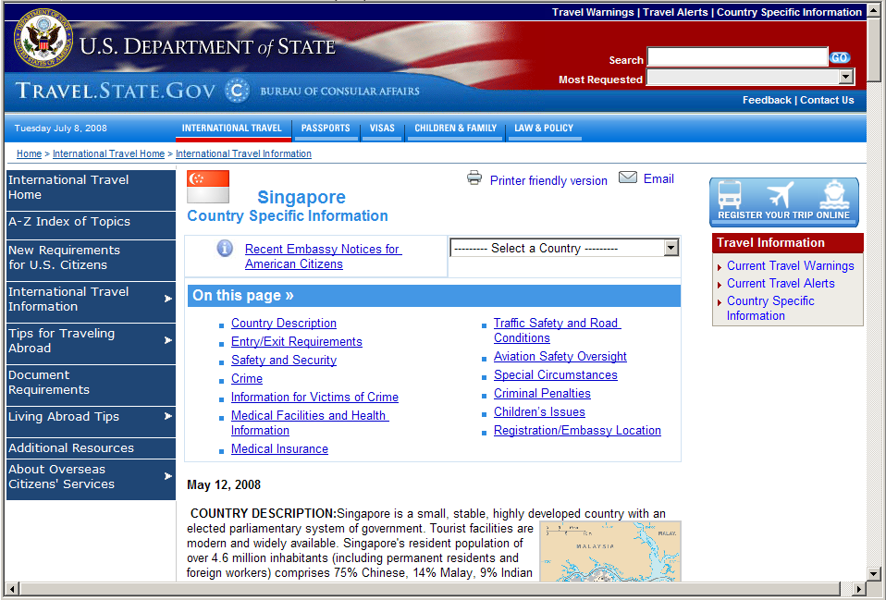


“singapore”
Notes:
For Singapore people have broader needs:
A travel related site?
An informational site?
A government site?
Or perhaps a site from your home government re: Singapore?
Or something else?

Slide 4
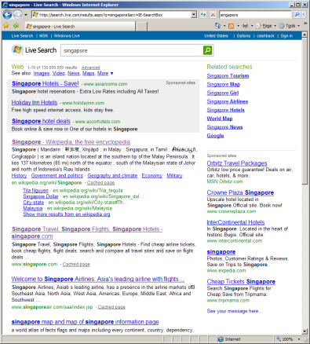
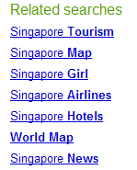
How Do the Two Queries Differ?
grand copthorne waterfront v. singapore
Knowing query ambiguity allow us to:
  Personalize or diversify when appropriate
  Suggest more specific queries
  Help people understand diverse result sets
Notes:
What’s the difference between the two queries?
The first is issued by people with the same intent.
The second is issued by people with many different intents.
We’d like to know the intent because then we can do a lot of things.

Slide 5
Understanding Ambiguity
Look at measures of query ambiguity
  Explicit
  Implicit
Explore challenges with the measures
  Do implicit predict explicit?
  Other factors that impact observed variation?
Build a model to predict ambiguity
  Using just the query string, or also the result set
  Using query history, or not

Slide 6
Related Work
Predicting how a query will perform
  Clarity [Cronen-Townsend et al. 2002]
  Jensen-Shannon divergence [Carmel et al. 2006]
  Weighted information gain [Zhou & Croft 2007]
  Performance for individual versus aggregate
Exploring query ambiguity
  Many factors affect relevance [Fidel & Crandall 1997]
  Click entropy [Dou et al. 2007]
  Explicit and implicit data, build predictive models

Slide 7
Measuring Ambiguity
Inter-rater reliability (Fleiss’ kappa)
  Observed agreement (P_{a}) exceeds expected (P_{e})
  κ = (P_{a}-P_{e}) / (1-P_{e})
Relevance entropy
  Variability in probability result is relevant (P_{r})
  S = -Σ P_{r} log P_{r}
Potential for personalization
  Ideal group ranking differs from ideal personal
  P4P = 1 - nDCG_{group}
Notes:
Focus in this talk on entropy.
Highlight that when entropy is high, a lot of different things were found relevant (e.g., “singapore”),
and when entropy is low, only a few things were (e.g., “grand copthorne waterfront”).

Slide 8
Collecting Explicit Relevance Data
Variation in explicit relevance judgments
  Highly relevant, relevant, or irrelevant
  Personal relevance (versus generic relevance)
12 unique queries, 128 users
  Challenge: Need different people, same query
  Solution: Given query list, choose most interesting
292 query result sets evaluated
  4 to 81 evaluators per query

Slide 9
Collecting Implicit Relevance Data
Variation in clicks
  Proxy (click = relevant, not clicked = irrelevant)
  Other implicit measures possible
  Disadvantage: Can mean lots of things, biased
  Advantage: Real tasks, real situations, lots of data
44k unique queries issued by 1.5M users
  Minimum 10 users/query
2.5 million result sets “evaluated”

Slide 10
How Good are Implicit Measures?
Explicit data is expensive
Implicit good substitute?
Compared queries with
  Explicit judgments and
  Implicit judgments
Significantly correlated:
  Correlation coefficient = 0.77 (p<.01)

Slide 11
Which Has Lower Click Entropy?
www.usajobs.gov v. federal government jobs
find phone number v. msn live search
singapore pools v. singaporepools.com
Results change
Click entropy = 1.5
Click entropy = 2.0
Result entropy = 5.7
Result entropy = 10.7
Notes:
Correlation of click entropy and result entropy: 0.53
Query Click Ent. Result Ent. Clicks/User Click Position
singaporepools.com 1.97489 10.65681 1.130435 1.965517
singapore pools 1.515033 5.668388 1.195122 1.69863
nytimes 2.46967 3.845487 1 2.615385
connecticut newspapers 0.978016 3.368705 1.1 1.588235
hockey equipment 2.198278 0.936667 2.181818 2.433333
soccer rules 1.66918 1.529389 1.1 3.230769
www.usajobs.gov 0.756619 1.986004 1.068966 1.407407
federal government jobs 1.817741 0.845351 1.227273 1.925926
msn live search 1.186278 1.288438 1 1.6875
find phone number 1.713079 0.684038 1.4 1.882353
tiffany's 0.413817 0 1 1.083333
tiffany 2.131177 2.240085 1.055556 1.904762
campbells soup recipes 0.371232 0.391244 1 1.142857
vegetable soup recipe 0.921928 0.721928 1 1.3

Slide 12
Which Has Lower Click Entropy?
www.usajobs.gov v. federal government jobs
find phone number v. msn live search
singapore pools v. singaporepools.com
tiffany v. tiffany’s
nytimes v. connecticut newspapers
Results change
Result quality varies
Click entropy = 2.5
Click entropy = 1.0
Click position = 2.6
Click position = 1.6
Notes:
Correlation of click entropy and click position: 0.73

Slide 13
Which Has Lower Click Entropy?
www.usajobs.gov v. federal government jobs
find phone number v. msn live search
singapore pools v. singaporepools.com
tiffany v. tiffany’s
nytimes v. connecticut newspapers
campbells soup recipes v. vegetable soup recipe
soccer rules v. hockey equipment
Results change
Result quality varies
Task affects # of clicks
Click entropy = 1.7
Click entropy = 2.2
Click /user = 1.1
Clicks/user = 2.1
Notes:
Correlation of click entropy and clicks/user: 0.73

Slide 14
Challenges with Using Click Data
Results change at different rates
Result quality varies
Task affects the number of clicks
We don’t know click data for unseen queries
Can we predict query ambiguity?

Slide 15
Predicting Ambiguity
Information | Query | Query length Contains URL Contains advanced operator Time of day issued Number of results (df) Number of query suggests
 | Results | Query clarity ODP category entropy Number of ODP categories Portion of non-HTML results Portion of results from .com/.edu Number of distinct domains

Slide 16
Predicting Ambiguity
 |  | History
 |  | No | Yes
Information | Query | Query length Contains URL Contains advanced operator Time of day issued Number of results (df) Number of query suggests | Reformulation probability # of times query issued # of users who issued query Avg. time of day issued Avg. number of results Avg. number of query suggests
 | Results | Query clarity ODP category entropy Number of ODP categories Portion of non-HTML results Portion of results from .com/.edu Number of distinct domains | Result entropy Avg. click position Avg. seconds to click Avg. clicks per user Click entropy Potential for personalization

Slide 17
Prediction Quality
 |  | History
 |  | No | Yes
Information | Query
 | Results
All features = good prediction
  81% accuracy (↑ 220%)
Just query features promising
  40% accuracy (↑ 57%)
No boost adding result or history
URL
Very Low
Ads
High
Length
Low
Medium
Yes
3+
No
=1
<3
2+
Notes:
All features: 0.254 0.813 (220% accuracy)
Just query: 0.254 0.399 (57% improvement)
Also controlled for Result Entropy.

Slide 18
Summarizing Ambiguity
Looked at measures of query ambiguity
  Implicit measures approximate explicit
  Confounds: result entropy, result quality, task
Built a model to predict ambiguity
These results can help search engines
  Personalize when appropriate
  Suggest more specific queries
  Help people understand diverse result sets
Looking forward: What about the individual?

Slide 19
Thank you
Questions?

