Slide 1
Multi-Click Search Behavior
Chia-Jung Lee¹, Jaime Teevan², and Sebastian de la Chica²
¹ University of Massachusetts, ² Microsoft
Notes:
Introduce CJ, describe her work.
Related to thesis research:
How people recall, recognize, re-use: http://people.csail.mit.edu/teevan/work/publications/papers/tois08.pdf
The Re:Search Engine: http://www.csail.mit.edu/~teevan/work/publications/papers/uist07.pdf
Thesis: http://www.csail.mit.edu/~teevan/work/publications/theses/phd/thesis.pdf

Slide 2
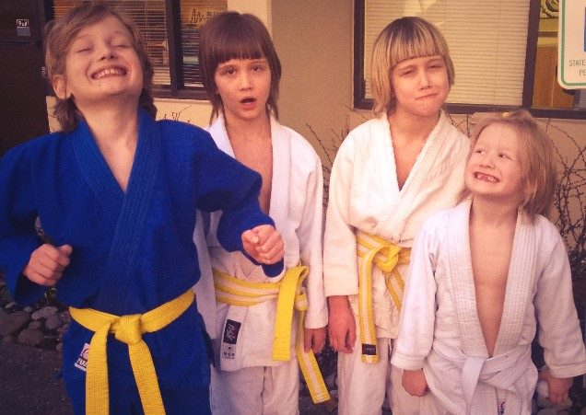
teevan children
Jaime Teevan, Ph.D.
research.microsoft.com/en-us/um/people/teevan/publications
Jaime Teevan, Ph.D. Researcher studying information retrieval and human computer interaction at Microsoft Research.
Jaime Teevan (Microsoft Research)
research.microsoft.com/en-us/um/people/teevan
Jaime Teevan, Ph.D. Researcher studying information retrieval and human computer interaction at Microsoft Research.
Teevan.com | Restoration, Preservation, Remodeling …
www.teevan.com
Voted San Francisco’s favorite small business. Call us at 415-474-TVAN. Building Restoration, Preservation, Friends and Community.
Jaime Teevan – Wikipedia, the free encyclopedia
en.wikipedia.org/wiki/Jaime_Teevan
Jaime Teevan is a researcher at Microsoft Research and an affiliate professor at the University of Washington. She was named a Technology Review (TR35) 2009 Young ...
Inside Microsoft Research – Home – TechNet Blog
blogs.technet.com/b/inside_microsoft_research/rss.aspx
Jaime Teevan, it seems, can do it all. Since joining Microsoft Research in 2006, ... Researcher Teevan Wins Borg Early Career Award. Posted by Rob Knies.
Notes:
Start with an example.
You may have noticed I brought one of my children with me to the Gold Coast.
Let’s say you’re interested in learning more about him.
And run a query for “teevan children”.
Look at the results.
The first few are my professional pages, and seem unlikely to have relevant content.
There’s one about another Teevan entirely, also irrelevant.
But perhaps my Wikipedia page has something.
Try clicking on that.

Slide 3
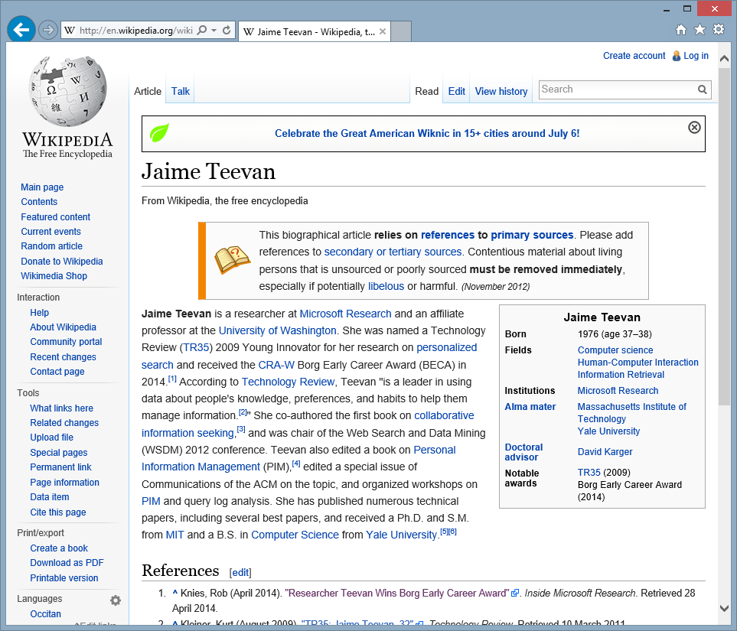
Notes:
But, no, in the grand tradition of most academic Wikipedia pages,
The page is primarily content-free, and pretty much just has a variant of my standard bio.
So click the back button and return to the search result page.

Slide 4
teevan children
Jaime Teevan, Ph.D.
research.microsoft.com/en-us/um/people/teevan/publications
Jaime Teevan, Ph.D. Researcher studying information retrieval and human computer interaction at Microsoft Research.
59%
For kids, by a kid – Bellevue Reporter
www.bellevuereporter.com/community/207896681.html
Griffin's mother, Jaime Teevan, said she first learned about Griffin's book when he was three months in to writing it. At the time, Griffin's teacher, ...
Jaime Teevan – Wikipedia, the free encyclopedia
en.wikipedia.org/wiki/Jaime_Teevan
Jaime Teevan is a researcher at Microsoft Research and an affiliate professor at the University of Washington. She was named a Technology Review (TR35) 2009 Young ...
Slow Searching: Attending a Conference with a Baby
slowsearching.blogspot.com/.../attending-conference...with-baby.html
May 03, 2013 · Below are some things that I found made attending a conference alone with a baby a little easier for me. ... Jaime Teevan Pacific Northwest, …
Inside Microsoft Research – Home – TechNet Blog
blogs.technet.com/b/inside_microsoft_research/rss.aspx
Jaime Teevan, it seems, can do it all. Since joining Microsoft Research in 2006, ... Researcher Teevan Wins Borg Early Career Award. Posted by Rob Knies.
Notes:
If you do this, you’re actually like most searchers who click on a search result.
Most queries (59%) with clicks have more than one click.
This has been true for years, and the percentage even appears to be growing.
We know people click more than one search result,
and we have attempted to build models of multi-click behavior.
But the truth is, we don’t really know a lot about the behavior.
The goal of this work is to characterize how a person interacts with the search result page after the first click.
In this case, for example, we might try this next result after the Wikipedia article.

Slide 5
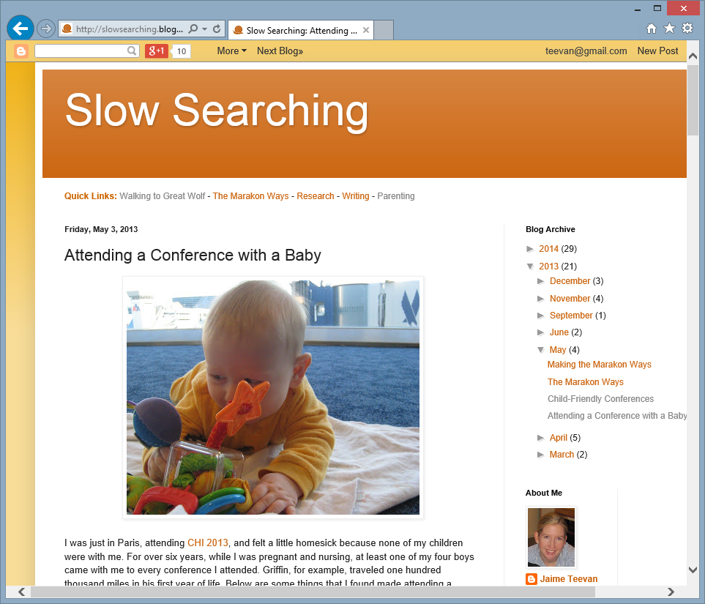
Notes:
And it points to my blog about conference travel with my children,
Which is very relevant to Dillon being here at SIGIR with me.

Slide 6
teevan children
Jaime Teevan, Ph.D.
research.microsoft.com/en-us/um/people/teevan/publications
Jaime Teevan, Ph.D. Researcher studying information retrieval and human computer interaction at Microsoft Research.
For kids, by a kid – Bellevue Reporter
www.bellevuereporter.com/community/207896681.html
Griffin's mother, Jaime Teevan, said she first learned about Griffin's book when he was three months in to writing it. At the time, Griffin's teacher, ...
Build a Picture of
Multi-Click Behavior
Jaime Teevan – Wikipedia, the free encyclopedia
en.wikipedia.org/wiki/Jaime_Teevan
Jaime Teevan is a researcher at Microsoft Research and an affiliate professor at the University of Washington. She was named a Technology Review (TR35) 2009 Young ...
Slow Searching: Attending a Conference with a Baby
slowsearching.blogspot.com/.../attending-conference...with-baby.html
May 03, 2013 · Below are some things that I found made attending a conference alone with a baby a little easier for me. ... Jaime Teevan Pacific Northwest, …
Inside Microsoft Research – Home – TechNet Blog
blogs.technet.com/b/inside_microsoft_research/rss.aspx
Jaime Teevan, it seems, can do it all. Since joining Microsoft Research in 2006, ... Researcher Teevan Wins Borg Early Career Award. Posted by Rob Knies.
Notes:
Know a lot about the search after the first click:
What they click
What position it is
How long it takes to make the click
How long the person stays on the result page
Want to see how this first click behavior correlates with what the user does next.
Enables us to build a better model of search behavior,
for estimating relevance, evaluating algorithms, ranking results, etc.

Slide 7
teevan children
teevan children
Jaime Teevan, Ph.D.
research.microsoft.com/en-us/um/people/teevan/publications
Jaime Teevan, Ph.D. Researcher studying information retrieval and human computer interaction at Microsoft Research.
Jaime Teevan, Ph.D.
research.microsoft.com/en-us/um/people/teevan/publications
Jaime Teevan, Ph.D. Researcher studying information retrieval and human computer interaction at Microsoft Research.
Jaime Teevan (Microsoft Research)
research.microsoft.com/en-us/um/people/teevan
Jaime Teevan, Ph.D. Researcher studying information retrieval and human computer interaction at Microsoft Research.
For kids, by a kid – Bellevue Reporter
www.bellevuereporter.com/community/207896681.html
Griffin's mother, Jaime Teevan, said she first learned about Griffin's book when he was three months in to writing it. At the time, Griffin's teacher, ...
Teevan.com | Restoration, Preservation, Remodeling …
www.teevan.com
Voted San Francisco’s favorite small business. Call us at 415-474-TVAN. Building Restoration, Preservation, Friends and Community.
Jaime Teevan – Wikipedia, the free encyclopedia
en.wikipedia.org/wiki/Jaime_Teevan
Jaime Teevan is a researcher at Microsoft Research and an affiliate professor at the University of Washington. She was named a Technology Review (TR35) 2009 Young ...
Jaime Teevan – Wikipedia, the free encyclopedia
en.wikipedia.org/wiki/Jaime_Teevan
Jaime Teevan is a researcher at Microsoft Research and an affiliate professor at the University of Washington. She was named a Technology Review (TR35) 2009 Young ...
Slow Searching: Attending a Conference with a Baby
slowsearching.blogspot.com/.../attending-conference...with-baby.html
May 03, 2013 · Below are some things that I found made attending a conference alone with a baby a little easier for me. ... Jaime Teevan Pacific Northwest, …
Inside Microsoft Research – Home – TechNet Blog
blogs.technet.com/b/inside_microsoft_research/rss.aspx
Jaime Teevan, it seems, can do it all. Since joining Microsoft Research in 2006, ... Researcher Teevan Wins Borg Early Career Award. Posted by Rob Knies.
Inside Microsoft Research – Home – TechNet Blog
blogs.technet.com/b/inside_microsoft_research/rss.aspx
Jaime Teevan, it seems, can do it all. Since joining Microsoft Research in 2006, ... Researcher Teevan Wins Borg Early Career Award. Posted by Rob Knies.
Notes:
At the same time we are learning about the user’s search experience between the first and second click,
We also have the opportunity to present new results to the user when they return to the search result.
Poll: How many people noticed that the search results changed?
Only two search results are actually exactly the same.
The result we clicked on moved up,
A few results disappeared,
And two new results appeared (including the one we clicked second).
Changes like this happens all of the time.
Some changes can be due to system failures.
Some changes can be intentional: new content found, contextualization, more content because we know you are diving deep.
For example: Bing starts with eight results initially and adds four results after the first click.
While the ability to change results presents an interesting opportunity, we need to be careful.
We know from research into human-computer interaction that change can cause problems.
Example: Dynamic menus
If we can build a picture of when change is beneficial and when it is harmful,
We can take advantage of the opportunity to present new content while minimizing any problems.

Slide 8
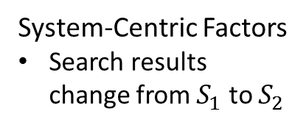
Problem Specification
𝑇 = $<\left(Q, S_{1},C_{S_{1}}\right), \left(δ_{S_{1}→S_{2}}\right)>$
User-Centric Factors
User issues query $Q$
User views results $S_{1}$
User clicks result $C_{S_{1}}$
System-Centric Factors
Search results change from $S_{1}$ to $S_{2}$
Which factors from 𝑇 impact user interaction with 𝑆2 and how? Which lead to the most user satisfaction?
How do changes to the result page (𝛿𝑆1→𝑆2) impact users? Do changes improve or degrade user experience?

Slide 9
Dataset
Two months of log data from Bing
Identify queries with a click and a return
Filtered for bots, spam, outliers
Adult and navigational queries removed
Know results shown before and after click
Queries | 8,863,684
Clicks | 17,154,920
Users | 1,658,931

Slide 10
Problem Specification
𝑇 = $<\left(Q, S_{1},C_{S_{1}}\right), \left(δ_{S_{1}→S_{2}}\right)>$
User-Centric Factors
User issues query $Q$
User views results $S_{1}$
User clicks result $C_{S_{1}}$
Which factors from 𝑇 impact user interaction with 𝑆2 and how? Which lead to the most user satisfaction?
How do changes to the result page (𝛿𝑆1→𝑆2) impact users? Do changes improve or degrade user experience?

Slide 11
Measures of Search Success
Number of clicks
$p(Abandon)=\frac{\#(\{queries, abandon\})}{\#(\left\{queries\right\}) }$
Satisfaction with click
$R_{SAT}=\frac{\#(\{queries,{ Return}_{SAT}\})}{\#(\{queries, {Return}_{NSAT}\})}$
Click position
Position change: Up, Down, Stay
$p\left(C=c\right)=\frac{\#(\{queries, c\}) }{\#(\{queries\})}, c∈C$
Time to click

Slide 12
Summary of Post-Click Behavior
Confirm trend to move down the page
Top results revisited for later clicks
Lower initial clicks mean larger subsequent jumps
Satisfied search behavior different
Slower, less likely to identify new content to visit
More likely to be satisfied when they do
Searchers learn about the search results
Second click faster than the first
Notes:
A user’s interaction with a result page following a click is strongly influenced by features of their initial interaction.

Slide 13
Problem Specification
𝑇 = $<\left(Q, S_{1},C_{S_{1}}\right), \left(δ_{S_{1}→S_{2}}\right)>$
User-Centric Factors
User issues query $Q$
User views results $S_{1}$
User clicks result $C_{S_{1}}$
System-Centric Factors
Search results change from $S_{1}$ to $S_{2}$
Which factors from 𝑇 impact user interaction with 𝑆2 and how? Which lead to the most user satisfaction?
How do changes to the result page (𝛿𝑆1→𝑆2) impact users? Do changes improve or degrade user experience?

Slide 14
Measures of Result Change
Clicked result changes
Move up or down
Stay in the same place
Disappear entirely
Other results change
Above or below
Assume clicked result stays the same
Jaime Teevan – Wikipedia, the free encyclopedia
en.wikipedia.org/wiki/Jaime_Teevan
Jaime Teevan is a researcher at Microsoft Research and an affiliate professor at the University of Washington. She...
Jaime Teevan – Wikipedia, the free encyclopedia
en.wikipedia.org/wiki/Jaime_Teevan
Jaime Teevan is a researcher at Microsoft Research and an affiliate professor at the University of Washington. She...
Jaime Teevan – Wikipedia, the free encyclopedia
en.wikipedia.org/wiki/Jaime_Teevan
Jaime Teevan is a researcher at Microsoft Research and an affiliate professor at the University of Washington. She...
Jaime Teevan – Wikipedia, the free encyclopedia
en.wikipedia.org/wiki/Jaime_Teevan
Jaime Teevan is a researcher at Microsoft Research and an affiliate professor at the University of Washington. She...

Slide 15
Change = Slower Interaction
Every type of change delays second click
Change to click: Up > Down > Gone
Changes around click: Above > Below

Slide 16
Change = More Abandonment
Change to click
Down > Stay > Up > Gone
Changes around click
Changes above increases abandonment
Changes below decreases it
Up | 0.432
Stay | 0.425
Down | 0.375
Gone | 0.492
 | Changes | Static
Above | 0.414 | 0.396
Below | 0.423 | 0.431
Notes:
[Lower number = better]
Why “Down” = less abandonment? Maybe forces people to look at more of the search result list.

Slide 17
Change = Increased Satisfaction
 | NSAT | SAT
Up | 2.00 | 4.65
Stay | 2.08 | 4.78
Down | 2.20 | 4.75
Gone | 2.31 | 4.61
Change to click
Unsatisfied initially
Gone > Down > Stay > Up
Satisfied initially
Stay > Down > Up > Gone
Changes around click
Always benefit NSAT users
Best below the click for satisfied users
NSAT | Changes | Static
Above | 2.30 | 2.21
Below | 2.09 | 1.99
SAT | Changes | Static
Above | 4.93 | 4.93
Below | 4.79 | 4.61
Notes:
[Higher number = better]

Slide 18
Post-Click Behavior with Change
Changes appear to attract attention
Correlated with less, slower interaction
Second click slower following change
People abandon more following most changes
Clicked result disappears, results above change
Clicked result moves down, results below change
Users more satisfied when they do interact
Particularly for changes below click
Satisfied users tolerate less change
Notes:
Change can appear good or bad. Use it thoughtfully.
Changes appear to attract attention. While people tend to progress down the page, they are more likely to move up the page when the results moves up or disappears, or when there are changes above the initial click.
While change is correlated with less interaction,
When they do interact with the results they appear more satisfied with what they find.
Satisfied users, not surprisingly, tolerate less change.
Opportunity to provide new information as people interact with results.
Using what we have learned, we can take advantage of the opportunity to present new content while minimizing any problems.

Slide 19
Questions?

Slide 20
Clicks Progress Down Page
Probability
Click Position

Slide 21
Initial Click Position Matters
Initial click can be on a top result or low
When the initial click is low
Searchers tend to make larger jumps
More likely to move up the list than down
Search is more likely to be abandoned

Slide 22
Second Click Faster
Particularly after NSAT
Notes:
Median time to click first result:
All: 9.66
NSAT: 8.36
SAT: 10.75

Slide 23
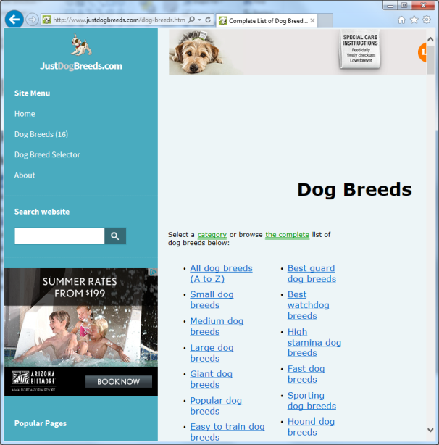
Clicks Oriented Around Initial Click
Click position much more likely to move upwards if initial click moves upwards
 | S1: dog breed
1 | www.nextdaypets.com/directory/breeds
2 | www.dogbreederdirectory.com/breeders...
3 | www.justdogbreeds.com/dog-breeds.html
4 | en.wikipedia.org/wiki/List_of_dog_breeds
5 | www.nctoybreeds.com/
6 | en.wikipedia.org/wiki/Breed_of_dog
7 | www.democraticunderground.com/discus...
8 | www.dogbreedinfo.com/abc.htm
 | S1: dog breed
1 | www.nextdaypets.com/directory/breeds
2 | www.dogbreederdirectory.com/breeders...
3 | www.justdogbreeds.com/dog-breeds.html
4 | en.wikipedia.org/wiki/List_of_dog_breeds
5 | www.nctoybreeds.com/
6 | en.wikipedia.org/wiki/Breed_of_dog
7 | www.democraticunderground.com/discus...
8 | www.dogbreedinfo.com/abc.htm

Slide 24
Clicks Oriented Around Initial Click
Click position much more likely to move upwards if initial click moves upwards
 | S1: dog breed | S2: dog breed
1 | www.nextdaypets.com/directory/breeds | www.nextdaypets.com/directory/breeds
2 | www.dogbreederdirectory.com/breeders... | www.justdogbreeds.com/dog-breeds.html
3 | www.justdogbreeds.com/dog-breeds.html | www.dogbreederdirectory.com/breeders...
4 | en.wikipedia.org/wiki/List_of_dog_breeds | en.wikipedia.org/wiki/List_of_dog_breeds
5 | www.nctoybreeds.com/ | www.nctoybreeds.com/
6 | en.wikipedia.org/wiki/Breed_of_dog | en.wikipedia.org/wiki/Breed_of_dog
7 | www.democraticunderground.com/discus... | www.democraticunderground.com/discuss...
8 | www.dogbreedinfo.com/abc.htm | www.justdogbreeds.com/
9 |  | www.dogbreedinfo.com/abc.htm
10 |  | www.akc.org/breeds/
11 |  | www.dogbreedinfo.com/index.htm
12 |  | www.terrificpets.com/dog_breeds/
 | S1: dog breed | S2: dog breed
1 | www.nextdaypets.com/directory/breeds | www.nextdaypets.com/directory/breeds
2 | www.dogbreederdirectory.com/breeders... | www.justdogbreeds.com/dog-breeds.html
3 | www.justdogbreeds.com/dog-breeds.html | www.dogbreederdirectory.com/breeders...
4 | en.wikipedia.org/wiki/List_of_dog_breeds | en.wikipedia.org/wiki/List_of_dog_breeds
5 | www.nctoybreeds.com/ | www.nctoybreeds.com/
6 | en.wikipedia.org/wiki/Breed_of_dog | en.wikipedia.org/wiki/Breed_of_dog
7 | www.democraticunderground.com/discus... | www.democraticunderground.com/discuss...
8 | www.dogbreedinfo.com/abc.htm | www.justdogbreeds.com/
9 |  | www.dogbreedinfo.com/abc.htm
10 |  | www.akc.org/breeds/
11 |  | www.dogbreedinfo.com/index.htm
12 |  | www.terrificpets.com/dog_breeds/

Slide 25
Clicks Oriented Around Initial Click
Click position much more likely to move upwards if initial click moves upwards
Click position much more likely to move upwards if above results change

